Slide 1
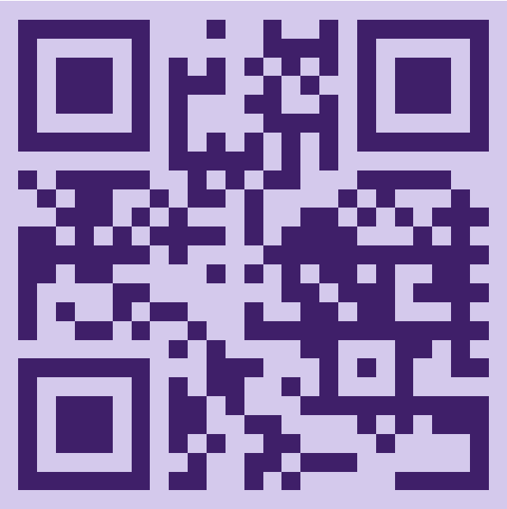
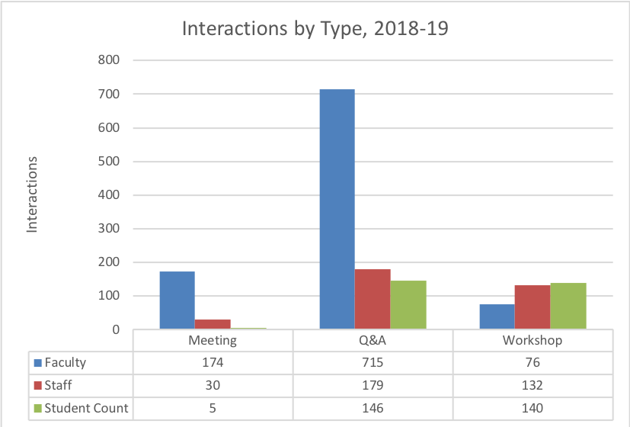
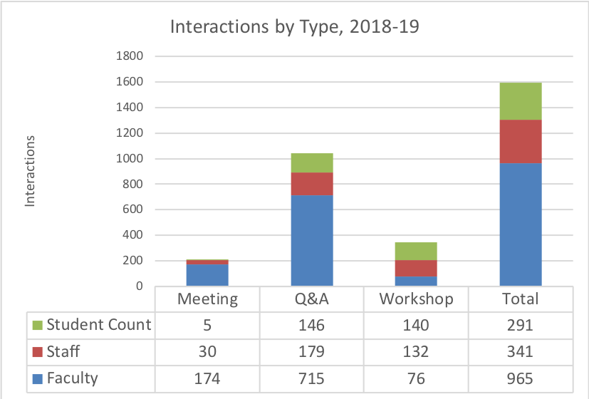
Academic Technology in Action Website - Selected Articles
Academic Technology in Action Website:
www.amherst.edu/go/ata
Website featuring curated examples of digital pedagogy practices by Amherst College faculty
Launched in 2020 by Academic Technology Services (ATS) and regularly updated
Pedagogical design examples to foster a faculty Community of Practice (CoP)
Foster Collaborative Learning & Multimodal Assessment for Accessibility
Build an Inclusive Learning Community with Digital Annotation & Collaborative Analysis
Podcast as Pedagogy Promote Reflective & Metacognitive Thinking
Collect & Reflect with Digital Portfolios as Metacognitive Practice
Increase Student Engagement with Transcripts
Offer Low-stakes & Repeatable Quizzes for Self-Regulated Learning
Use Infographics to Develop Linguistic & Cultural Proficiency
Develop an Accessibility Mindset with Caption & Audio Description Projects
Employ Multiple UDL Practices from the Music Classroom
Create inclusive & respectful learning communities with NameCoach
Amherst College Academic Technology Services
Email: ats@amherst.edu

Slide 2
Examples from the Classroom - Teaching That Incorporates the UDL Framework & Inclusive Practices with Technology
Liberal Arts and Digital Learning
How to Assess the Usefulness of Digital Tools and Platforms Using Evidence Based Demonstration of Effectiveness
Amherst College, Mount Holyoke, and Smith College are small, in-person, liberal arts colleges
A digitally networked learning environment enhances opportunities for engagement, intellectual inquiry, and inclusivity
Faculty are pioneering in these areas and students come to college expecting this
Course evaluations from students - ask students to mention specific tools used and inclusive practices that were helpful
Direct dialogue with students
Evaluate students’ growth in their skills
Determine if students are meeting the learning goals for the courses
Consider how digital academic tools and platforms have contributed to growth
Discuss digital tools and platforms with other faculty, especially when co-teaching or where multiple faculty are involved
Concrete Examples Mapped to the UDL Framework
Details of how specific inclusive practices map to the UDL framework and relate to representation and recognition networks, action and expression and strategic networks, and engagement and affective networks.
Reflection Questions To Use To Develop One’s Own Practices
As a learner, what constitutes a respectful and inclusive learning environment for you?
As a learner, what constitutes a barrier for you?
Consider which digital tools for learning are most accessible to guide your selection process.
Where are there opportunities to incorporate UDL strategies and inclusive practices?

