Slide 1
Active Citizenship
Highlights from the Semester
Will Lonnquist

Slide 2
“What have you done to earn your box? Besides being born at a certain place in a certain time, did you have to do anything? Anything at all? If you wanted to have a career, if you wanted to have a life, if you wanted to exist as a human being, what would you have done?”

Slide 3
“The man at the cash register wants to know if you think your card will work. If this is his routine, he didn't use it on the friend who went before you. As she picks up her bags, she looks to see what you will say. She says nothing. You want her to say something – both as witness and as a friend. She is not you; her silence says so. Because you are watching this all take place even as you participate in it, you say nothing as well.” Page 54

Slide 4
“The electoral integrity project, using a number of benchmarks and measurements, was stunned to find that when it applied those same calculations in the United States as it had in Egypt, Yemen, and Sudan, North Carolina was “no longer considered to be a fully functioning democracy.”” Page 97

Slide 5
“But those of us who are “white” can only become part of the solution if we recognize the degree to which we are already part of the problem — not because of our race, but because of our possessive investment in it.” Page 384

Slide 6
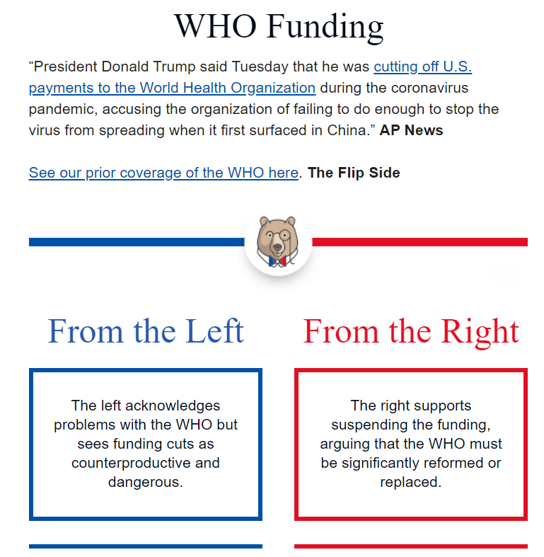

Slide 7
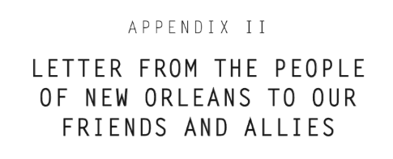
“While we remain in crisis, understaffed, underfunded and in many cases in desperate need of help, we have seen promises go unfulfilled. From the perspective of the poorest and the least powerful, it appears that the work of national allies on our behalf has either not happened or if it has happened it has been a failure.” Page 1

Slide 8
“I feared after the election that those of us who are not directly targeted would do what people have often done during despotic regimes: withdraw into private life, wait it out, take care of themselves and no one else. Something else happened instead.” Page 167

Slide 9
Personal Changes

Slide 10
Interest in local issues
Withdrawal when faced with new perspectives

