Slide 1
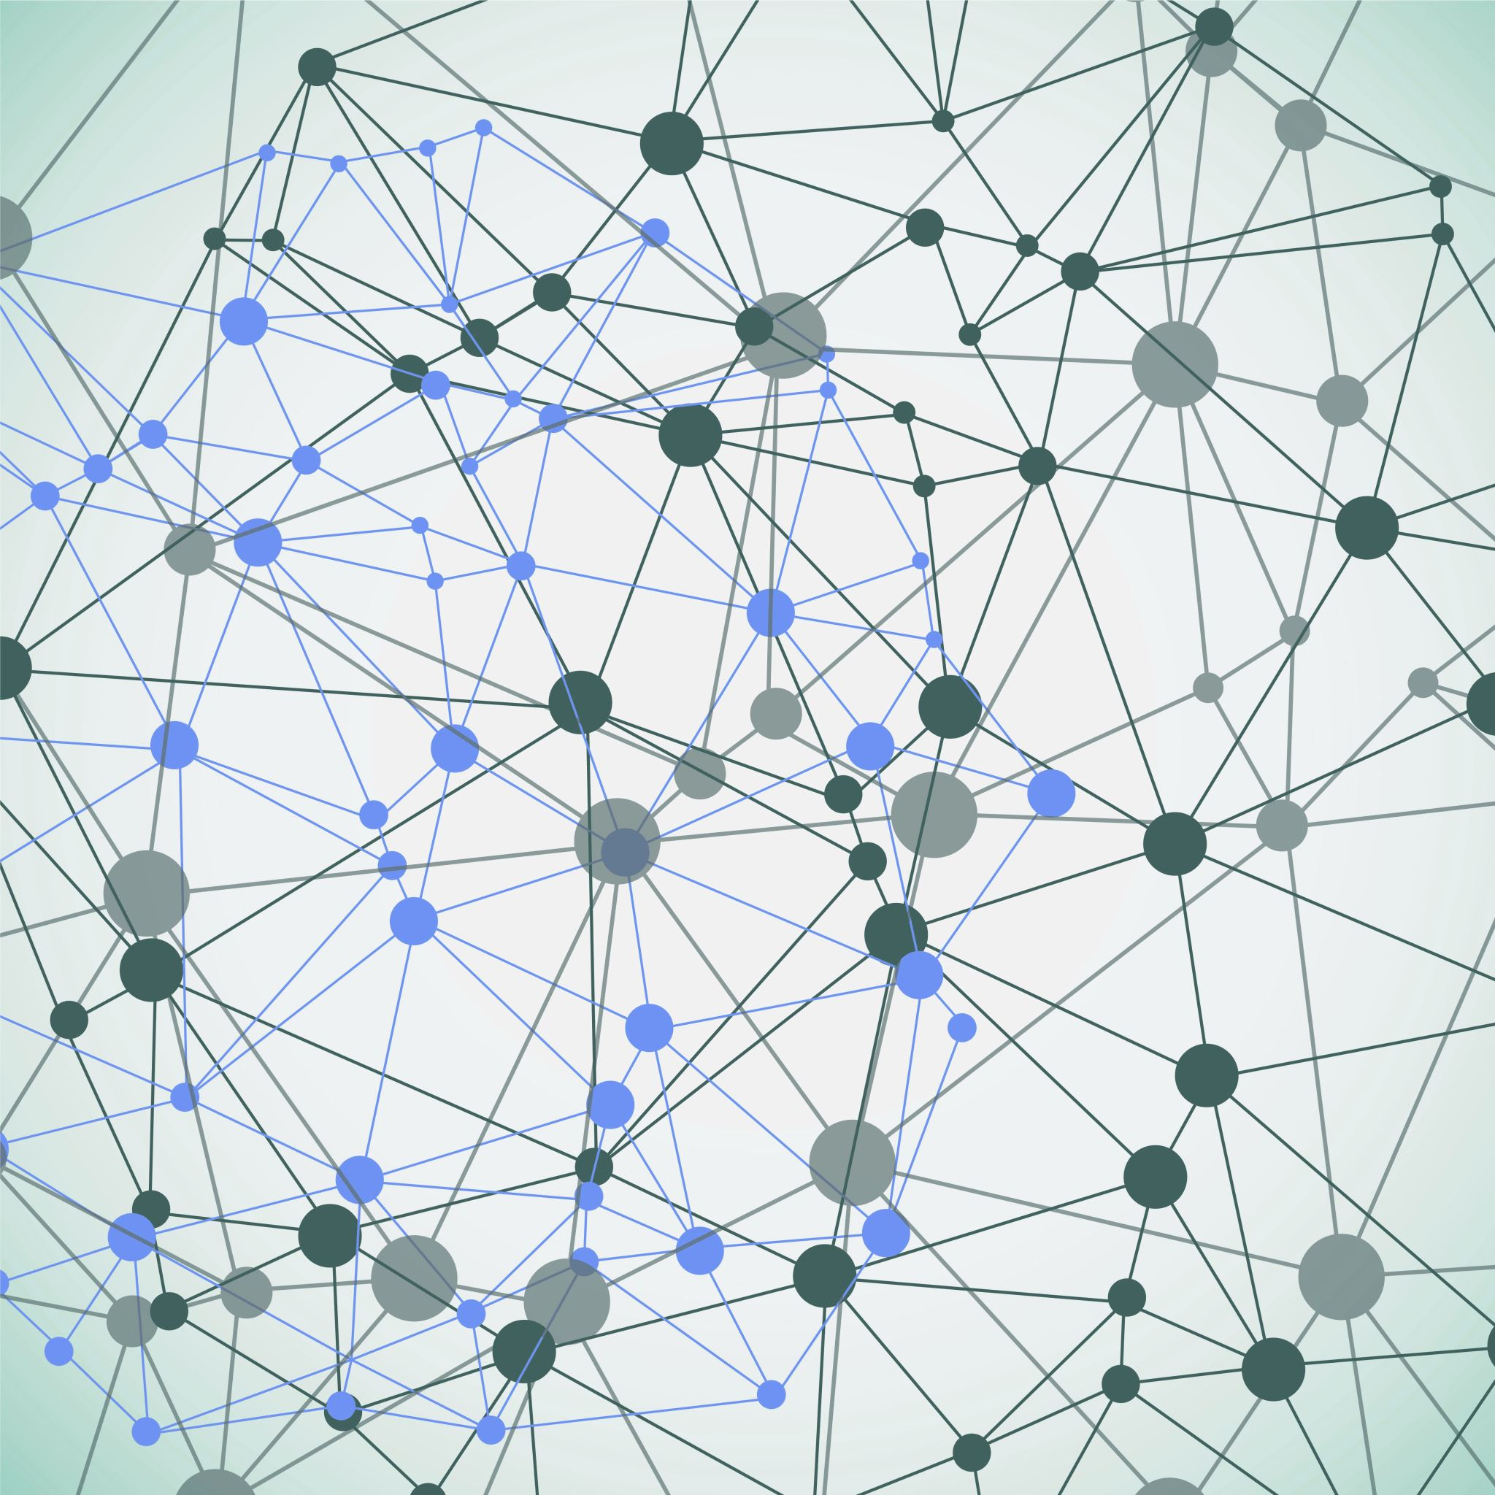
Active Citizenship
XXXXXXXXXXXX

Slide 2
Takeaway: Challenge previous thoughts

Slide 3
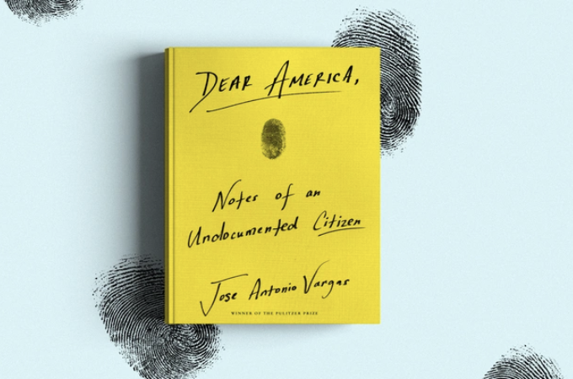
Citizen?
What does it mean to be a citizen?
Who gets to be a citizen? Vargas explains that his grandfather “swiped the card from his hand, and uttered a sentence that changed the course of [his] life… His voice was soft, soaking in shame… You are not supposed to be here” (Vargas 33). “What did you have to do to earn your box? Besides being born at a certain place in a certain time, did you have to do anything? Anything at all? If you wanted to have a career, if you wanted to have a life, if you wanted to exist as a human being, what would you have done?” (Vargas 72).
Citizenship should not have an effect on a person’s effectiveness to infiltrate society in a positive light. But sadly, for the term active citizen, it does.
Dr. Julia lafrate on CNN

Slide 4
Power?
Who has power?
Why does a person have power?
Who has power when the two sides are so intensely divided?
I attended the Amherst Regional Public Schools Four Towns Committee Meeting
The goal of the meeting was to decide on an assessment method for the gap in funding in the 2020-1 school year budget
It was town against town
Couldn’t accomplish anything because they were so divided
Similar to political polarization in the US today
Colleges closing / reopen due to coronavirus

Slide 5
Prison / Mass Incarceration?
Who is in prison?
Why is someone in prison?
Who is society protecting by locking people up?
Alexander states that “mass incarceration operates with stunning efficiency to sweep people of color off the streets, lock them in cages and then release them into an inferior second-class status” (Alexander 103).
Alexander writes, “19.5 million illicit drug users per year and only 1.5 million are arrested and only 175,000 actually go to prison, the law enforcement must make “strategic choices… about whom to target and what tactics to imploy” (104).
Alexander cites a study from the Journal of Alcohol and Drug Education and cites that 95% of people thought of drug users as black men. This stereotyped of black men being the vast majority of drug users and dealers is engrained into American society.

Slide 6
COVID-19 & Racism?
Is America as accepting of a place as we once thought?
How does COVID-19 and the racism that surrounds it challenge our previous notions about race in the US today?
After 9/11 America pushed out Middle Easterners and Muslims, America shunned their religion and made people who identified in these ways feel unwelcomed and unsafe. America – which had always been considered a melting pot – had made it apparent who was allowed to melt in the pot.
“As the coronavirus upends American life, Chinese Americans face a double threat. Not only are they grappling like everyone else with how to avoid the virus itself, they are also contending with growing racism in the form of verbal and physical attacks. Other Asian-Americans — with families from Korea, Vietnam, the Philippines, Myanmar and other places — are facing threats, too, lumped together with Chinese-Americans by a bigotry that does not know the difference” (Tavernise and Oppel).

