Slide 1
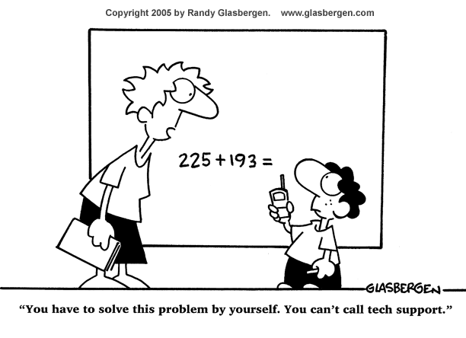
PHYS16 – Lecture 2
Math Review
Ch. 1 Physics and Measurement

Slide 2
Agenda
Register clickers
Class logistics
Math review
Before next time

Slide 3
Register clickers
Can you correctly answer A to this question?
Yes
No
http://kookaburra.com.au

Slide 4
Class Logistics
Get Text book + Access card
Purchase them from book store
Purchase them online – Lifetime Edition vs. Single term
Homework for next week – Due Wednesday at 11:00 am
Online homework is on WebAssign
Written homework is on course website
Get clickers, need them by next Wednesday

Slide 5
Math Review
Ch. 1 Physics and Measurement
Unit Analysis
Order-of-Magnitude
Significant Digits
Scientific Notation
Ch. 2 Vectors
Trigonometry
Vectors
Calculus

Slide 6
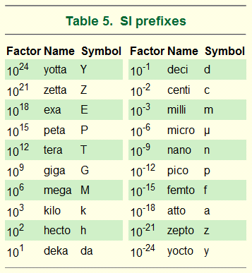
Unit Analysis
Units = SI, metric system
Mass = kg
Length = m
Time = s
Prefixes
Unit conversion
Multiply by ratios
1 ton * 1000 kg/ton * 2.2 lb/kg
Dimensional analysis
Check units of variables to make sure they match
p=mv, if m is in (kg) and v is in (m/s) then p is in (kgm/s)

Slide 7
Order-of-Magnitude
The order-of-magnitude of a number is the highest digit’s decimal place
347 -> 100
1002 -> 1000
0.000674 -> 0.0001
Purpose – gives you an estimate within a factor of 10 for what the number’s value is
Premise – from Enrico Fermi
You can estimate anything to an order of magnitude
Scientists now estimate what their results should be before taking the data to make sure you are in the right ball park

Slide 8
Significant Digits - Definition
Digits that actually have meaning!
All digits in a number except for trailing or leading zeros
All digits that relate to the precision of the number
Purpose – tells us precision of number
Examples
1.001 (4 sig figs)
234 (3 sig figs)
900 (1 sig fig)
0.005 (1 sig fig)
3.4 (2 sig figs)
45.6 (3 sig figs)
10 (1 sig fig)
To write 900 and 10 with more sig figs need Sci. Not.

Slide 9
Sig. Digits - Accuracy vs. Precison
Accuracy = How close measurements are to the target
Precision = Spread in measurements
Accurate, not precise
Precise, not accurate

Slide 10
Significant Digits - Calculations
What is significant digits for calculation?
Add or Subtract – new number should be to the same decimal place as number with the highest decimal place in the rightmost digit
Multiply or Divide – the same as number with least sig figs
Other operations – undefined, but most people just use the multiplication and division rules
Purpose – propagates the precision correctly
Examples
1.001 + 234 = 235
234 + 900 =1134
3.4*0.005 = 0.02

Slide 11
Scientific Notation
A way of representing a number so that you can clearly see the significant digits and the order of magnitude
110 would be 1.1E2 or 1.1x10²
Examples
1.001 (1.001E0)
234 (2.34E2)
900 (9.00E2 or 9.0E2 or 9E2)
0.005 (5E-3)
3.4 (3.4E0)
45.6 (4.56E1)
10 (1.0E1 or 1E1)

Slide 12
For next time…
Get the text book and the access card
Register for course in WebAssign whether you have the access card or not
Homework for next Wednesday
Read Ch. 1-4 and Lab #1
Do the homework assignment
Get your clicker!

