Slide 1
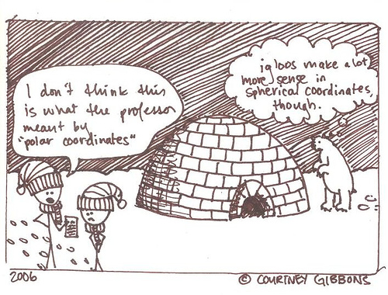
PHYS16 – Lecture 10
Ch. 6 Circular Motion

Slide 2
Force post-question
A locomotive breaks through a wall at a train station. Which of the following is true?
A) (force exerted by locomotive on wall) > (force exerted by wall on locomotive)
B) (force exerted by locomotive on wall) is equal and opposite (force exerted by wall on locomotive)
C) (force exerted by locomotive on wall) < (force exerted by wall on locomotive)
D) the wall does not exert a force; it broke

Slide 3
Force post-question
Anahita is pushing a box horizontally with a 200-N magnitude force. The box is sliding across the horizontal floor with a forward acceleration. What must be true about the magnitude of the kinetic friction acting on the box:
A) it is > 200 N
B) it is < 200 N
C) it = 200 N
D) None of the statements above are necessarily true

Slide 4
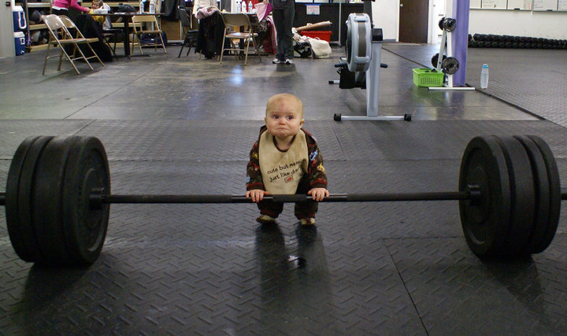
Force post-question
Which action involves more force, lifting a weight at a constant velocity or lowering a weight at a constant velocity?
Lifting the weight
Lowering the weight
Equal force in both cases
There is not enough information
http://www.loltimeout.com/wp-content/uploads/2010/04/Av8fL.jpg

Slide 5
Force post-question
How long will it take a 5-kg block with a force of 7.5 N acting on it to travel 3.0 m?
2.0 s
1.9 s
4.0 s
1.4 s
None of the above

Slide 6
Ch. 6 Circular Motion
Circular Motion – Definitions
Tangential vs. Radial
Angular position, velocity, acceleration
Uniform circular motion –α=0
Uniform vs. Nonuniform
Centripetal Force
Solving problems with Circular Motion

Slide 7
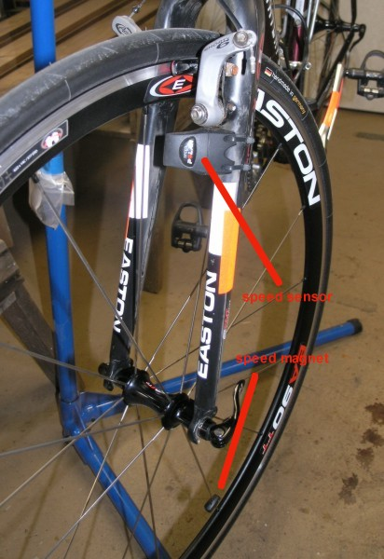
Circular Motion pre-question
A bicycle speedometer sensor is mounted on the bike at a fixed location, usually the fork, and pulses when the spoke-mounted magnet passes by. If the speedometer sensor is mounted at a radius of 0.50 m and counts 320 pulses, how far has the cyclist traveled?
0.50 km
0.80 km
1.0 km
1.5 km
1.8 km
sensor
magnet

Slide 8
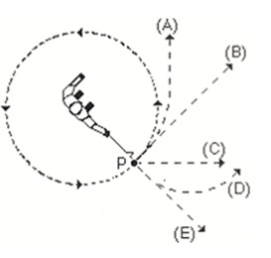
Circular Motion pre-question
At the point P indicated in the figure the string suddenly breaks. What is the trajectory of the ball?
http://daed.be/paul/temp/review.php_files/fci7.jpg

Slide 9
Circular Motion - Definitions

Slide 10
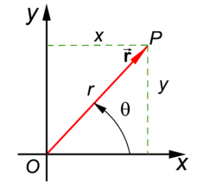
Polar coordinates
http://en.citizendium.org/images/thumb/1/18/Polar_coordinates_.png/250px-Polar_coordinates_.png

Slide 11
Tangential vs. Radial
Radial – points along the radius
Tangential – perpendicular to
radial direction and along the
tangent to the circle

Slide 12
Angular displacement
Angular displacement – the angular difference between final and initial angle
Arc length – angular equivalent of distance, how long the arc is that the angle sweeps out
Scalar or vector?
Scalar
0.5 ft
A tire goes 12 ft in 4 rev, how big is it?

Slide 13
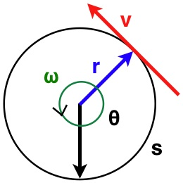
Angular velocity
Angular velocity (ω) – how much an object’s angular coordinate changes with time
Related to linear velocity

Slide 14
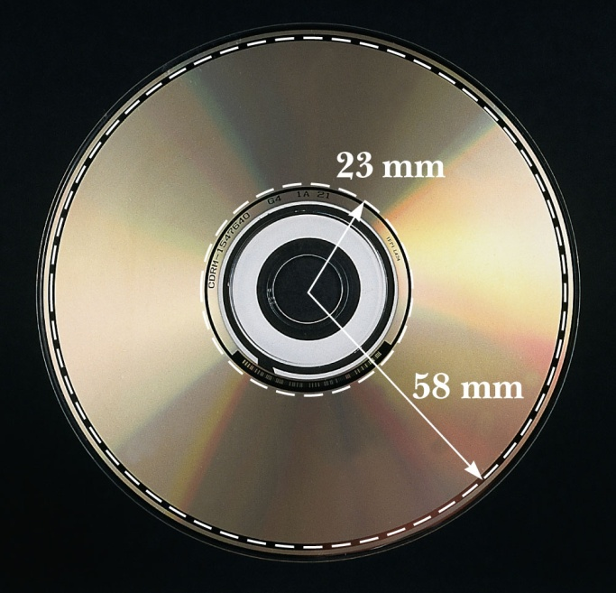
Discussion Questions
If you want a to read a DVD at a constant speed do you have to change the rotation of the DVD? Where on the DVD is the maximum angular velocity? Where is the maximum linear velocity?
Yes. Angular velocity is the same
for any point on DVD.
Linear velocity is greatest at edge

Slide 15
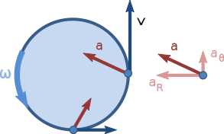
Angular acceleration
Angular acceleration (α) – how the angular velocity changes in time
Related to linear acceleration (a)
a_{T}
a_{C}
http://upload.wikimedia.org/wikipedia/commons/thumb/2/22/Nonuniform_circular_motion.svg/293px-Nonuniform_circular_motion.svg.png

Slide 16
Discussion Questions
If an object moves in a circle with a constant speed, does it accelerate?
What’s wrong with this statement: An object that moves in a circle with a constant velocity accelerates.
Yes
Can’t move in a circle
with constant velocity

Slide 17
Period and Frequency
Period (T) – time for one revolution, (unit=s)
Frequency (f) – # of revolutions per time (unit=Hz)
Related to angular velocity

Slide 18
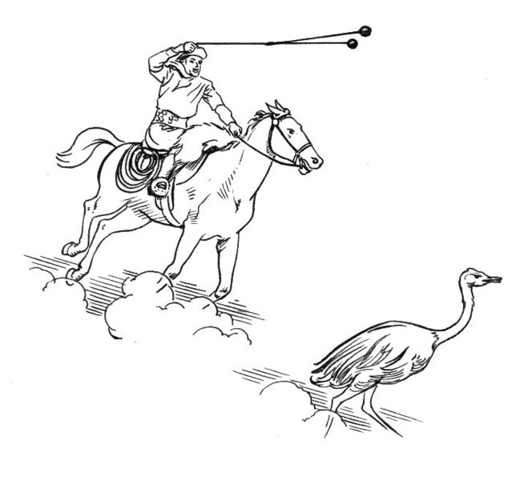
Discussion Question
http://en.wikipedia.org/wiki/File:Bola_(PSF).jpg
If a gaucho swings a 1-m bola in a circle with a period of 2 s, what will be the linear speed of the bola when released?
v = 2πr/T = 3 m/s

Slide 19
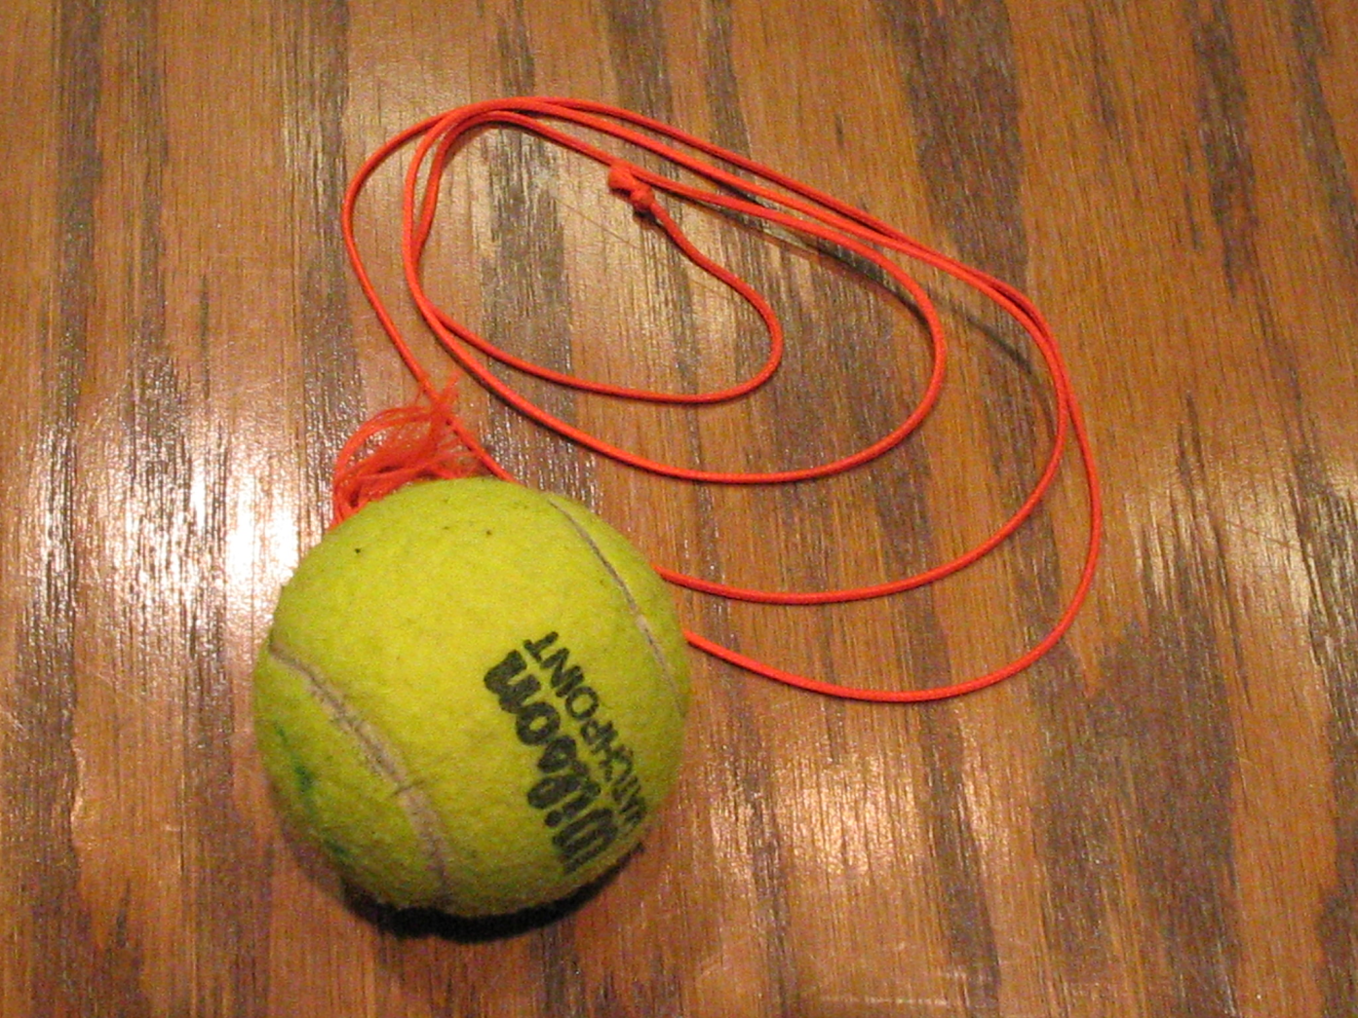
Demo – Ball on String

Slide 20
Uniform Circular Motion

Slide 21
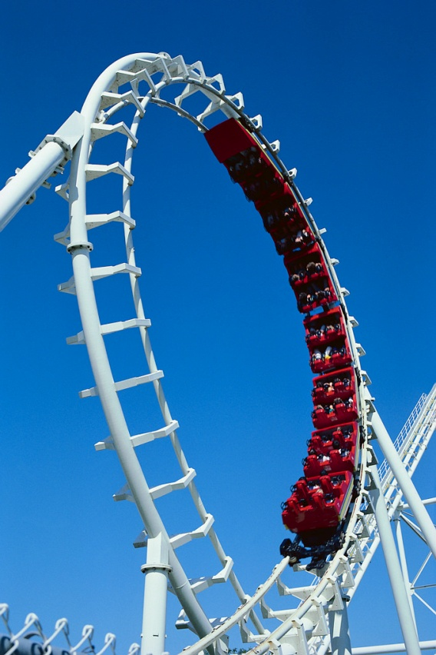
Uniform Circular Motion
Non-uniform circular
motion – both a_{T} and a_{C}
Uniform circular motion – α =0
only centripetal accel. (a_{C})
http://sciencefair.math.iit.edu/projects/forces/roller_coaster.jpg
http://www.faqs.org/photo-dict/photofiles/list/409/2271alarm_clock.jpg

Slide 22
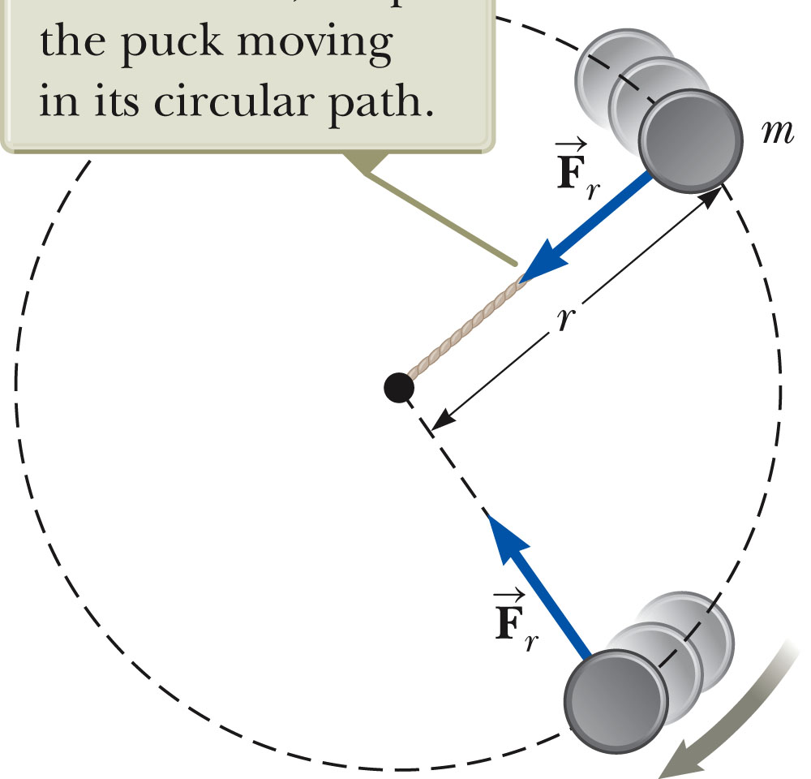
Centripetal Force
Force pointing radially inward that keeps an object going in a circular path

Slide 23
Conclusions
Angular position, velocity, and acceleration
Angular displacement vs. arc length
Angular vs. linear velocity
Angular vs. linear acceleration
Uniform circular motion –α=0
Centripetal Force

