Slide 1
PHYS16 – Lecture 12
Ch. 6 Circular Motion

Slide 2
Announcements
Test – Week of Feb. 28
Format
20 MCAT style problems – similar to lecture problems
5 math-style problems – similar to intermediate problems from homework and study guide
1 essay question – similar to the homework questions
Study Guide – problems from lecture, homework and those in student solution manual – other texts as well

Slide 3
Ch. 6 Circular Motion
Circular Motion – Definitions
Tangential vs. Radial
Angular position, velocity, acceleration
Uniform circular motion –α=0
Uniform vs. Nonuniform
Centripetal Force
Solving problems with Circular Motion

Slide 4
Solving Problems with Circular Motion

Slide 5
Process of solving problems
Read the problem carefully!
Draw a picture (Trick – Free Body Diagram)
Write down the given quantities (Trick – remember Third Law)
Write down what you should solve for
Identify the eqns./concepts you should use (Trick – Second Law & separate into x/y)
6) Do the math and solve

Slide 6
Discussion Question
You think that you are sitting there, watching me lecture, but are you really moving? If you are moving, why doesn’t it feel that way?
What is your velocity? (R_{Earth} = 6.38E6 m)
r
R
θ

Slide 7
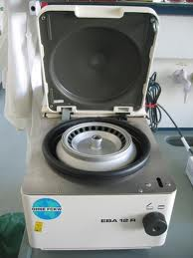
Discussion Question
Centrifuge is a device used in biochemistry that spins to separate solutions. You want 840,000g of centripetal acceleration in a sample rotating at a distance of 23.5 cm, what frequency should you enter?
http://upload.wikimedia.org/wikipedia/commons/0/0d/Tabletop_centrifuge.jpg

Slide 8
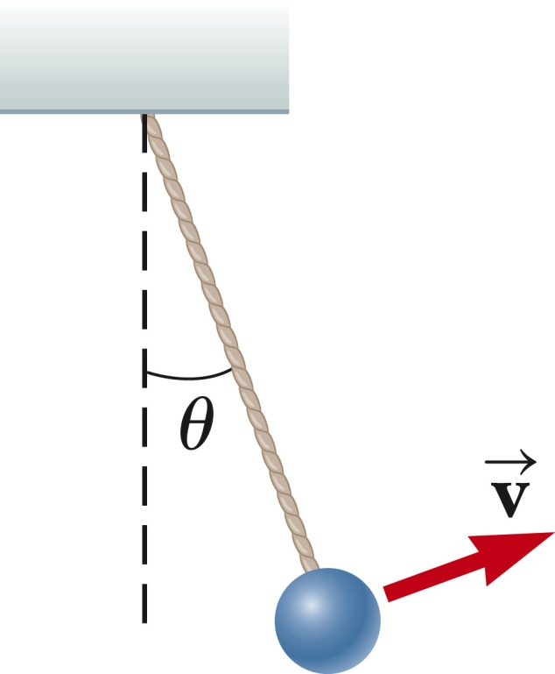
Pendulum
A bob of mass, m, swings in an arc. At angle, θ, what is the centripetal acceleration?
What is the tangential acceleration?

Slide 9
Roller Coaster loop
Why doesn’t the car fall off the track?
How fast does the car have to go to make it around?
What happens if the car goes faster?
Would a bigger or smaller loop require more speed?
Would a bigger or smaller loop be more fun?

Slide 10
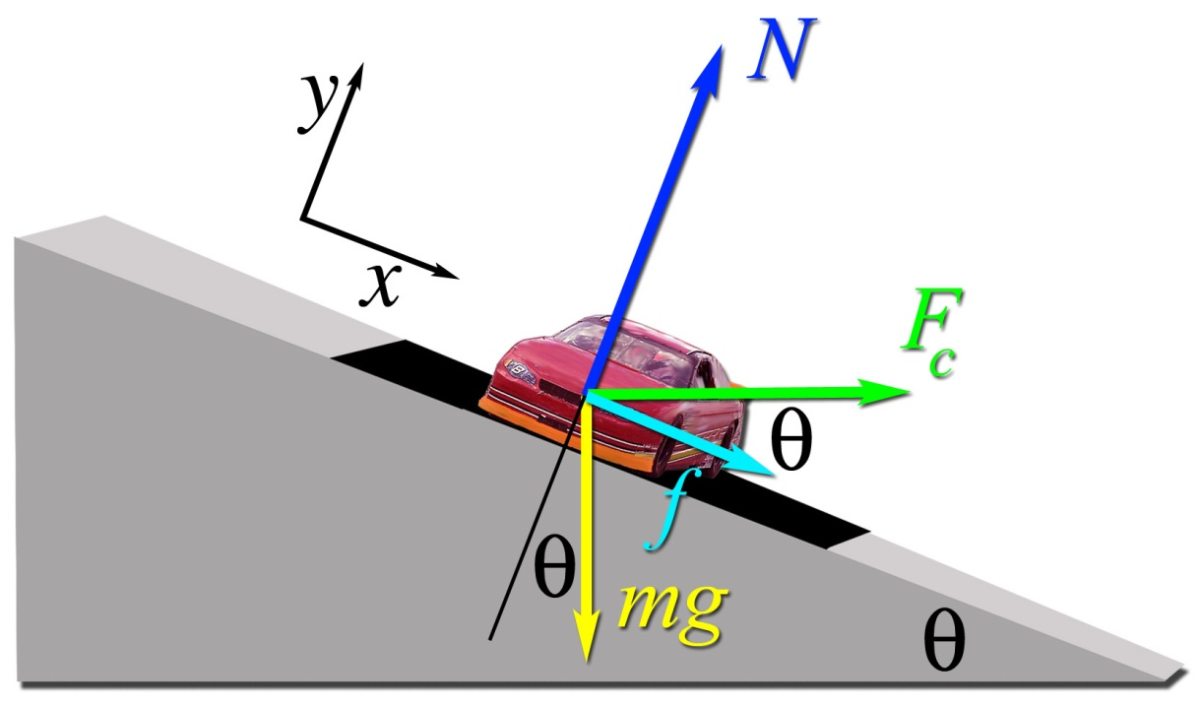
Banked Curves
If the coefficient of friction between the track and tires is μ_{s} = 0.620 and the radius of the turn is R = 110.0 m, what is the maximum speed with which the driver can take this curve banked at 21.1˚?

Slide 11
Banked Curves
Is it better to have a banked or flat curve when racing?
Is it better to make wider or sharper turns when racing?
Why do you slow down when you turn?

Slide 12
Conclusions
Angular position, velocity, and acceleration
Angular displacement vs. arc length
Angular vs. linear velocity
Angular vs. linear acceleration
Uniform circular motion –α=0
Centripetal Force

