Slide 1
PHYS16 – Lecture 18
Ch. 8 Energy Conservation

Slide 2
Ch. 8 Energy Conservation
Conservative vs. Non-conservative Forces
Conservation of Energy
Basic Equations
Systems without Friction
Systems with Friction
Power

Slide 3
P16 at the Circus… … Continued

Slide 4
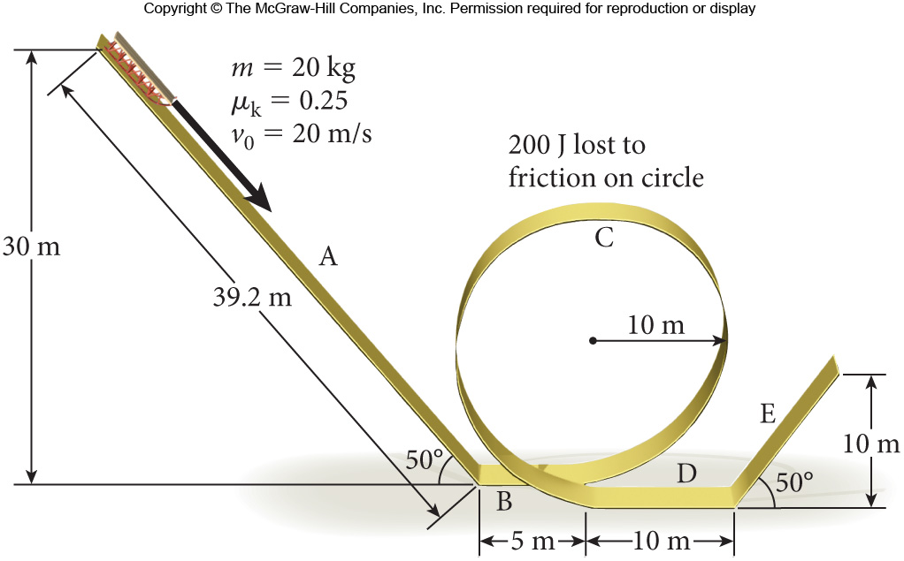
Motorcycles, Flames, and Loops
What is speed at end of ramp E?
23 m/s

Slide 5
Discussion Question
When is kinetic energy negative?
When is work negative?
When is potential energy negative?
Give some examples of each…
Never!

Slide 6
When is work negative?
Work is (+) when done on system, (-) when done by system
Work is (+) when force and displacement in the same direction, (-) when in opposite directions

Slide 7
When is potential energy negative?
Potential is (+) when movement and force are in opposite directions (-) when movement and force are in same direction
Potential is (+) when external work is (+)

Slide 8
Power

Slide 9
Let’s define Power
Power – the rate at which work is performed
Units = W = J/s
Scalar

Slide 10
Lingenfelter Corvette…
What is the power of the 1420 kg Lingenfelter Corvette that can go 0 to 26.8 m/s in 1.97 s?
Approach #1
Approach #2
Answer = 259 kW
Spec says 1100 kW, why?

Slide 11
Horsepower
1 hp = 33,000 ft lbs/min = 746 W
Comes from how much weight a horse could pull up a mine shaft a particular amount of feet in a given minute
Horse Force

Slide 12
Estimating horsepower
Car = 250-1475 hp
1 hp = 746 W
Lingenfelter corvette = 1475 hp
Small compact= 250 hp
Lawnmower = 5-25 hp
Person = ~1 hp
Estimate using time it takes to run up stairs

Slide 13
Conclusions
Conservative vs. Nonconservative Forces
Energy Conservation
Power

