Slide 1
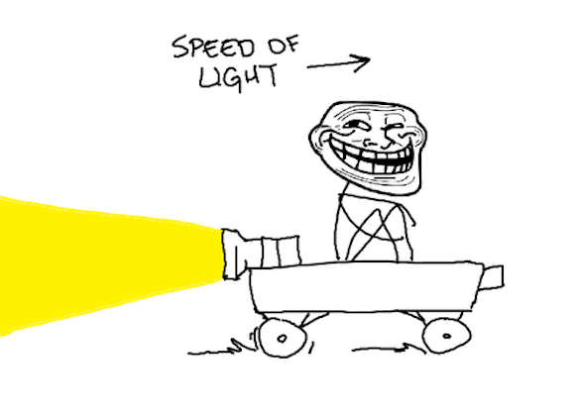
PHYS16 – Lecture 20
http://www.blogcdn.com/www.urlesque.com/media/2010/10/5.jpg
Ch. 9 Momentum and Collisions

Slide 2
Announcements
Extended Office Hours: 12-3 pm Today
Pick up homework and test

Slide 3
Momentum pre-question
A 0.50 kg ball accelerates from rest at 10.0 m/s² for 2.0 s. It then collides with and sticks to a 1.0 kg ball that is initially at rest. After the collision, how fast are the balls going?
A) 3.3 m/s
B) 6.7 m/s
C) 10 m/s
D) 15 m/s
E) None of the above.

Slide 4
Ch. 9 Momentum & Collisions
Linear Momentum
Related to Newton’s second law
Rocket Propulsion
Momentum Conservation
Collisions
Elastic vs. Inelastic
1D and 2D
Impulse

Slide 5
Momentum Conservation
According to Newton’s third law momentum is conserved in an isolated system

Slide 6
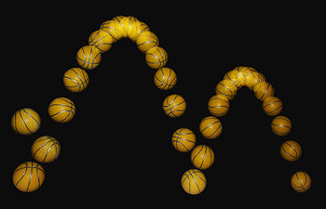
Elastic and Inelastic Collisions
Perfectly Elastic – no losses due to the interaction
Objects bounce perfectly off one another
Ex. pool balls, gliders on air track
Inelastic – there are losses
Objects don’t perfectly bounce
Ex. basketball hitting ground
Perfectly Inelastic – objects adhere
Ex. clay ball with floor

Slide 7
Conservation Laws
Perfectly Elastic – both momentum and energy conserved
Inelastic – only momentum conserved
Perfectly Inelastic – only momentum conserved

Slide 8
Practice Question 1
In a perfectly inelastic collision the following is not true?
A) Objects adhere
B) E is conserved
C) P is conserved
D)F=dp/dt

Slide 9
Practice Question 2
True or false. In an inelastic collision the kinetic energy after the collision can be greater than the kinetic energy before the collision.
A) True
B) False

Slide 10
Solve Problems with collisions
Read problem carefully!
Draw a picture.
Write down given quantities and what you want to solve for.
Find the correct equation (conservation of momentum and possibly conservation of energy).
Do the math and solve!

Slide 11
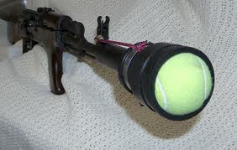
Tennis Ball Launcher
If I put 2 balls in the tennis ball launcher, how far is the recoil compared to one ball?
http://www.laxin.net/Launcher/goodHPIM2548.jpg

Slide 12
Conclusions
Perfectly Elastic – both momentum and energy conserved -> 3 equations
Inelastic – only momentum conserved -> 2 equations
Perfectly Inelastic – only momentum conserved -> 2 equations

