Slide 1
PHYS16 – Lecture 22
Ch. 10 & 11 Rotation

Slide 2
Wrapping up Impulse…
Impulse describes the change in momentum
Good for describing what happens during a collision
If momentum is conserved why is Impulse NOT equal to 0?

Slide 3
Discussion
Why does an airbag reduce injury?
What is better in bungee jumping- a stiff cable that won’t break at high forces or a stretchy cable?
Why should a boxer “ride the punch” and not stiffen her neck muscles?

Slide 4
Momentum post-question
A 0.50 kg ball accelerates from rest at 10.0 m/s² for 2.0 s. It then collides with and sticks to a 1.0 kg ball that is initially at rest. After the collision, how fast are the balls going?
A) 3.3 m/s
B) 6.7 m/s
C) 10 m/s
D) 15 m/s
E) None of the above.

Slide 5
Momentum post-question
Consider two carts on a frictionless air track with masses m and 2m. If you push the lower mass cart for 3 s and then the other cart for the same length of time and with the same force, which cart undergoes the larger change in momentum?
Cart with mass m
Cart with mass 2m
Change in momentum is the same for both
There is not enough information

Slide 6
Ch. 10 & 11 Rotation
Angular Motion
Angular displacement, velocity, & acceleration
Constant acceleration problems
Angular Inertia
Angular Energy
Rotational Kinetic Energy
Angular Force
Centripetal Force
Torque
Angular Momentum & Collisions

Slide 7
Angular Motion

Slide 8
Angular displacement, velocity, and acceleration
Angular displacement –
Arc length –
Angular velocity (ω) –
Angular acceleration (α) –
Linear acceleration( ) –

Slide 9
Angular kinematics – same as linear
Assume α=constant

Slide 10
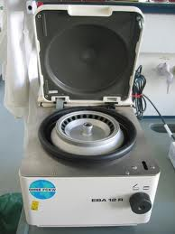
Example Question: The Centrifuge
A centrifuge rotates with an angular speed of 3600 rpm. Then it is switched off and it rotates 60 times before coming to rest. What was the angular acceleration that made it stop?
http://upload.wikimedia.org/wikipedia/commons/0/0d/Tabletop_centrifuge.jpg

Slide 11
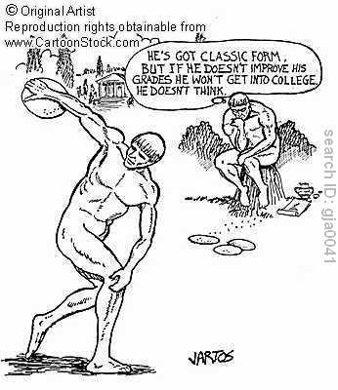
Example Question: The Discus
A discus thrower with arm radius of 1.2 m starts from rest and then starts to rotate with an angular acceleration of 2.5 rad/s². How long does it take for the throwers hand to reach 4.7 rad/s?

Slide 12
Rotational Inertia & Kinetic Energy

Slide 13
Rotational Inertia
In linear motion we just care about mass
In rotational motion we care about how mass is distributed so we need rotational inertia (I)
Use formulas! No derivation or memorization for test.
Which has more rotational inertia?
A)
B)
A does!

Slide 14
Formulas for Rotational Inertia
Sphere – solid
Sphere – hollow
Disk or solid cylinder
Hollow cylinder

Slide 15
Rotational Kinetic Energy
For rotational kinetic energy we use rotational inertia instead of mass and angular velocity instead of linear velocity
What is kinetic energy of the earth? Mass = 5.98E24 kg and radius=6.37E6 m.

Slide 16
Discussion Question: Rolling vs. Sliding
Which has more energy: a cylinder that slides down a ramp with a speed of v₀ or a cylinder that rolls down a ramp with the same speed?
Cylinder that slides
Cylinder that rolls
Both are equal
There is not enough information

Slide 17
Discussion Question
Two cylinders roll down a ramp. One has lead on the outside of a wood core, and the other has wood outside a lead core. The two cylinders weigh the same. Which cylinder will have a faster speed at the bottom of the ramp?
Cylinder with lead outside wood core
Cylinder with wood outside lead core
Both will have the same speed

Slide 18
Conclusions
Parameters for circular motion/ rotation basically have linear equivalents
θ is related to x, ω is related to v, α is related to a
I is related to m
K_{rotational} is related to K
L is related to p, L=Iω=rpsin(θ)
τ is related to F, τ=Iα =rFsin(θ)

