Slide 1
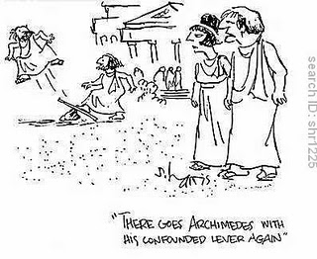
PHYS16 – Lecture 25
Ch. 12 Static Equilibrium

Slide 2
Static Equilibrium pre-question
In an iron cross the gymnast is able to lift his weight with perfectly horizontal arms by:
Tensile forces – he pushes outward
Compressive forces – the rings pushes inward
Nonconservative forces – the gymnast uses his muscles
None of the above. The iron cross does not require perfectly horizontal arms.

Slide 3
Ch. 12 Static Equilibrium
Simple Machines – levers
Static Equilibrium
Center of Gravity
Newton’s Second law for torques and forces

Slide 4
Levers

Slide 5
Simple Machine: Lever
Lever is a machine that improves mechanical advantage by using rotation
In a lever the applied force can be reduced by increasing the distance between force and fulcrum
Increasing r allows for decreasing F

Slide 6
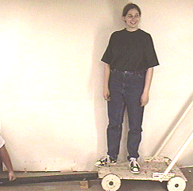
Example Question: Lifting students
If the fulcrum is placed in the middle it takes me 1 kN of force to lift two students. Now, if I place the fulcrum such that it is ¾ of the way from my end, how much force do I need?
A third of the force!

Slide 7
Three kinds of levers: Video
http://www.youtube.com/watch?v=PW7ztbwJKBk
This movie reminds me of a high school film strip, but is useful…

Slide 8
Three Kinds of Levers
Manahoran Lectures, Harvard

Slide 9
Gain a Mechanical Advantage?
Same Force!
No!

Slide 10
Gain a Mechanical Advantage?
Yes!
No!

Slide 11
Gain a Mechanical Advantage?
Yes!
Yes!

Slide 12
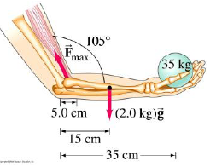
Example Question: Biceps
Mindy and Meredith each hold 35 kg at a distance of 35 cm from elbow. But Mindy’s bicep muscle is attached 5 cm from the elbow joint whereas Meredith’s is attached 8 cm from the joint. Whose biceps exerts more force?
Mindy’s biceps
Meredith’s biceps
They exert the same force

Slide 13
Static Equilibrium

Slide 14
Static Equilibrium
Forces should not cause linear acceleration
Torques should not cause rotational acceleration
Object has no rotational or linear motion

Slide 15
Strategy for solving problems
Free Body Diagram
Identify all forces
Draw exactly where forces act
Draw which way forces point
Define Axes
Apply Force balance
Apply Torque balance
Make sure to determine pivot correctly

Slide 16
Example: Iron Cross
Draw the free body diagram…
Photo © King (The Reluctant Curmudgeon) - www.kingdouglas.com/

Slide 17
Example: Identify the Pivot point
A
A
resting on surface
in space
D
D
B
C
B
C
A
A
D
B
D
B
C
on platform
on hinge
C

Slide 18
Example: Wheelbarrow
I want to use a wheelbarrow to move 30 kg of yard waste with a center of mass 0.2 m from the wheel axle. If the handle is located at 1 m from the wheel axle what is the max force I would have to apply to keep the wheelbarrow lifted?
What is my mechanical advantage?
F=(30kg)(9.8 m/s^2)(0.2 m)/(1 m) = 60 N
MA=(30kg)(9.8 m/s^2)/(60 N) = 5

Slide 19
Conclusions
Levers use torque to lift a load, as the length of the lever arm increases the force needed decreases
Static Equilibrium – both forces and torques on an object have to sum to zero

