Slide 1
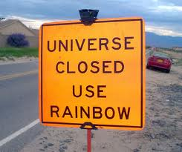
PHYS16 – Lecture 28
Ch. 13 Gravitation

Slide 2
This Week
Newton’s law of Gravity
Gravitational Potential Energy
Satellites
Kepler’s Laws of Planetary Motion
Orbital Shape
Orbital Areas
Orbital Period

Slide 3
Gravitational Force

Slide 4
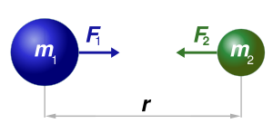
Newton’s law of Gravity
Gravity – an attractive force between two masses
G= gravitational constant = 6.674E-11 Nm²/kg²
Acts at the center of mass
http://scienceblogs.com/startswithabang/upload/2009/06/the_last_100_years_1919_einste/300px-NewtonsLawOfUniversalGravitation.svg.png

Slide 5
Gravity – in the heavens and on earth
The moon and a falling apple behave in the same way…
g_{apple}=9.81 m/s²
g_{moon}=0.00272 m/s²=g_{apple}/3600

Slide 6
Disputing Gravity
Required given Newton’s system of
accelerations being enacted by forces
There is a force
of attraction
between all objects
across empty space,
proportional to m
and to M
and to 1/r².
Proof: apples, moon, celestial bodies fall
towards each other
Proof: 130 years later by Cavendish, but at
the time seemed nice not to distinguish
between an apple and a planet
Proof: None at the time. Galileo said there was no
dependence of gravity on mass. Later, Cavendish
experiment proves.
Proof: Cavendish experiment. However, no way to
measure mass of the sun or planet independently.
Proof: Comparison of moon’s acceleration to that of an apple,
Kepler’s Laws
Adapted from Physics for Poets by Robert March

Slide 7
Disputing Gravity
There is a force
of attraction
between all objects
across empty space,
proportional to m
and to M
and to 1/r².
So called “Spooky action at a distance.” Einstein
later shows that gravity leads to curvature in
space-time. Is there a gravitational particle? Is
gravity just a product of entropy?
Adapted from Physics for Poets by Robert March

Slide 8
Example Question: Gravity on Jupiter
What is the weight of a 65 kg person on Jupiter? (R_{J}=7.15E7 m, M_{J}=1.9E27 kg)

Slide 9
Example Question: Mars and the Earth
How big is the gravitational force between Mars and the Earth?
(r=1.36E8 km, M_{M}=6.42E23 kg, M_{E}=5.97E24 kg)
So why doesn’t Mars revolve around the Earth?
How would you measure the mass of a planet?

Slide 10
Gravitational Potential

Slide 11
Gravitational Potential Energy
Potential Energy associated with being in a gravitational field

Slide 12
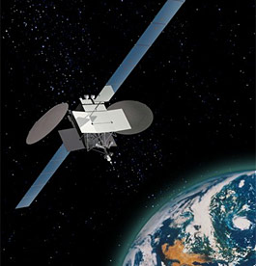
Does this make sense?
As you get further from the Earth the potential gets – bigger, smaller?
What do you think happens to kinetic
energy as you go higher?
http://www.orbitcast.com/archives/sirius-live-ear.html

Slide 13
Satellites

Slide 14
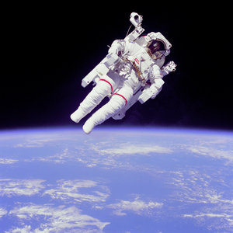
Weightlessness
Why do astronauts feel weightless? Isn’t there still a force of gravity on them?
Yes, just not a normal force!
So why doesn’t Moon fall into earth?

Slide 15
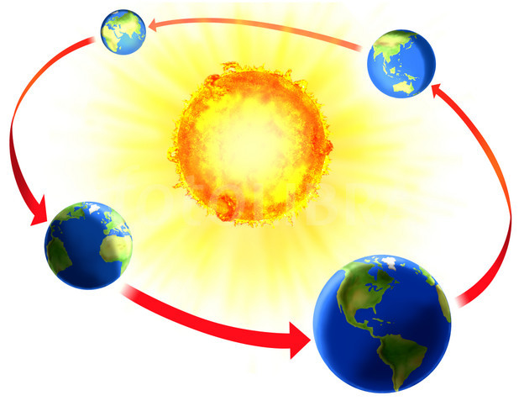
Centripetal Force and Gravity
For an object (like a satellite) in circular motion due to gravity
F_{c} = F_{G}
http://qwickstep.com/search/earth-orbit-around-the-sun.html

Slide 16
Main Points
Gravitational Force = GMm/r²
Centripetal force = gravitational force for object in orbit
Gravitational Potential = -GMm/r
To get further from a massive object requires more energy
Gravitational potential = zero at infinity

