Slide 1
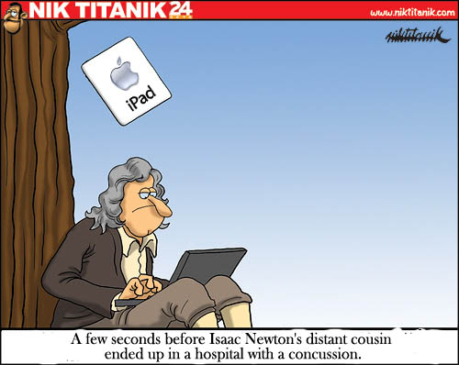
PHYS16 – Lecture 29
Ch. 13 Gravitation

Slide 2
This Week
Newton’s law of Gravity
Gravitational Potential Energy
Satellites
Kepler’s Laws of Planetary Motion
Orbital Shape
Orbital Areas
Orbital Period

Slide 3
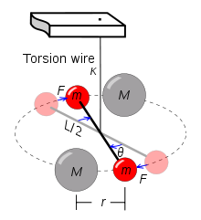
Cavendish Experiment
Uses a torsional pendulum
F=GMm/r²

Slide 4
Satellites

Slide 5
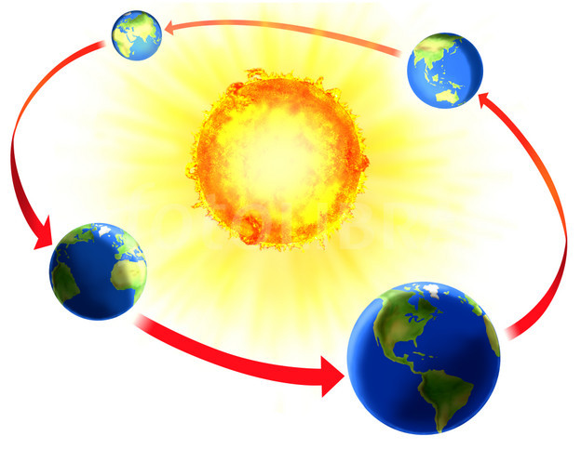
Centripetal Force and Gravity
For an object (like a satellite) in circular motion due to gravity
F_{c} = F_{G}
http://qwickstep.com/search/earth-orbit-around-the-sun.html

Slide 6
Example Question: Moon Energy
If the Moon-Earth distance were to shrink what would happen to the Moon’s kinetic energy?
Increase
Stay the same
Decrease

Slide 7
Example Question: Moon Period
If the Moon-Earth distance were to shrink what would happen to the period of the moon?
Increase (Greater than ~28 days)
Stay the same at ~28 days
Decrease (Less than ~28 days)

Slide 8
Orbital Energy
Gravitational potential energy increases as distance increases
Kinetic energy decreases as distance increases
So, why do higher orbitals have more energy?

Slide 9
Example Question: Satellite
A Satellite orbiting the Earth in a circular orbit wants to go to a lower orbit. What should the satellite do?
A) Nothing. It is falling toward the earth.
B) Turn on rocket thrusters to accelerate, moving to a lower orbital.
C) Turn on rocket thrusters to decelerate, moving to a lower orbital

Slide 10
Escape velocity
Minimum velocity needed to “escape” the gravitational force

Slide 11
Discussion: Launching Rockets
When launching a rocket to escape the Earth’s gravity, does the mass of the rocket matter? Why or why not?
The escape velocity does not depend on mass. But
the kinetic energy does. Thus, a more massive rocket
requires more fuel.

Slide 12
Discussion: Launching Rockets
When launching a rocket to escape the Earth’s gravity, does the mass of the rocket matter? Why or why not?
Which planet has the smallest escape velocity?
Mercury!

Slide 13
Discussion: Launching Rockets
When launching a rocket to escape the Earth’s gravity, does the mass of the rocket matter? Why or why not?
Which planet has the smallest escape velocity?
What would be the escape velocity of a black hole?
Infinity!

Slide 14
Disscussion: Launching Rockets
When launching a rocket to escape the Earth’s gravity, does the mass of the rocket matter? Why or why not?
Which planet has the smallest escape velocity?
What would be the escape velocity of a black hole?
Does the direction of launch from the earth matter? Why or why not?
Want to launch eastward to take advantage of the Earth’s
rotational velocity. Also want to launch along Earth’s orbital
path, as well.

Slide 15
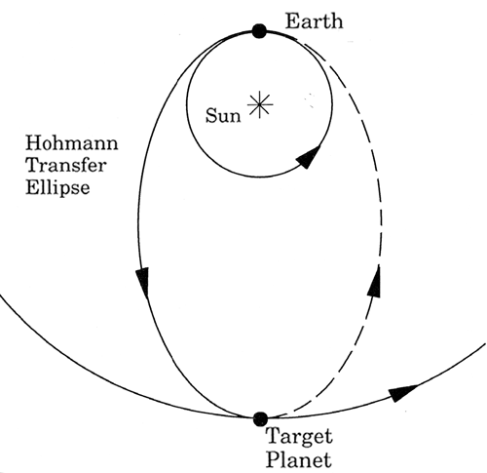
Discussion: Launching Rockets
Launch with Earth’s rotation
Launch with Earth’s orbital

Slide 16
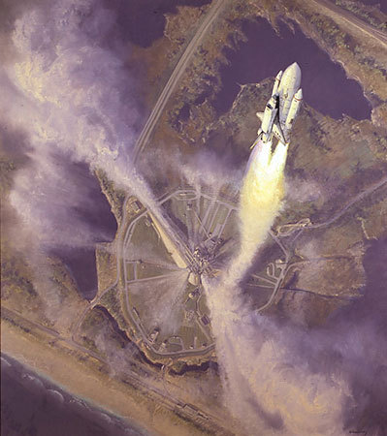
Discovery Launch
http://www.youtube.com/watch?v=4FROxZ5i67k
http://www.intothemusic.biz/wp-content/uploads/2010/04/space_shuttle_launch.jpg

Slide 17
Main Points
Satellites
Escape velocity depends on the gravitational field of planet
Launch with rotational and orbital velocity of Earth

