Slide 1
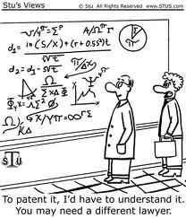
PHYS16 – Lecture 32
Ch. 14 Fluid Mechanics

Slide 2
This Week
Fluid Statics
Pressure and Pascal’s Principle
Buoyant Force and Archimedes’ Principle
Fluid Dynamics
Equation of Continuity
Bernoulli’s Equation

Slide 3
Fluids pre-question
A 0.2-kg coke can floats in fresh water (1000. kg/m³). The can is 12 cm long and has a radius of 2.5 cm. What is the buoyant force on the can?
2.0 N
2.3 N
1.8 N
0.3 N

Slide 4
Fluid Statics: Pressure

Slide 5
Pressure
Pressure- feeling of compression or tension all around object
As area goes down pressure goes up – nail head vs. nail point
As force goes up pressure goes up – baby laying on chest vs. adult laying on chest!
Force is perpendicular to surface area
Shear
Pressure

Slide 6
Pressure in a Fluid
(0) Force is perpendicular to surface area
Air
Water

Slide 7
Pressure in a Fluid
(1) Pressure increases as you go down in a fluid due to weight of fluid
P₁
z₁
Water
ρ
h
P₂
z₂

Slide 8
Pressure in a Fluid
(2) Pascal’s Principle – if you apply a CHANGE in pressure at any point in a confined fluid, an equal CHANGE in pressure occurs at every point in fluid
ΔF
ΔP=ΔF/A
Water

Slide 9
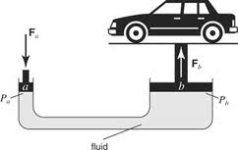
Pressure in a Fluid
(2) Pascal’s Principle – if you apply a CHANGE in pressure at any point in a confined fluid, an equal CHANGE in pressure occurs at every point in fluid

Slide 10
Pressure in a Fluid
Wait! But you said pressure changes with depth, why is now the pressure the same at any point in a fluid?
Pressure CHANGES at one point
are carried through to all points,
but absolute pressure will still be
different.

Slide 11
Example Question
What is the mechanical advantage of a hydraulic press with a piston that you push with a radius of 0.2 m and a piston that lifts a weight with a radius of 0.4 m?

Slide 12
Example Question
A 5-kg weight is applied to a piston with an area of 1 m². At the bottom of the tank (depth=2 m), what is the pressure change due to the weight?

Slide 13
Fluid Statics: Buoyant Force

Slide 14
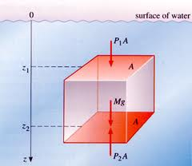
Buoyant Force
Buoyant Force – force due to pressure difference on object
Pressure goes up as you go down
So Buoyant Force pushes up
http://www.open2.net/open2static/source/file/root/0/30/19/124156/pressure_cube_b.jpg

Slide 15
Floating or Sinking?
If floating → buoyant force= weight of object
If sinking → buoyant force < weight of object
buoyant force = density * g * volume underwater
Buoyant force
What about weight of water?
What about sink at constant
velocity?
Water
Gravity

Slide 16
Archimedes’ Principle
Legend has it that Archimedes had a task to figure out the purity of the gold in the king’s crown. How much gold is in the crown? He came up the solution while taking a bath and ran naked through the streets shouting “Eureka!” or “I found it!”. There is the equation, what was his idea?

Slide 17
Demo: Bathtub Physics
Object floats. As object’s mass increases what happens to volume under water?
Two objects have the same volume, one floats and one sinks, do they have the same buoyant force?
Coke vs. Diet Coke, which floats higher?
Fresh water vs. Sea water, what is buoyant force on floating object?
Rocks in a floating boat. What happens if they get pitched out?
Funny block flip…

Slide 18
Main Points
Pressure = Force/Area
Pressure increases with depth
Pascal’s principle – pressure changes at one point occur at all points
Buoyant force is equivalent to the weight of the water displaced

