Slide 1
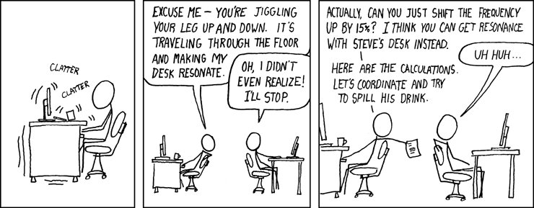
PHYS16 – Lecture 36
Xkcd.com
Ch. 15 Oscillations

Slide 2
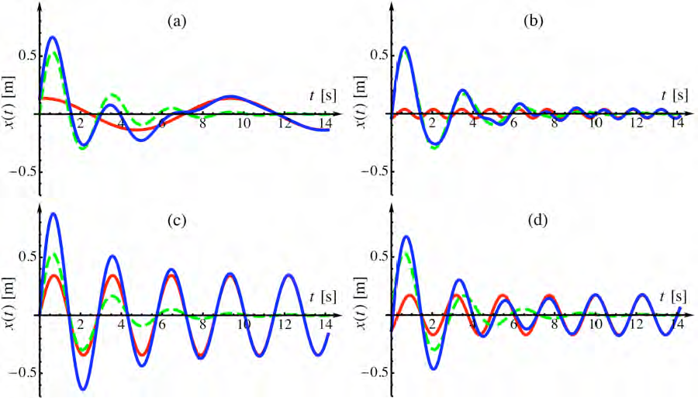
Oscillations pre-question
A mass on a spring is driven at a driving frequency (red curve) and the resulting position vs. time of the mass is given (blue curve). Which case is closest to resonance?

Slide 3
Outline for Oscillations
Simple Harmonic Motion
Position, Velocity, Acceleration
Force
Energy
Resonance and Damping

Slide 4
Simple Harmonic Motion – Cheat Sheet
Position, Velocity, and Acceleration
Restoring Force gives ang. freq. dependence

Slide 5
Simple Harmonic Motion: Restoring Force

Slide 6
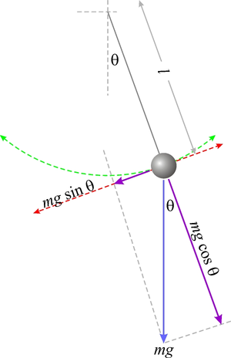
Example Question
What is the period of a pendulum?
Where is the restoring
force the greatest? Where is
tension the greatest?
Restoring force – At top of swing!
Tension – At bottom of swing
http://upload.wikimedia.org/wikipedia/en/thumb/a/a8/Pendulum.png/300px-Pendulum.png

Slide 7
Simple Harmonic Motion: Energy

Slide 8
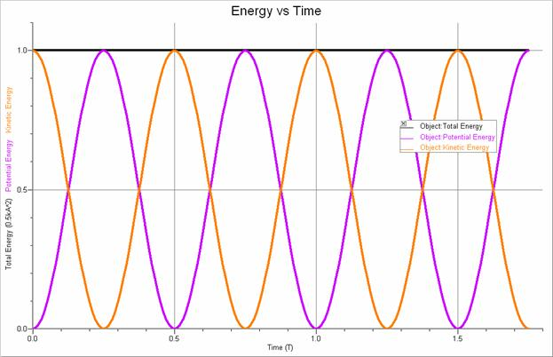
Energy in SHM
http://www.farraguttn.com/science/milligan/APPhys/SHMOver_files/image022.jpg

Slide 9
Example Question
A 0.5-kg mass hits a spring with a velocity of 2 m/s and sticks wikthout energy loss. The spring starts in its equilibrium position and has a spring constant of 0.5 N/m. What is the amplitude of the oscillation?
A = 2 m

Slide 10
Simple Harmonic Motion: Damping and Resonance

Slide 11
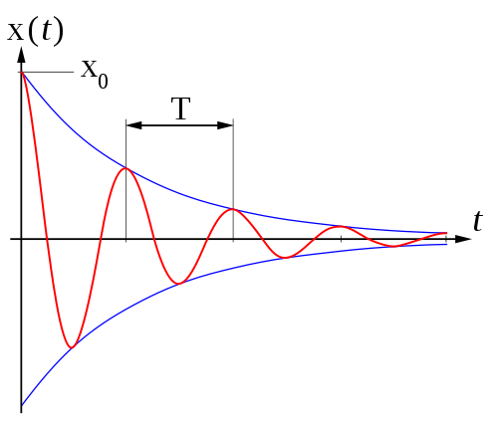
Damping
Damping – when a force (friction, air drag) causes the oscillator to lose energy
A
http://beltoforion.de/pendulum_revisited/Damped_oscillation_graph2.png

Slide 12
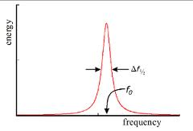
Resonance
Resonance – when a driving force has the same frequency of oscillation as the oscillator

Slide 13
Discussion: Resonance vs. Damping
When would you want to have resonance or damping? When would resonance or damping be unwanted?
Damping – when you don’t want oscillations: buildings, bridges
Resonance – when you want to have oscillations: pushing a kid on a swing, making standing waves in cavity

Slide 14
Oscillations pre-question
Is a bouncing ball an example of simple harmonic motion?
Yes
No

Slide 15
Oscillations pre-question
Two kids are swinging on two swings of the same height – one kid is a little chubbier than the other. Neglecting frictional forces, which kid completes a back and forth swing in the fastest time?
A) The chubby kid
B) The skinny kid
C) The kid who pushes off the ground the best
D) Both complete in the same time

Slide 16
Oscillations pre-question
A mass on a spring is driven at a driving frequency (red curve) and the resulting position vs. time of the mass is given (blue curve). Which case is closest to resonance?

Slide 17
Main Points - SHM
Movement is dependent upon amplitude, period and phase
Restoring Force creates oscillation
Energy is dependent on amplitude
Damping decreases A, Resonance increases A

