Slide 1
PHYS16 – Lecture 38
“Interference is much clearer in HD”
Ch. 16 Wave Motion

Slide 2
Ch. 16 Wave Motion
Mechanical Waves
Transverse vs. Longitudinal
Properties
Example: Wave on a String
How the wave propagates
Speed
Reflection and Transmission
Superposition and Standing Waves

Slide 3
Waves pre-question
Which of the waveforms has the shortest period?
A) 1st harmonic
B) 2nd harmonic
C) 3rd harmonic
D) Superposition of 1st, 2nd, & 3rd harmonic
E) Not enough information

Slide 4
Reflection and Transmission

Slide 5
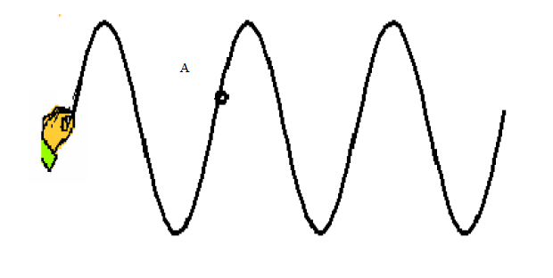
Demo: Wave on String Simulation
PhET website

Slide 6
Reflection
Reflection – when pulse moves backward in upon reaching a boundary
occurs when there is a change in the medium, either the string mass density changes or a boundary is reached
mass density ↑ or the boundary = fixed then reflected pulse is inverted
mass density ↓ or the boundary = free then the reflected pulse is NOT inverted
Fixed
Free

Slide 7
Transmission
Transmission – when the pulse moves forward upon reaching a medium change
occurs when there is a change in the medium NOT when there is a fixed or free boundary
transmitted pulse is never inverted
Mass density increases
Mass density decreases

Slide 8
Energy and Speed
Energy is conserved when a wave reaches a medium change
Speed in a medium is related to the medium properties
mass density ↑ then speed ↓

Slide 9
Discussion
A pulse along a string encounters a point where the string mass density increases.
What should happen to the speed of the transmitted wave? What about the speed of the reflected wave?
What should happen to their amplitudes?
What should happen to their widths?

Slide 10
Demo: Wave on String Simulation
http://paws.kettering.edu/~drussell/Demos/reflect/reflect.html

Slide 11
Superposition, Interference, and Standing Waves

Slide 12
Superposition and Interference
Superposition - When two stimuli overlap they will superimpose, or the new stimulus will be the sum of the two individual stimuli
Interference – the superposition of two or more waves, amplitudes sum together
“out of phase” or phases shifted by 180 degrees then they will “destructively” interfere
“in phase” or phases not shifted then they will “constructively” interfere

Slide 13
Interference
Constructive
Destructive
PhET website

Slide 14
Example Question 1
PhET website

Slide 15
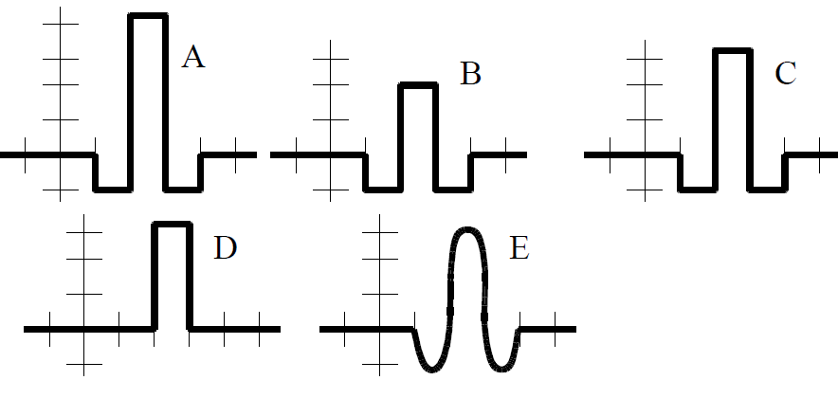
PhET website

Slide 16
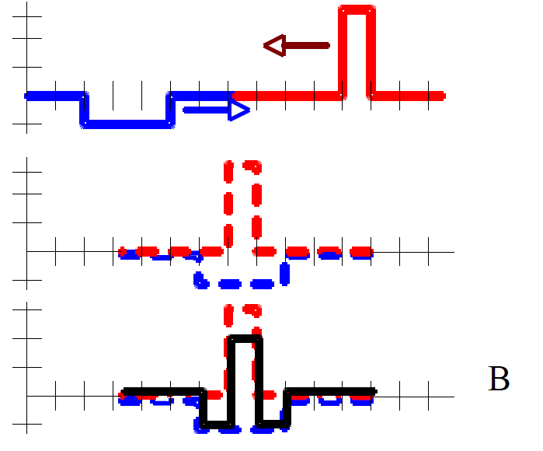
PhET website

Slide 17
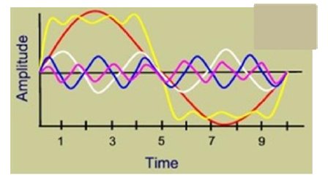
Example Question
Which of the following waveforms is a superposition of the other waveforms?
Yellow!

Slide 18
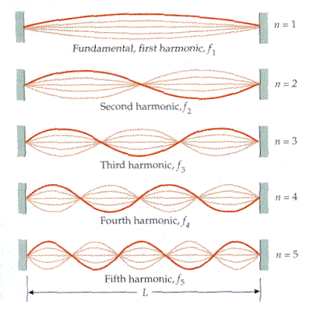
Standing Waves
Standing waves – waves that constructively interfere in a cavity and “stand” in one spot
Node
Antinode
http://kottan-labs.bgsu.edu/teaching/workshop2001/chapter7_files/image023.gif

Slide 19
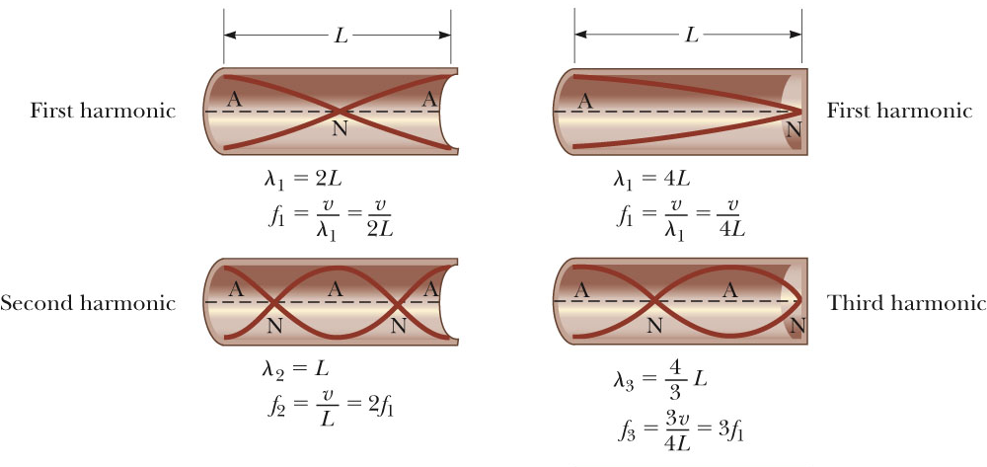
Standing Waves in pipes

Slide 20
Example Question 2
A string of 0.25 kg/m is stretched to a tension of 4 N between 2 plates that are 0.5 m apart. What is the wavelength of the first harmonic in the string?
4 m
2 m
1 m
0.5 m
0.25 m

Slide 21
Main Points - Waves
Reflection and Transmission – if medium changes or boundary is reached then pulse changes
Superposition – wave amplitudes add together
Interference – when two or more waves superimpose (destructive -> less A and constructive -> bigger A)
Standing waves – waves that constructively interfere within a cavity and appear to “stand” in one spot

