Slide 1
PHYS16 – Lecture 41
Mistakes students make on science tests
"The moon is a planet just like the earth, only it is even deader.“
"The tides are a fight between the Earth and moon. All water tends towards the moon, because there is no water in the moon, and nature abhors a vacuum. I forget where the sun joins in this fight."
“Momentum: What you give a person when they are going away.”
“A vibration is a motion that cannot make up its mind which way it wants to go.”
“To most people solutions mean finding the answers. But to chemists solutions are things that are still all mixed up.”
Ch. 17 Sound
http://stormysunshine.blogspot.com/2006/11/funny-student-science-test-mistakes.html

Slide 2
Ch. 17 Sound
Sound
Longitudinal Pressure Waves
Sound Velocity
Sound Reflection and Standing Waves
Intensity
Beats
Doppler

Slide 3
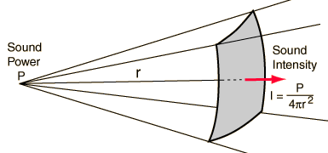
Sound Intensity
Intensity is the power per unit area in a wave
http://hyperphysics.phy-astr.gsu.edu/hbase/acoustic/imgaco/isc2.gif

Slide 4
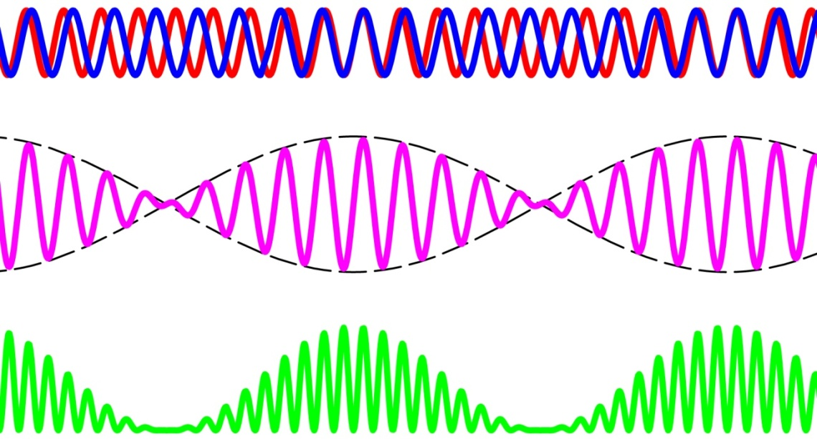
Beats
Beats occur when two sine waves (two notes) with very similar frequency interfere
Y
Y
I
t
t
t

Slide 5
Discussion: Beats
What is the beat frequency between 440 Hz and 442 Hz? How many beats in 10 seconds?
What is the beat frequency between 440 Hz and 2 Hz? Can you hear this?
Using beats, how would you tune a piano?
Why don’t you get beats when you play two guitar strings?

Slide 6
Doppler Effect

Slide 7
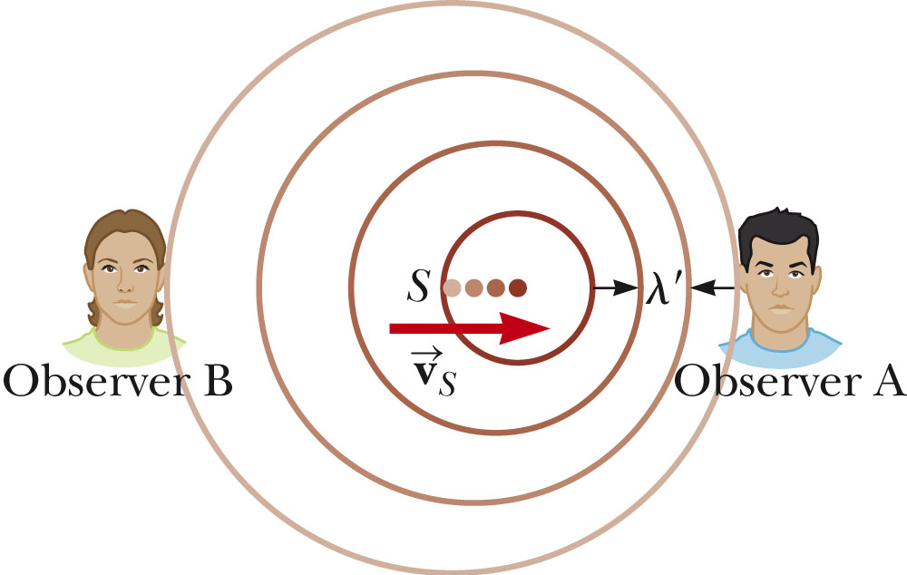
Doppler Effect
Frequency of sound changes when relative velocity changes
Frequencies on approach sound higher
Frequencies that recede sound lower
Need to know (source/observer) and (approach/ recede)

Slide 8
Doppler Effect
If observer receding then negative
If source receding then negative

Slide 9
Demo: Tuning Fork
http://hyperphysics.phy-astr.gsu.edu/hbase/music/tunfor.html

Slide 10
Example Question
The frequency of an ambulance siren is 1200 Hz. The ambulance is going 60 mph (26.8 m/s). As the ambulance approaches your stopped car, you hear what frequency?
f_{approach} = 1300 Hz

Slide 11
Main Points - Sound
Sound– a longitudinal pressure wave that moves through a medium
Velocity – 343 m/s in air
Reflection – occurs when medium changes – either tension between molecules or density
Resonance and Standing Waves – depends on open/closed ends

Slide 12
Main Points - Sound
Intensity and Sound Level
Interference and Beats
Doppler Effect

Slide 13
Review

Slide 14
Question 1
A mechanical wave has the following measured values:
Amplitude = 0.40 N/m^2
Frequency = 2.0E3 Hz
Intensity = 6.0E-3 W/m^2
Phase Angle = 3π/2 rad
Wavelength = 2.5 m
What is the speed at which this wave travels?
A) 1.9 m/s
B) 4.2E2 m/s
C) 5.0E3 m/s
D) 9.4E3 m/s
E) None of the above.

Slide 15
Question 2
A large cylindrical tank filled with water is 10 m deep and has an inside diameter of 5 m. A drain pipe projects horizontally from the bottom of the tank side and has a valve that can be opened to rapidly empty the tank. The pipe has a length of 1 m and is tapered, with a cross section of 0.2 m^2 next to the tank and 0.1 m^2 at the other end.
A) At the top of the tank
B) At the bottom of the tank
C) At the wide end of the pipe
D) At the narrow end of the pipe
E) None of the above

Slide 16
Question 3
Two mechanical waves of the same frequency pass through the same medium. The amplitude of wave A is 3 m, and the amplitude of wave B is 5 m. Which of the following describes the range of amplitudes possible when the 2 waves pass through the medium simultaneously?
A) Always 4 m
B) Between 2 and 8 m
C) Between 3 and 5 m
D) Between 5 and 8 m
E) None of the above

Slide 17
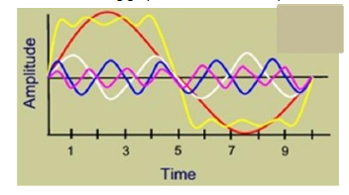
Question 4
At the second position where all the waveforms intersect, the waveforms are all:
A) in phase
B) out of phase
C) at a node
D) at maximum amplitude
E) None of the above

Slide 18
Question 5
A mass (M = 2.0 kg) slides with speed (v = 4.0 m/s) along a horizontal tabletop with negligible friction. It collides inelastically with a bumper plate of mass (m = 0.20 kg) and sticks to the plate. The bumper plate is attached to a horizontal spring fastened to a wall with a spring constant, k = 0.30 N/m. The bumper plate is originally at rest at the spring equilibrium position. What is the period of oscillation of the mass/bumper system?
A) 2.7 s
B) 11 s
C) 17 s
D) 19 s
E) None of the above

Slide 19
Question 6
A stationary receiver detects a change in frequency of the signal from a jet flying directly away from it at 300 m/s. Which of the following receivers will detect the same change in frequency from a jet moving away at 600 m/s?
A) A receiver moving at 900 m/s in the opposite direction as the jet
B) A receiver moving at 300 m/s in the opposite direction as the jet
C) A stationary receiver
D) A receiver moving at 300 m/s in the same direction as the jet
E) None of the above

Slide 20
Question 7
What is the expression for the angular frequency, ω, of a pendulum of length, L, with a bob on the end of mass, m, and at an angle of θ?
A)
B)
C)
D)
E) None of the above

Slide 21
Question 8
Which of the following best explains why ultrasonic waves are reflected at boundaries within a human body?
A) Reflections occur at the boundary between objects with different shapes.
B) Reflections occur at the boundary between objects with different densities.
C) Reflections occur when the frequency of the ultrasonic wave decreases.
D) Reflections occur when the frequency of the ultrasonic wave increases.
E) None of the above

Slide 22
Question 9
When a trumpet is tuned by comparison with a 512-Hz note from a piano, a beat frequency of 4 Hz is produced. The trumpet could have produced which of the following pairs of frequencies?
A) 508 Hz and 516 Hz
B) 508 Hz and 512 Hz
C) 504 Hz and 508 Hz
D) 512 Hz and 516 Hz
E) None of the above

Slide 23
Question 10
What is the magnitude of the restoring force for a pendulum of length, 3 m, with a bob on the end of mass, 2 kg, and at an angle of 10 degrees?
A) 20 N
B) 19 N
C) 4 N
D) 3 N
E) None of the above

Slide 24
Essay Question
Using a tuning fork how would you tune a piano?
Physically, why might it be easier to swim in the ocean than in a lake? Is this the case?
Would it be easier to send up a satellite from Mars or the Earth? Why?

Slide 25
Goals for the Semester
Introduce you to the physics of motion, force, and energy, AND some of its applications (fluids, waves, gravitation)
Prepare you for the MCAT
Show you how physics applies in your every day lives.

