Slide 1
PHYS16 – Lecture 5
Motion
Ch. 2 Motion in 1D & Ch. 4 Motion in 2D

Slide 2
Math Review Questions 1
Let’s say we make a measurement of our position with 3 different GPS devices (GPS watch, GPS phone, and a car GPS) and we know that we are right next to the bank (red x). Which GPS is the most ACCURATE?
GPS watch
GPS phone
Car GPS
BANK
GROCERY

Slide 3
Math Review Questions 2
Let’s say we make a measurement of our position with 3 different GPS devices (GPS watch, GPS phone, and a car GPS) and we know that we are right next to the bank (red x). Which GPS is the most PRECISE?
GPS watch
GPS phone
Car GPS
BANK
GROCERY

Slide 4
Math Review Questions 3
A problem asks you to find the pressure (P) a piston exerts given a force (F) of 23.7 N and a length (l) and width (w) of the piston of 11 cm and 0.001 km, respectively. The equation that governs this is P=F/(lw). How many significant digits should you enter in your answer?
A. 1
B. 2
C. 3
D. 4
E. There is not enough information.

Slide 5
Math Review Questions 4
A problem asks you to find the pressure (P) a piston exerts given a force (F) of 23.7 lbs and a length (l) and width (w) of the piston of 11 in and 0.001 in, respectively. The equation that governs this is P=F/(lw). What are the units of pressure?
A.lbs
B. in
C. lbs/in
D. lbs/(in^2)
E. There is not enough information.

Slide 6
Math Review Questions 5
What is the value for V₃?
(4,4)
(-2,2)
(2,-2)
(3,3)
(4,3)
V₃=?
V₂= (1,3)
V₁= (3,1)

Slide 7
Motion
Ch. 2 Motion in 1D
Position, Velocity, and Acceleration
Free Fall
Ch. 4 Motion in 2D
Projectile Motion
Relative Motion

Slide 8
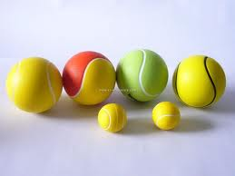
Intro - Motion pre-question
If a 0.50 kg ping-pong ball and a 2.0 kg tennis ball are dropped from 2 m, ignoring air resistance, which ball will hit the ground first? (g=9.8 m/s².)
A) The ping-pong ball
B) The tennis ball
C) Both hit at the same time
D) None of the above
http://www.sz-wholesale.com/uploadFiles/upimg9%5CPU-tennis-balls_172249.jpg

Slide 9
Intro - Process of solving problems
Read the problem carefully!
Draw a picture
Write down the given quantities
Write down what you should solve for
Identify the eqns./concepts you should use
Do the math and solve

Slide 10
Intro - Constant acceleration

Slide 11
Free Fall

Slide 12
Free Fall
Object under Earth’s gravity is in Free Fall
http://www.bkpc.co.uk/freefall.jpg

Slide 13
Free Fall Examples
A sky diver falls from 1 km. How long before they hit the ground?
You throw a ball up with a velocity of 5 m/s along positive y, what is the velocity of the ball right before you catch it?
You throw a ball up with 10 m/s and another down with 10 m/s. At the ground, which ball is going faster?
http://www.bkpc.co.uk/freefall.jpg

Slide 14
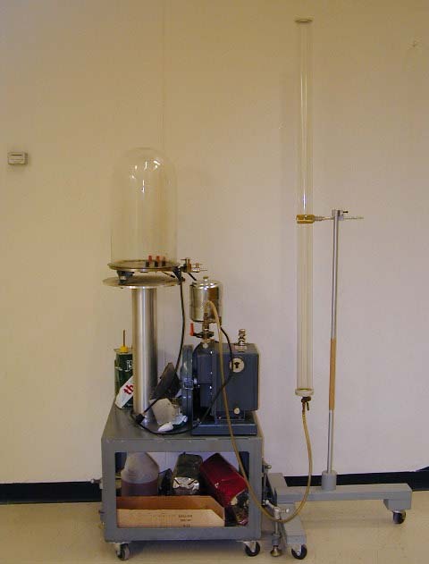
Challenge Question
I have a feather and a penny. The feather has a smaller mass than the penny. If they are dropped from the same height which will hit the ground first?
http://panda.unm.edu/demos

Slide 15
Other 1D Motion - Cars

Slide 16
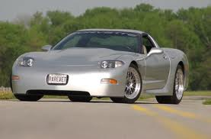
Lingenfelter Corvette
Can it really do 0 to 60 mph in 1.97 s?
Let’s calculate some #’s to see if it is reasonable – assume constant acceleration
http://Z06-corvette.com

Slide 17
Lingenfelter – 0 to 60 mph in 1.97 s

Slide 18
Stock Car – 0 to 333. 2 mph in ¼ mile

Slide 19
C6 Corvette – 0 to 60 mph in 4.2 s

Slide 20
2D Motion

Slide 21
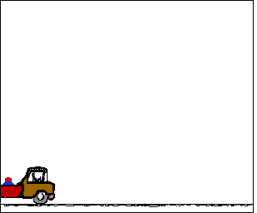
2D Motion
Each axis is independent.
So use kinematic equations in x and in y
Demo: train and ball…

Slide 22
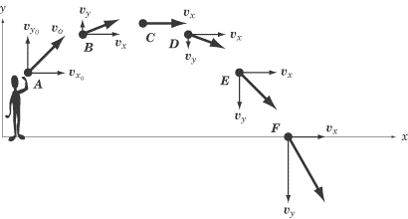
Projectile Motion
Object under both free fall in the vertical direction and a horizontal component
Path or trajectory is a parabola
http://img.sparknotes.com/content/testprep/bookimgs/sat2/physics/0012/projectile.gif

Slide 23
Conclusions
1D Motion
Free fall – constant acceleration
Cars – sometimes constant acceleration
2D Motion
Projectile motion – constant acceleration
Use the kinematic equations!

