Slide 1
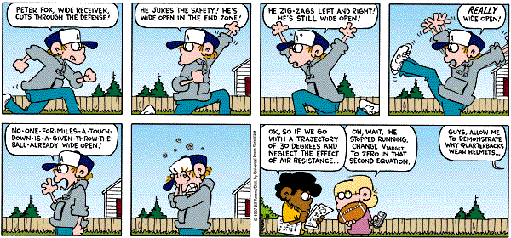
PHYS16 – Lecture 6
Fox Trot by Bill Amend
Motion
Ch. 4 Motion in 2D

Slide 2
Announcements
TA help sessions
Sat 4-6 pm in Merrill 116
Sun 7-10 pm in Merrill 116
If there is a room change then the TAs will leave a note on the door
Assignment #2 due on Monday
Clarification from last time
Velocity magnitude and direction
a_{y}=-9.8 m/s², g=9.8 m/s²

Slide 3
Motion
Ch. 2 Motion in 1D
Position, Velocity, and Acceleration
Free Fall
Ch. 4 Motion in 2D
Projectile Motion
Relative Motion

Slide 4
Motion pre-question
You want to catapult 0.5 kg rocks 0.35 km. You set the catapult to the angle that will give you the maximum distance (ignoring air resistance). What is the initial speed you have to throw the rocks at?
A) 59 m/s
B) 19 m/s
C) 1.9 m/s
D) None of the above

Slide 5
Motion pre-question
A girl is rollerblading at 8 m/s and overtakes a boy rollerblading at 5 m/s. Before she overtakes him the boy throws a ball back to her at 12 m/s relative to him. What is the speed of the ball relative to the girl?
(8 + 5 + 12) m/s
(8 – 5 – 12) m/s
(8 + 5 – 12) m/s
(8 – 5 + 12) m/s
(-8 + 5 + 12) m/s

Slide 6
Projectile Motion

Slide 7
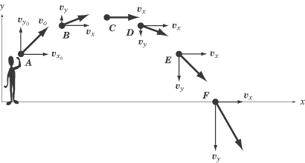
Projectile Motion
Object under both free fall in the vertical direction and a horizontal component
Path or trajectory is a parabola
http://img.sparknotes.com/content/testprep/bookimgs/sat2/physics/0012/projectile.gif

Slide 8
2D Kinematic Equations

Slide 9
Examples – Catapulting rocks
I launch a rock with an initial speed of 5 m/s and at an angle of 30 degrees. What is it’s maximum height?
How far will it go?

Slide 10
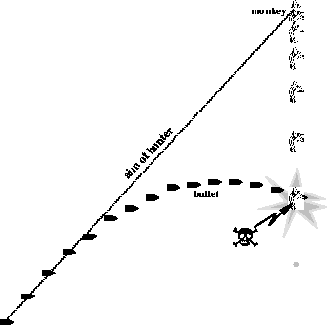
Challenge Question
I want to shoot a tin can. The tin can is suspended above the ground and it drops when the bullet is fired. Where should I aim my gun?
http://physics.ucr.edu/~wudka/Physics7/Notes_www/img149.gif

Slide 11
Relative Motion

Slide 12
Relative Motion – Math
Relative motion – motion of a frame that an object is moving in
Motion of object in frame is just equal to object’s motion
Motion of object out of frame is equal to object’s motion + frame motion

Slide 13
Relative Motion – Walkway at Airport
Alice is running at 2 m/s in the airport and the moving walkway is at 3 m/s. What is Alice’s speed to an outside observer?
v_{out,A} = v_{obj,A} + v_{frame,A} = 2 + 3 = 5 m/s
Bob is running at 6 m/s not on the walkway. What is Alice’s speed relative to Bob?
v_{obj,A} = v_{out,A} – v_{frame,B} = 5 – 6 = -1 m/s

Slide 14
Relative Motion – River Problem
A river has a current of 3 m/s. A boat pointed straight across the river with a speed of 4 m/s appears from the shore to have a velocity of what value?
4 m/s
3 m/s

Slide 15
Relative Motion – River Problem
A river has a current of 3 m/s. A boat pointed straight across the river with a speed of 4 m/s appears from the shore to have a velocity of what value?
5 m/s at an angle of 40 degrees from the shore

Slide 16
Relative Motion – Bucket Problem
A bucket is left out in the rain. The rain is coming down at 5 m/s. If a crosswind starts to blow at 2 m/s, will the bucket fill faster or slower?
Wind at
2 m/s
5 m/s
Original rain
5 m/s
Same Rate!
Scenario #1
Scenario #2

Slide 17
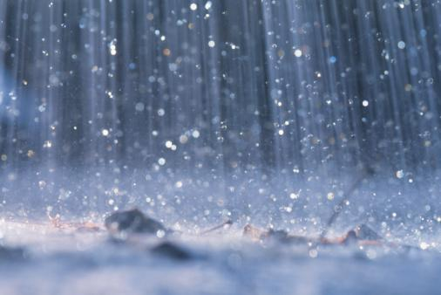
Relative Motion – Run or Walk in Rain?
Is it better to run or walk in the rain?

Slide 18
Relative Motion – Run or Walk in Rain?
Is it better to run or walk in the rain?
Assume rain is coming straight down at 1 m/s
If you run at 2 m/s, what does the rain look like in your frame?
looks like coming at you instead of straight down
If you just look at surface area of body getting wet, does walking or running hit less surface area?
Walking
If you look at how many rain drops hit you, does walking or running have less total rain drops?
Running because you reach your destination sooner

Slide 19
Motion post-question
If a 0.50 kg ball is launched straight up and is given an initial velocity of 15 m/s, what will be the velocity of the ball on the way back down at the launch point? (Note: assume air resistance is negligible and that g=9.8 m/s².)
A) It is the same as when it was launched.
B) It is dependent on initial velocity.
C) It is dependent on the acceleration constant.
D) It is dependent on the angle it was shot at.
E) None of the above

Slide 20
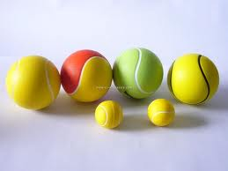
Motion post-question
If a 0.50 kg ping-pong ball and a 2.0 kg tennis ball are dropped from 2 m, ignoring air resistance, which ball will hit the ground first? (g=9.8 m/s².)
A) The ping-pong ball
B) The tennis ball
C) Both hit at the same time
D) None of the above
http://www.sz-wholesale.com/uploadFiles/upimg9%5CPU-tennis-balls_172249.jpg

Slide 21
Motion post-question
You want to catapult 0.5 kg rocks 0.35 km. You set the catapult to the angle that will give you the maximum distance (ignoring air resistance). What is the initial speed you have to throw the rocks at?
A) 59 m/s
B) 19 m/s
C) 1.9 m/s
D) None of the above

Slide 22
Motion post-question
A girl is rollerblading at 8 m/s and overtakes a boy rollerblading at 5 m/s. Before she overtakes him the boy throws a ball back to her at 12 m/s relative to him. What is the speed of the ball relative to the girl?
(8 + 5 + 12) m/s
(8 – 5 – 12) m/s
(8 + 5 – 12) m/s
(8 – 5 + 12) m/s
(-8 + 5 + 12) m/s

Slide 23
Conclusions
Describe Motion
Use vectors (both magnitude and direction)
Displacement -> Velocity -> Acceleration
(take derivatives)
Constant acceleration – use kinematic equations
Free fall
Cars
Projectile motion – for 2D separate into x and y
Relative Motion

