Slide 1
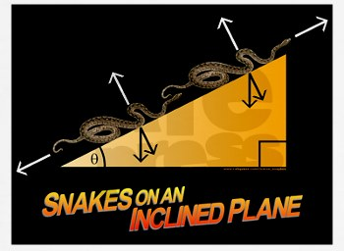
PHYS16 – Lecture 8
http://images.cafepress.com/product_zoom/160644695v4_350x350_Front_Color-White.jpg
Ch. 5 Force and Newton’s Laws

Slide 2
Ch. 5 Force
Force – Definition & Types
Newton’s Laws
Law of inertia
F=ma
F_{action}= -F_{reaction}
Friction
Applying of Newton’s Laws

Slide 3
Force pre-question
Anahita is pushing a box horizontally with a 200-N magnitude force. The box is sliding across the horizontal floor with a forward acceleration. What must be true about the magnitude of the kinetic friction acting on the box:
A) it is > 200 N
B) it is < 200 N
C) it = 200 N
D) None of the statements above are necessarily true

Slide 4
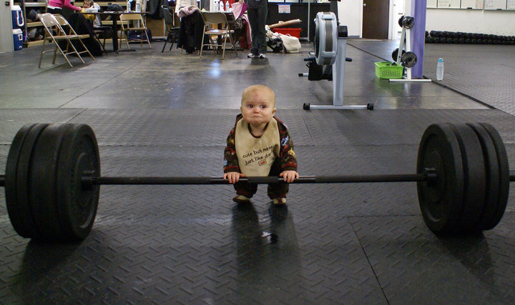
Force pre-question
Which action involves more force, lifting a weight at a constant velocity or lowering a weight at a constant velocity?
Lifting the weight
Lowering the weight
Equal force in both cases
There is not enough information
http://www.loltimeout.com/wp-content/uploads/2010/04/Av8fL.jpg

Slide 5
Friction

Slide 6
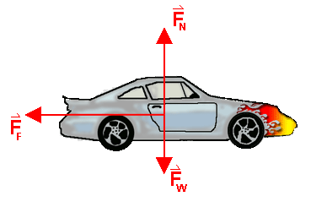
Frictional forces
Forces that oppose motion relative to surface
Static Friction – opposes impending motion
Kinetic Friction – opposes motion
Friction is parallel to surface and opposite motion
Both static and kinetic friction are proportional to the normal force
http://www.saskschools.ca/curr_content/physics30/opt_kindyn/images/car_friction2.gif

Slide 7
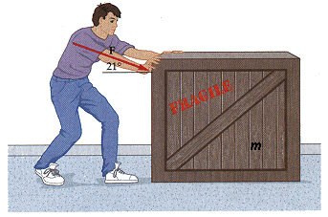
Frictional forces
3) Kinetic friction is usually less than static friction.
F_{app}
f
http://www.webassign.net/walker/06-16alt.gif
http://www.wsu.edu/~jtd/Physics205/Chap4/Image189.gif

Slide 8
Frictional forces
3) Kinetic friction is usually less than static friction.
Time (s) | Force (N)
0 | 0
1 | 1500
2 | 3000
3 | 4500
4 | 6000
5 | 7500
6 | 6000
7 | 6000
8 | 6000
9 | 6000
MCAT Problem
A rope pulls horizontally on an axle that is locked so that the tire cannot roll. During an experiment the force on the rope is steadily increased until the tire begins to skid along the road without rotating. Once the tire starts to skid, the dragging force is reduced to the minimum needed to maintain a steady speed.
What is the acceleration during the first 4 s?
What is max static force?
What is the kinetic force?
Why is this important in ABS?

Slide 9
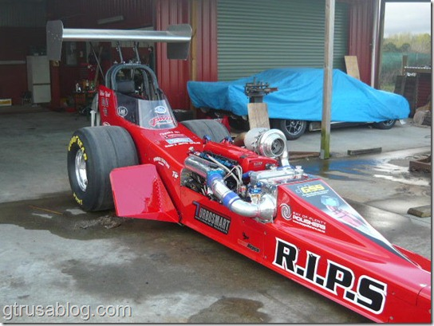
Challenge question
Why do dragsters have wide tires?
Friction is independent of surface area,
but tire wear and traction are not!

Slide 10
Applying Newton’s Laws

Slide 11
Process of solving problems
Read the problem carefully!
Draw a picture
Write down the given quantities
Write down what you should solve for
Identify the eqns./concepts you should use
Do the math and solve

Slide 12
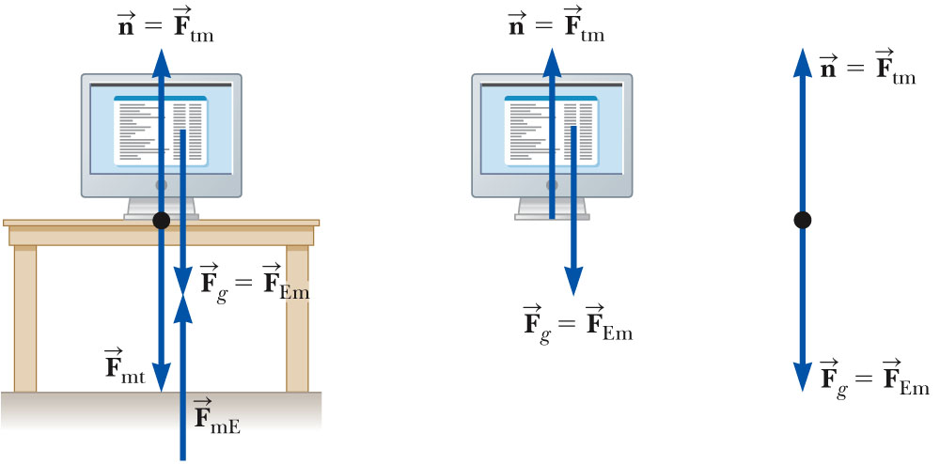
Trick #1 = Draw a free body diagram
Free body diagram – a picture that shows the object as a dot and all the forces that act on it

Slide 13
Trick #2 = Remember Third law when identifying forces
Third Law – every action has an equal and opposite reaction

Slide 14
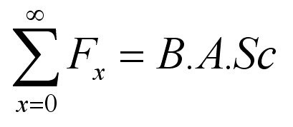
Trick #3 = Eq. to use is second law
Second Law -->
http://www.chrismclaren.com/blog/wp-content/images/2006/01/Hanging/Formula.jpg

Slide 15
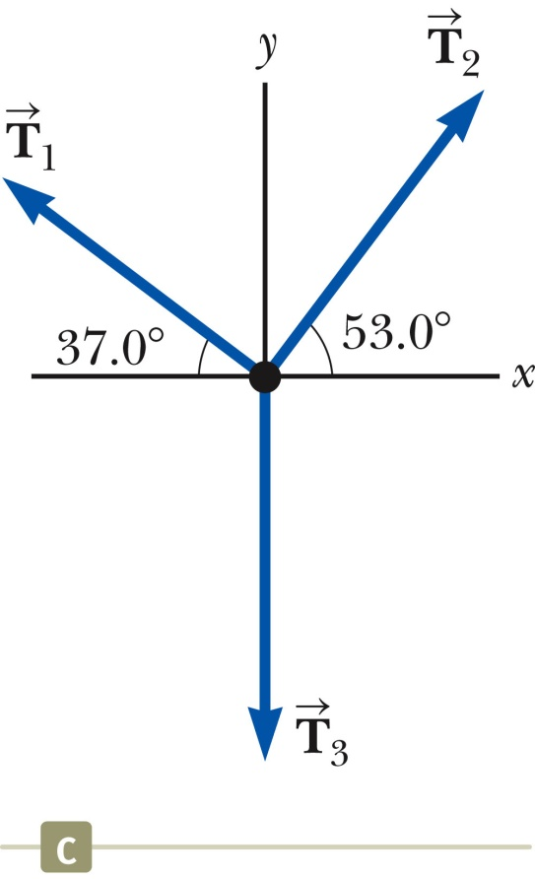
Trick #4 = Forces are vectors, use x & y
Break forces into their x and y components and solve each component separately
Example: What is T₃if object is still?
= 13 N
= 10. N

Slide 16
Problem #1
For each of the following situations Jorge applies a 50 N force to a 10-kg crate. Answer: How much force is the crate applying to Jorge? What is the frictional force on the crate?
The crate is still.
The crate moves at 5 m/s
relative to the ground.
3) The crate accelerates at
2 m/s² relative to the ground.
http://www.wsu.edu/~jtd/Physics205/Chap4/Image189.gif

Slide 17
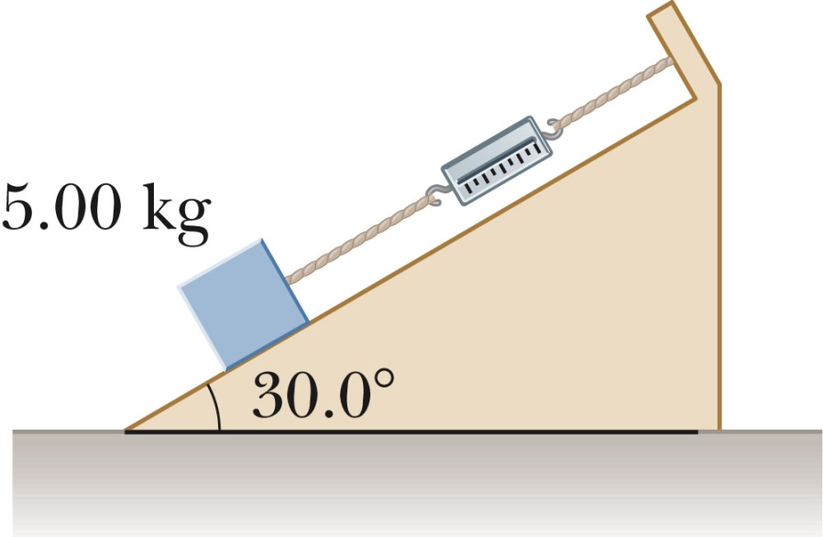
Problem #2
5.00 kg block sits on 30.0 degree inclined plane. If the coefficient for static friction is 0.7, what is the static frictional force?

Slide 18
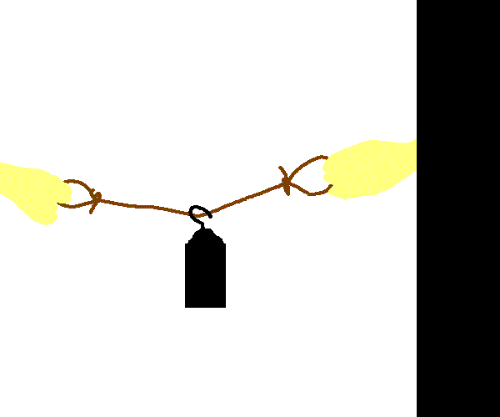
Problem #3
Two students want to lift a 1 kg block. They thread a rope through the block and then each student pulls on the rope. How much force do they have to exert to lift the block such that the rope is taut?
http://www.physicslessons.com/forcev12.gif

Slide 19
Conclusions
Force – push or a pull
Newton’s laws
First – Law of inertia
Second – F=ma
Third – F_{action} = -F_{reaction}
Friction – static and kinetic

