Slide 1
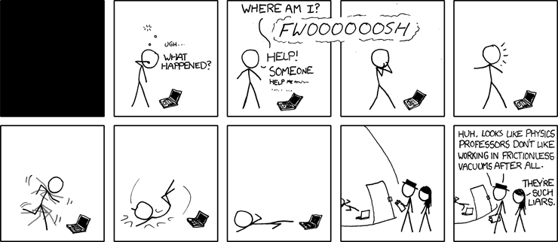
PHYS16 – Lecture 9
xkcd.com
Ch. 5 Force and Newton’s Laws

Slide 2
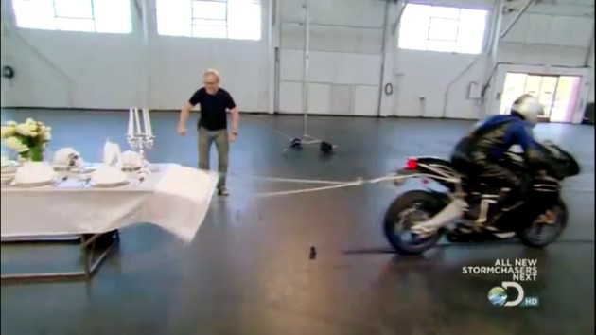
Josh kills my tablecloth trick
http://www.autoblog.com/2010/10/28/mythbusters-put-the-motorcycle-tablecloth-trick-to-the-test/

Slide 3
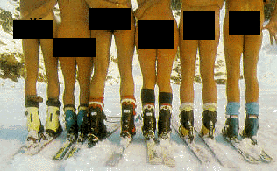
Ethan’s Extra Credit
1) Women have a lower center of mass than Men
2) Maximum height you can jump increases as your center of mass increases
3) For high jump – probably greater inertia and kinetic propulsion of males makes
them better jumpers

Slide 4
Ch. 5 Force
Force – Definition & Types
Newton’s Laws
Law of inertia
F=ma
F_{action}= -F_{reaction}
Friction
Applying of Newton’s Laws

Slide 5
Process of solving problems
Read the problem carefully!
Draw a picture (Trick – Free Body Diagram)
Write down the given quantities (Trick – remember Third Law)
Write down what you should solve for
Identify the eqns./concepts you should use (Trick – Second Law & separate into x/y)
6) Do the math and solve

Slide 6
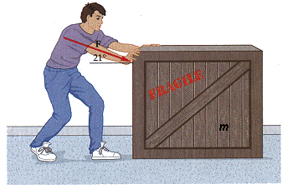
Crate problems
Jorge pushes on a 10-kg crate with a 50 N horizontal force. Ignore friction. What is the crate’s acceleration?
Jorge pushes on a 10-kg crate with a horizontal force of 50 N, but it doesn’t move. The coefficient of static friction is 0.7. What is the frictional force?
Jorge pushes on a 10-kg crate with a 50 N force at 21 degrees. The coefficient of kinetic friction is 0.2. What is the acceleration of the crate?
5 m/s²
50N
2 m/s²
http://www.wsu.edu/~jtd/Physics205/Chap4/Image189.gif

Slide 7
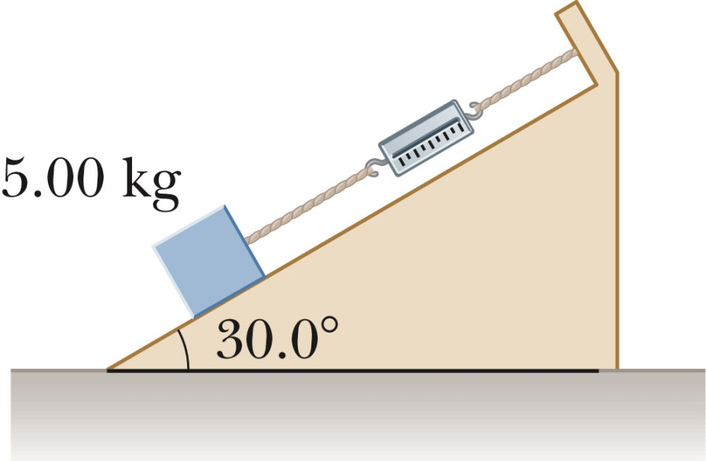
Inclined plane problems
A 5.00 kg block sits on 30.0 degree inclined plane. The coefficient for static friction is 0.7. The coefficient of kinetic friction is 0.2.
What is the static frictional force?
What force do you have to apply to move block at a constant velocity up the ramp?
f=mgsin(θ)
Fapp=mg(sin(θ)+μcos(θ))

Slide 8
Mechanical Advantage
Mechanical Advantage is the factor by which a simple machine multiplies the force
Example: Incline plane and pulley

Slide 9
Pulley problems
What is the tension needed to lift the weight at a constant velocity?
What is the tension needed to lower the weight at a constant velocity?
What is the mechanical advantage?
mg/2
mg/2
2
Bauer and Westfall

Slide 10
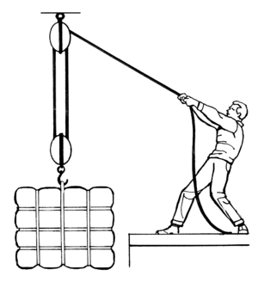
Chair of Death!
http://wpcontent.answcdn.com/wikipedia/commons/thumb/c/ca/Block_and_tackle_(PSF).png/300px-Block_and_tackle_(PSF).png

Slide 11
Conclusions
Applying Newton’s Laws
Follow problem solving guide
Remember tricks
Mechanical Advantage
Inclined Plane
Pulleys

