Slide 1
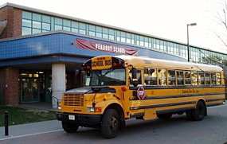
Making Census of Cambridge, Massachusetts: Schools, Highways, and Historical GIS
Andy Anderson Josie Fisher ’12
Yinan Zhang ’12
Hilary Moss
Amherst College
Northeast Arc Users Group Spring Meeting — Northampton 5-22-2012

Slide 2
Faculty-Student Collaboration
This work began in a junior-year research seminar in Spring 2011, Cities, Schools, and Space
Urban history and education policy
An experiment to encourage faculty- student collaboration in the humanities and social sciences
Also an experiment to integrate GIS into the curriculum
Of eight students:
Two completed history theses that grew out of their class work
One expanded their class work and presented at the American Education Research Association conference.
Two collaborated on this work (while writing economics theses!)

Slide 3
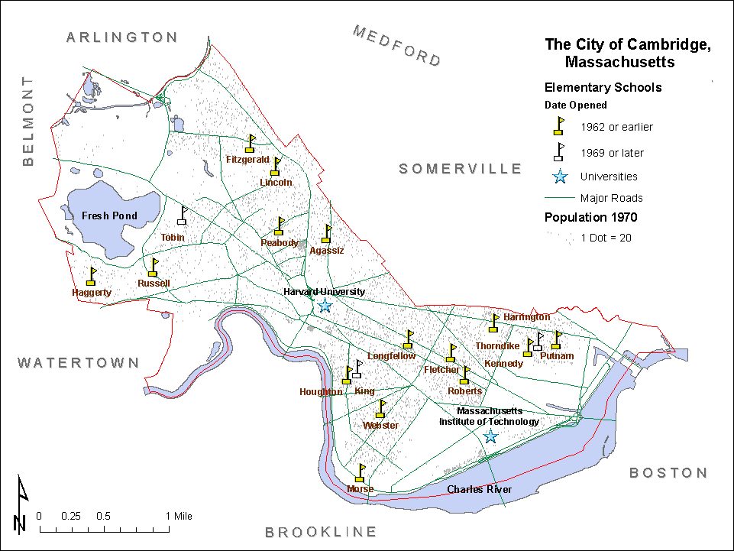
The University City

Slide 4
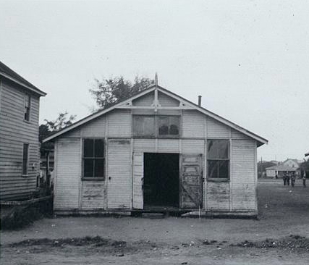
Opportunity & Infrastructure
Quality of school facilities is a strong predictor of teacher retention and attrition rates
Buckley, Schneider, and Shang 2004
Positive association exists between school’s physical environment and students’ behavioral problems
Kumar, O’Malley, and Johnston 2008
In Cambridge, school infrastructure is also linked with educational opportunity…
Black School in Louisa County, Virginia, ca. 1935 (LOC/NAACP)

Slide 5
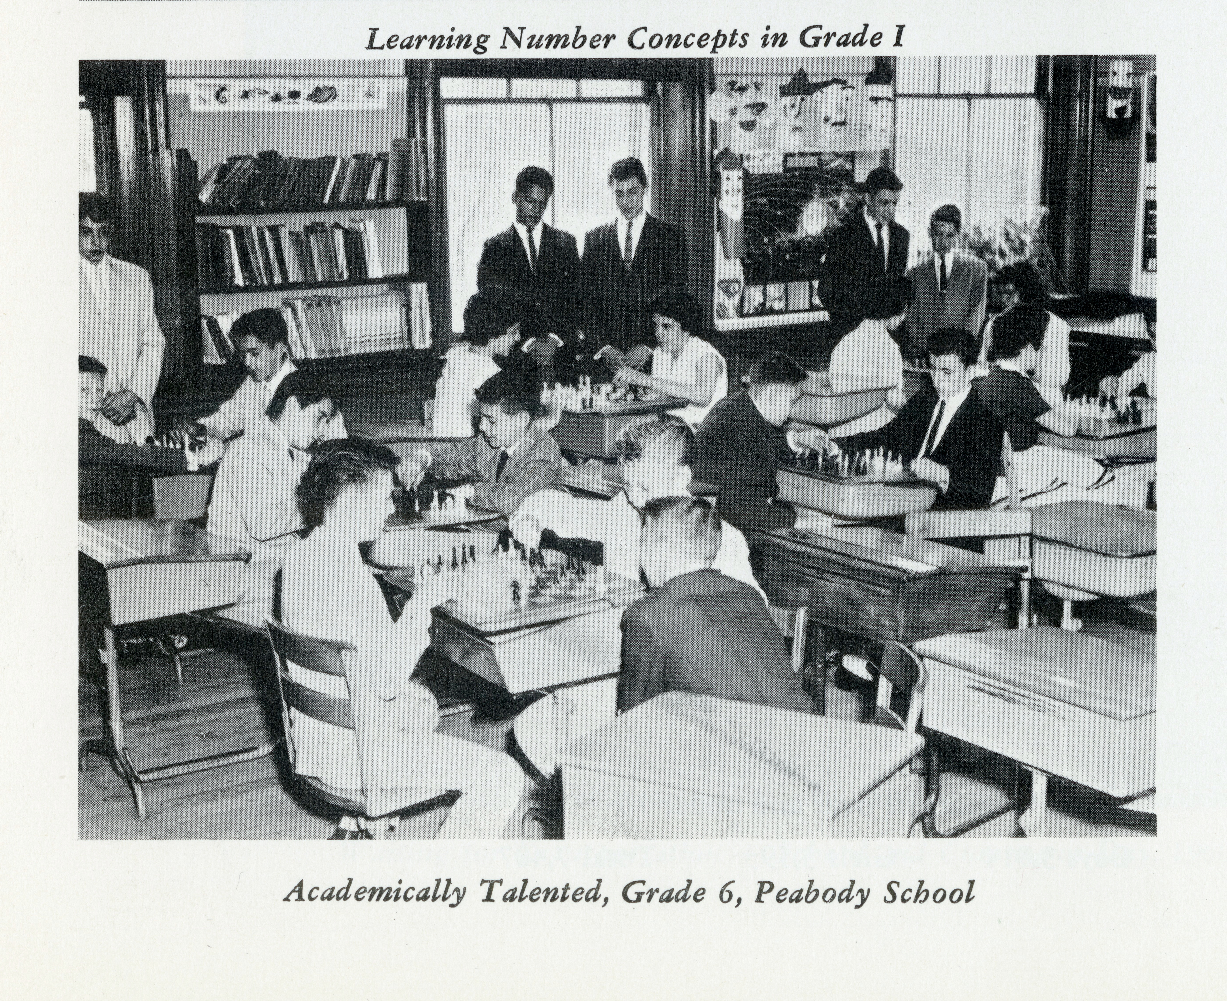
Academically Talented Classes

Slide 6
AT Classes & School Facilities
School | AT Students (1967) | Condition of School Facilities (1967) | Year Opened or Expanded
Agassiz | 58% | School freshly painted; rooms light and cheerful. Very pleasant school atmosphere. | 1915
Peabody | 45% | New, very beautiful building, Library, science room, boys' and girls' gymnasiums, showers, locker rooms, cafeteria, audiovisual room. Auditorium. Heath and dental suites. | 1960
Haggerty | 24% | Assembly hall, but no gym. Very well kept. | 1914
Russell | 13% | Assembly hall and gymnasium combined. Home economics and woodworking facilities. | 1897, 1924
Longfellow | 12% | Light, cheerful classrooms. Assembly Hall converts into gymnasium. Library being set up. Newly installed science room. | 1931
Fitzgerald | 10% | Attractive building with all facilities such as gymnasiums, cafeteria, home economics and woodworking facilities. | 1957
Thorndike | 10% | Combination assembly hall and gym. Home economics and woodworking facilities. Though building is fairly old, atmosphere of school is cheerful | 1911
Morse | 9% | New and very beautiful school. Bright rooms. Ceramic murals. Gymnasiums for boys and girls, cafeteria, excellent facilities for woodworking, sewing and cooking classes. Auditorium; health and dental suites. | 1955
Harrington | 7% | New, very attractive, and with all facilities, such as gymnasiums, auditorium, and science room. | 1959
Fletcher | 5% | Assembly hall. No gym, library, or science room. No home economics or woodworking facilities. | 1903
Webster | 5% | Assembly hall; no gym, library, or science room. | 1852, 1885, 1909, 1929
Putnam | 4% | Over 100 years old. Lacks all special facilities. | 1887
Roberts | 4% | Combination of assembly hall and gym. | 1929
Houghton | 4% | Assembly hall. No gym (physical education held in large room). | 1904, 1923

Slide 7
AT Classes & School Facilities
School | AT Students (1967) | Condition of School Facilities (1967) | Year Opened or Expanded
Agassiz | 58% | School freshly painted; rooms light and cheerful. Very pleasant school atmosphere. | 1915
Peabody | 45% | New, very beautiful building, Library, science room, boys' and girls' gymnasiums, showers, locker rooms, cafeteria, audiovisual room. Auditorium. Heath and dental suites. | 1960
Haggerty | 24% | Assembly hall, but no gym. Very well kept. | 1914
Russell | 13% | Assembly hall and gymnasium combined. Home economics and woodworking facilities. | 1897, 1924
Longfellow | 12% | Light, cheerful classrooms. Assembly Hall converts into gymnasium. Library being set up. Newly installed science room. | 1931
Fitzgerald | 10% | Attractive building with all facilities such as gymnasiums, cafeteria, home economics and woodworking facilities. | 1957
Thorndike | 10% | Combination assembly hall and gym. Home economics and woodworking facilities. Though building is fairly old, atmosphere of school is cheerful | 1911
Morse | 9% | New and very beautiful school. Bright rooms. Ceramic murals. Gymnasiums for boys and girls, cafeteria, excellent facilities for woodworking, sewing and cooking classes. Auditorium; health and dental suites. | 1955
Harrington | 7% | New, very attractive, and with all facilities, such as gymnasiums, auditorium, and science room. | 1959
Fletcher | 5% | Assembly hall. No gym, library, or science room. No home economics or woodworking facilities. | 1903
Webster | 5% | Assembly hall; no gym, library, or science room. | 1852, 1885, 1909, 1929
Putnam | 4% | Over 100 years old. Lacks all special facilities. | 1887
Roberts | 4% | Combination of assembly hall and gym. | 1929
Houghton | 4% | Assembly hall. No gym (physical education held in large room). | 1904, 1923

Slide 8
AT Classes & School Facilities
School | AT Students (1967) | Condition of School Facilities (1967) | Year Opened or Expanded
Agassiz | 58% | School freshly painted; rooms light and cheerful. Very pleasant school atmosphere. | 1915
Peabody | 45% | New, very beautiful building, Library, science room, boys' and girls' gymnasiums, showers, locker rooms, cafeteria, audiovisual room. Auditorium. Heath and dental suites. | 1960
Haggerty | 24% | Assembly hall, but no gym. Very well kept. | 1914
Russell | 13% | Assembly hall and gymnasium combined. Home economics and woodworking facilities. | 1897, 1924
Longfellow | 12% | Light, cheerful classrooms. Assembly Hall converts into gymnasium. Library being set up. Newly installed science room. | 1931
Fitzgerald | 10% | Attractive building with all facilities such as gymnasiums, cafeteria, home economics and woodworking facilities. | 1957
Thorndike | 10% | Combination assembly hall and gym. Home economics and woodworking facilities. Though building is fairly old, atmosphere of school is cheerful | 1911
Morse | 9% | New and very beautiful school. Bright rooms. Ceramic murals. Gymnasiums for boys and girls, cafeteria, excellent facilities for woodworking, sewing and cooking classes. Auditorium; health and dental suites. | 1955
Harrington | 7% | New, very attractive, and with all facilities, such as gymnasiums, auditorium, and science room. | 1959
Fletcher | 5% | Assembly hall. No gym, library, or science room. No home economics or woodworking facilities. | 1903
Webster | 5% | Assembly hall; no gym, library, or science room. | 1852, 1885, 1909, 1929
Putnam | 4% | Over 100 years old. Lacks all special facilities. | 1887
Roberts | 4% | Combination of assembly hall and gym. | 1929
Houghton | 4% | Assembly hall. No gym (physical education held in large room). | 1904, 1923

Slide 9
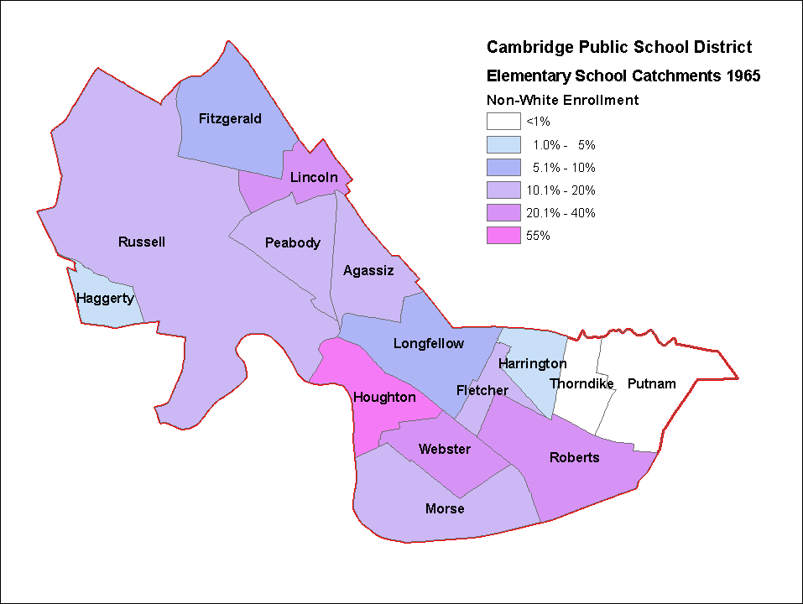
School Catchments & Minorities

Slide 10
School Catchments & Minorities
1965 Racial Imbalance Act violated — Houghton more than 50% Minority

Slide 11
School Construction in the ’60s
The School Committee:
Built three new schools:
King
Kennedy
Tobin
Instituted open enrollment:
At first just whites into and minorities out of Houghton/King — no takers
Later any school if enrollment allowed — but this only increased imbalance.
Notes:
the School Committee’s failure to advertise for the limited open enrollment program at the Houghton School, to provide transportation or to encourage parents to take advantage of the opportunity, not a single child transferred in or out. “Ellen S. Jackson to Alflorence Cheatham,” (November 30, 1973), Koocher Papers, in possession of the author.

Slide 12
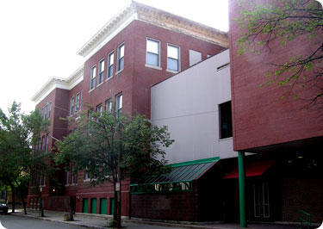
School Construction Choices
The School Committee’s stated priorities for rebuilding schools were:
Expectations of increased enrollment.
But Houghton and and Putnam/Thorndike actually declined in the ’60s.
Deficient in facilities.
But several schools were in far worse shape than Russell.
Excluded from these plans:
Fletcher
Webster
Roberts
Why?
Fletcher (now Cambridgeport) School, Cambridge

Slide 13
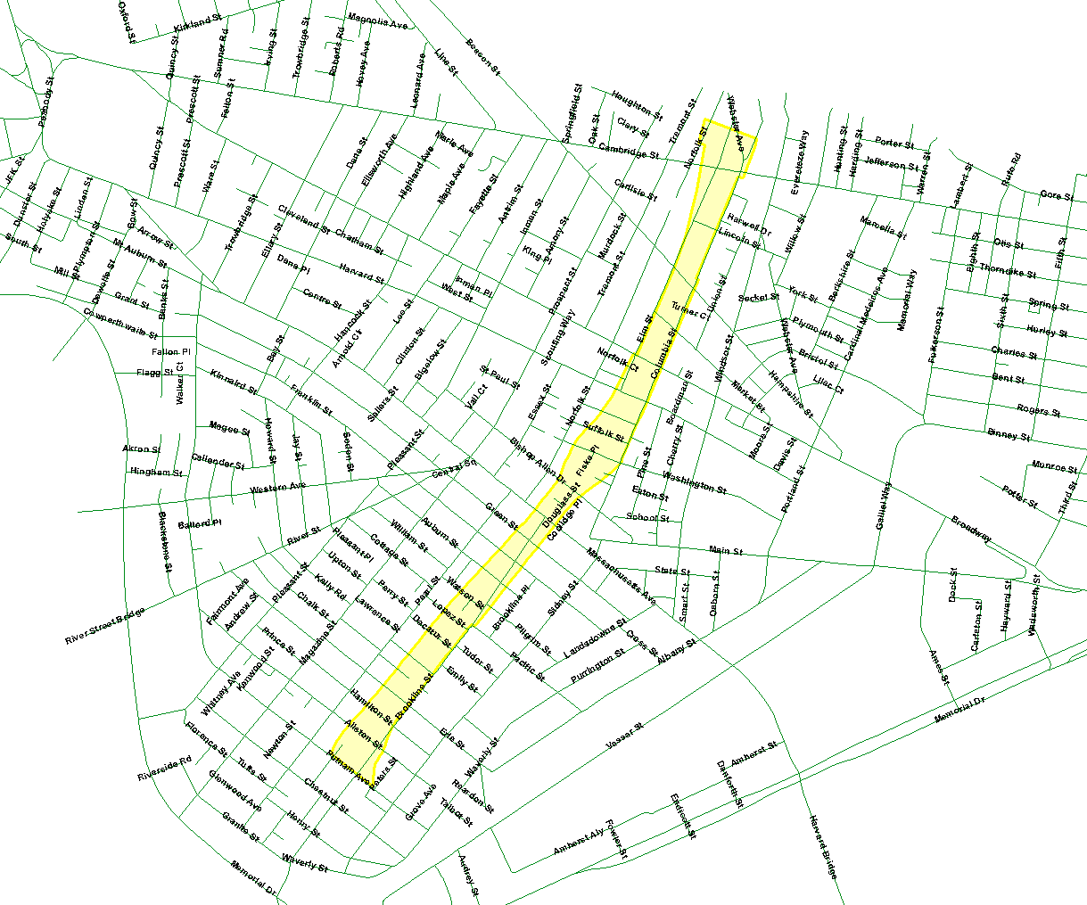
Fletcher School
Fletcher School was an exception due to its proximity to the route of the expected “Inner Belt” Highway
First identified on maps as an issue, later confirmed in School Committee minutes.

Slide 14
Silent Segregation?
Even with new schools, long waiting lists existed for the “better” schools, and the School Committee continued to receive complaints.
In 1976, one School Committee member responded with an accusation of past segregation: Peabody’s zone was drawn “to exclude an established community of blacks in the Concord Avenue area”.

Slide 15
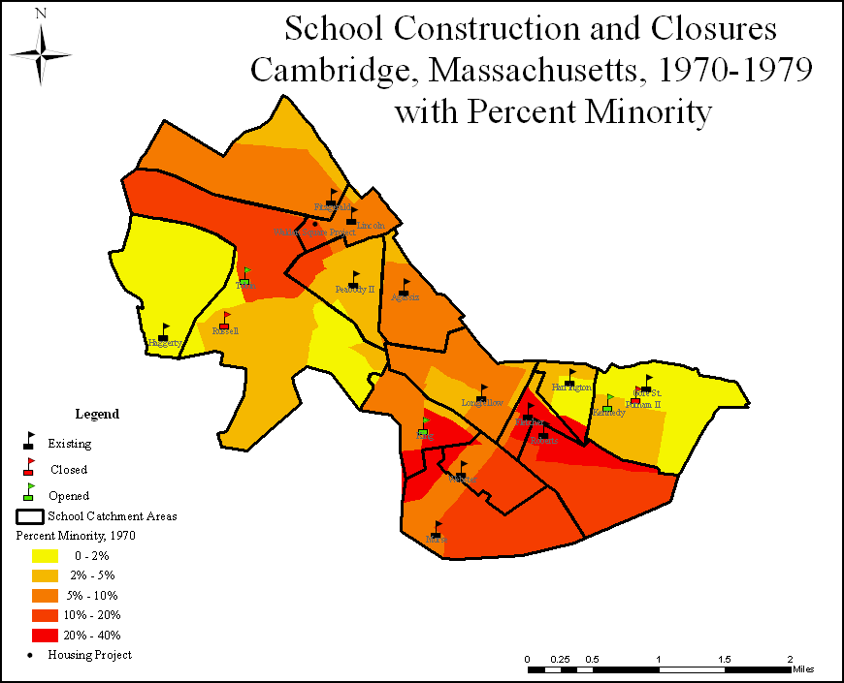
Cambridge Minority by Tract
1969
Census Tracts
www.census.gov/ only has block-level data from 1990

Slide 16
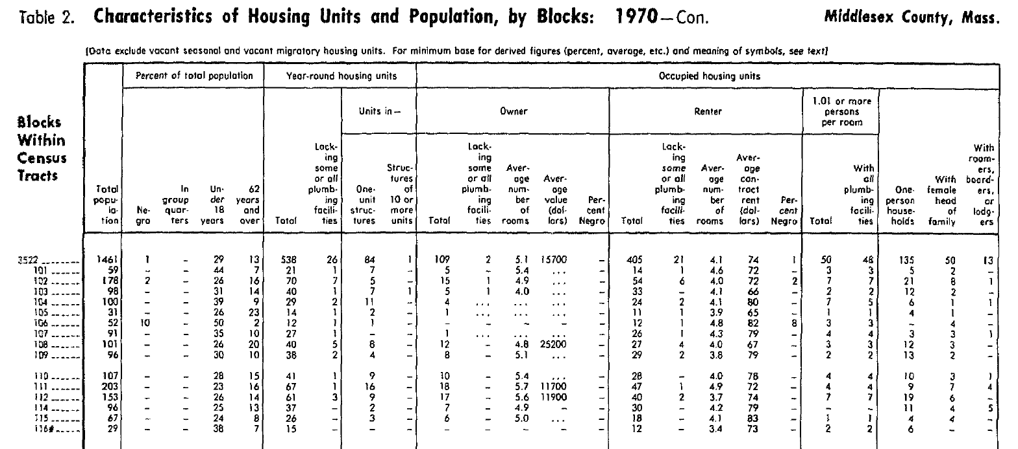
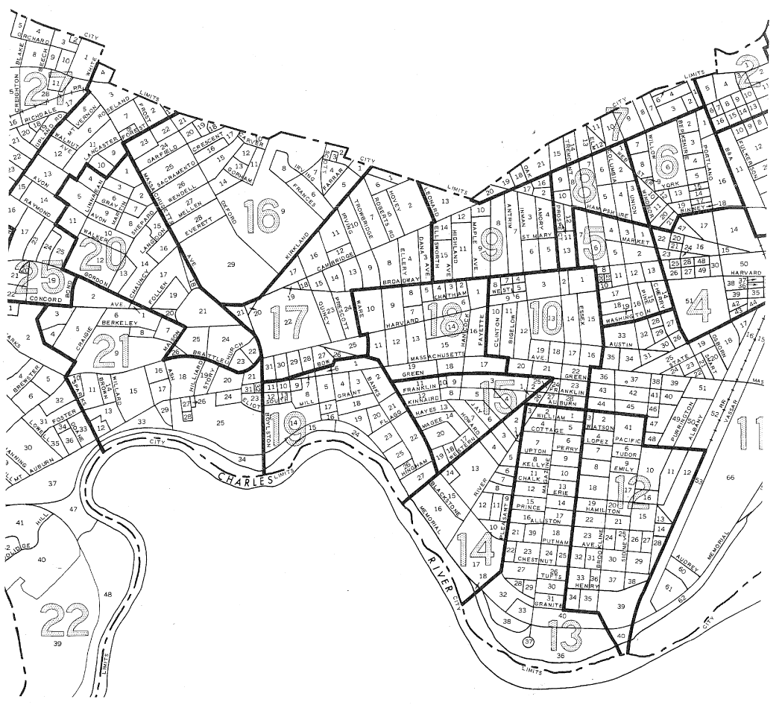
Clearer Picture: Census Blocks
Discovery in the MIT archives: early block-level data does exist!

Slide 17
Census Block Data Extraction
Last year we transcribed the block data and created block layers for 1940 – 1970
New this year: some block data now available from the National Historical GIS, www.nhgis.org/ including 1970 — and raw values rather than percents

Slide 18
Census Block Data Suppression
Many values at the block level are suppressed where there are small numbers of people or housing units (…)
Intended to protect privacy

Slide 19
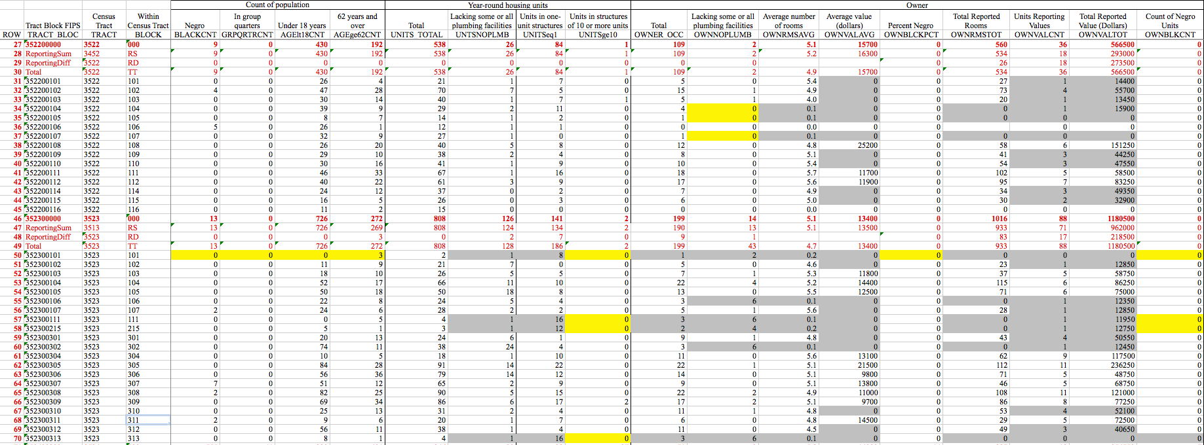
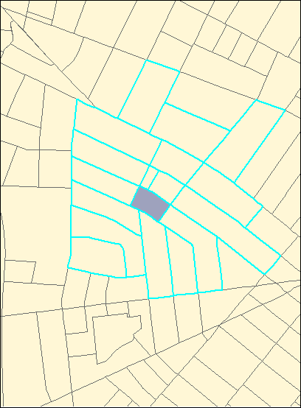
Census Block Data Enhancement
Many suppressed values (yellow) can be determined by comparison with the tract summary
Other values (gray) can be estimated using averages of nearby blocks (≤ 0.1 mi), constrained by tract (except $)

Slide 20
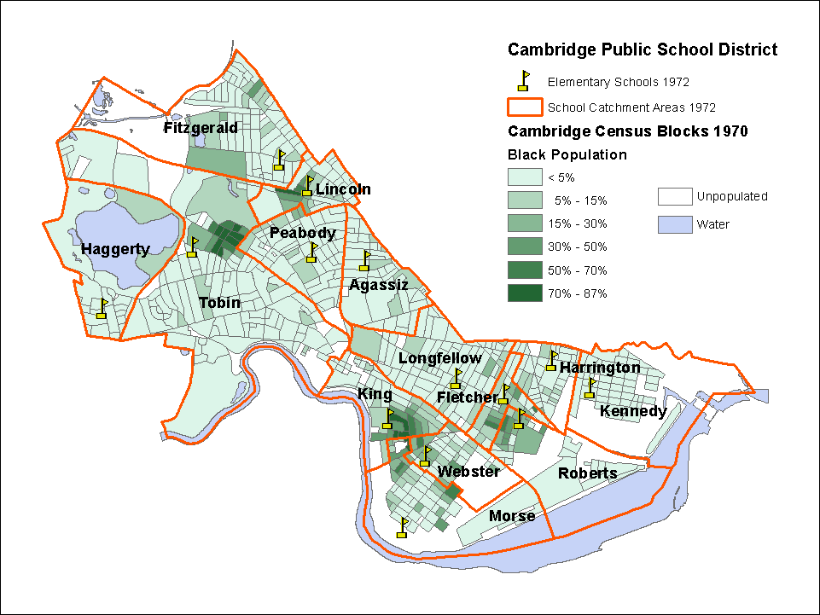
Black Population by Block 1970
Segregated community?

Slide 21
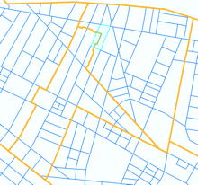
Census Block Integration
Integrating block-level data into the school catchments is far more accurate than estimation using tracts, but still requires some approximation.
Some blocks must be split — assume constant areal density (average values must first be totaled).
“Union” with school catchments distributes block data into sub-catchments, which can then be “dissolved” back into the catchments.

Slide 22
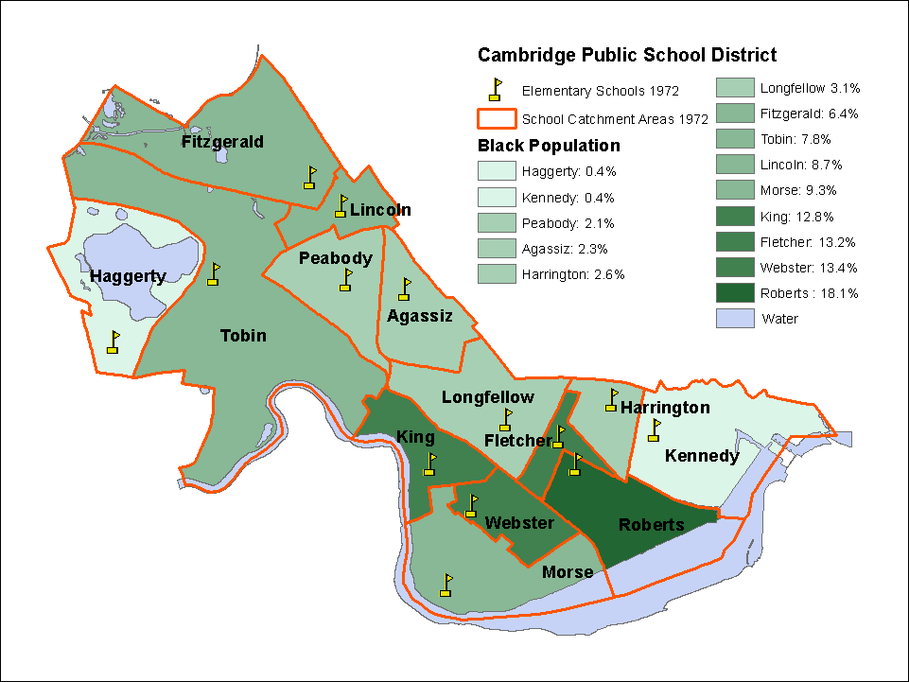
Black Population by School 1970

Slide 23
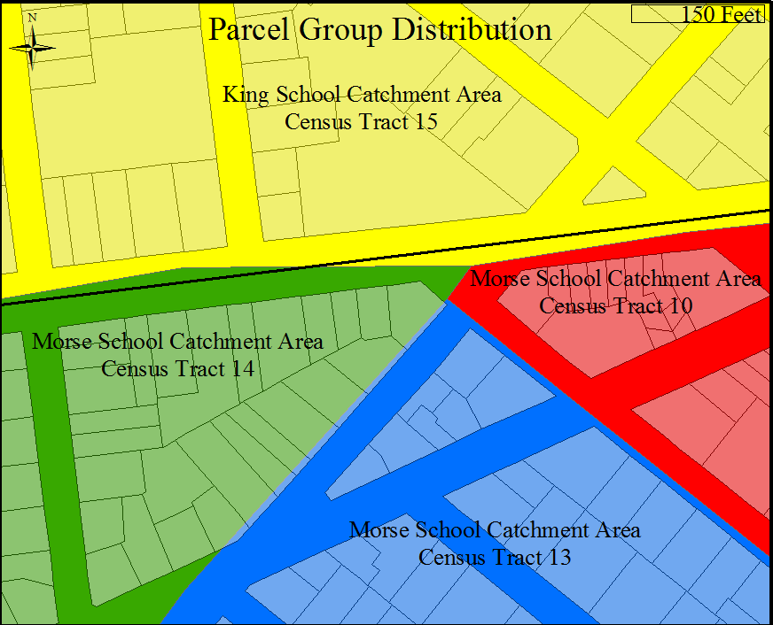
Census Block Modeling
Block data is focused on basic population and housing
Tract-level data is more extensive but can be weighted by block-level population or occupancy:

Slide 24
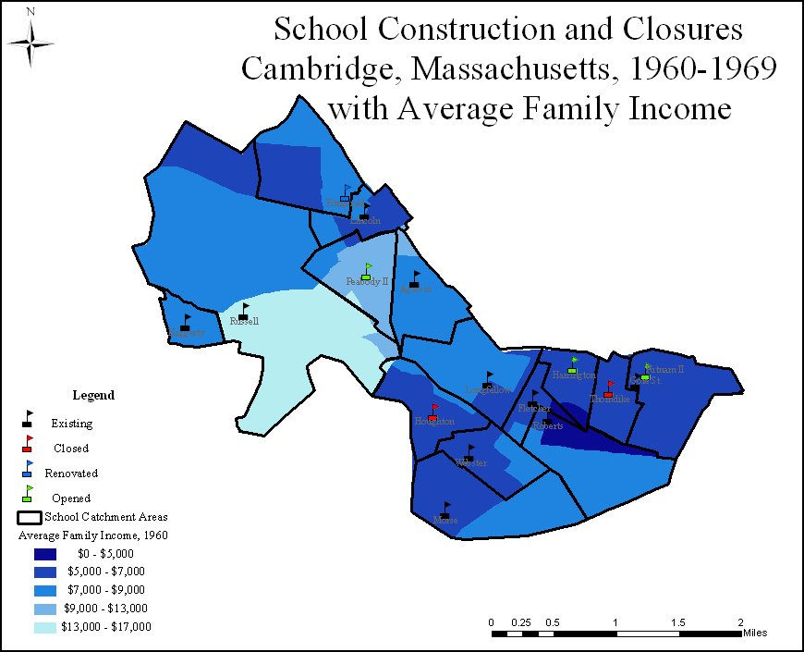
Cambridge Income by Tract
1965
Census Tracts

Slide 25
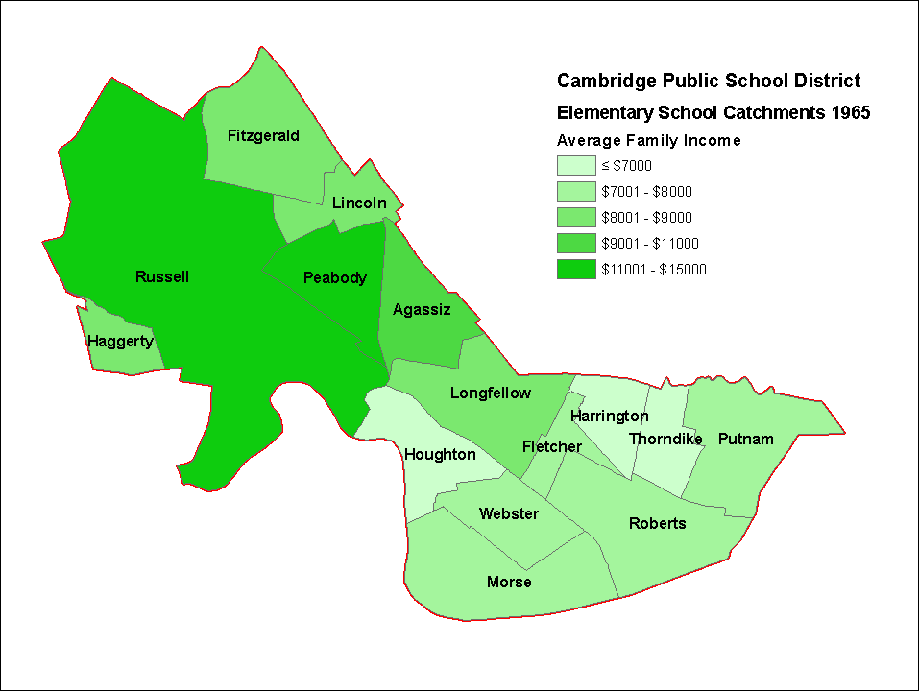
Average Family Income 1965

Slide 26
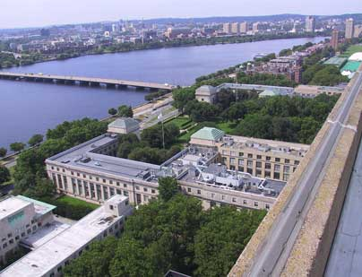
Higher Education: MIT & Harvard
Provided consulting support to the School Committee and influenced school construction choices.
Recommended faculty members live in certain neighborhoods with better schools (Peabody and Agassiz).
Produced assessment reports that were used to steer home buyers and renters.
Massachusetts Institute of Technology

Slide 27
The Inner Belt Highway Effects …
Interstate 695:
Planned from the 1940s, final route in 1967
MIT doesn’t want the highway adjacent.
Brookline-Elm residents don’t want it, either!
End result: neither is built! Canceled in 1972.
Even so, damage to the neighborhood:
local residents “didn’t bother to paint their houses – they figured they were just gonna be pushed out of them…they didn’t fix the shingles or roofs.”

Slide 28
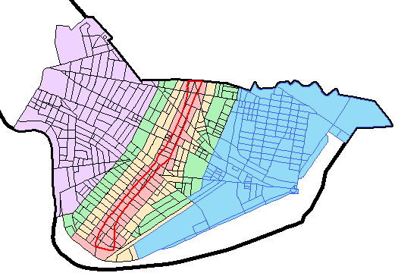
…Property Values
Census blocks grouped by proximity to the highway.
Using census data, average property values calculated for 1960 and 1970.
Relative to appreciation in value in the highway band, other areas had enhanced value:
yellow: +23%
green: +37%
overall: +166%

Slide 29
Thanks!
Cambridge GIS! Jeff Amero, et al.
Cambridge Assessor
Cambridge Historical Society
MIT Archives
National Historical GIS @ U. Minn
Mellon Foundation

Slide 30
Catchment Questions
Catchment boundaries are not always clear
Some obviously pass through the middle of blocks (we followed parcel bounds).
Some appear just off street edges — rough drawing or to keep streets together?

Slide 31
Future Research 2…
A distinct dividing line between the Roberts and Kennedy districts led to conflict in the 1970s…

