Slide 1
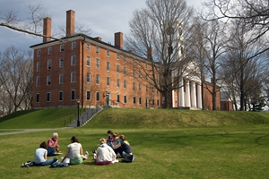
Cities, Schools, and Space
Andy Anderson (Academic Technology Services)
Hilary Moss (Departments of Black Studies & History)
Amherst College
A research seminar for juniors
Urban history and education policy
Potential thesis students encouraged!
Northeast Arc Users Group Spring Conference — Smith College 5/17/2011

Slide 2
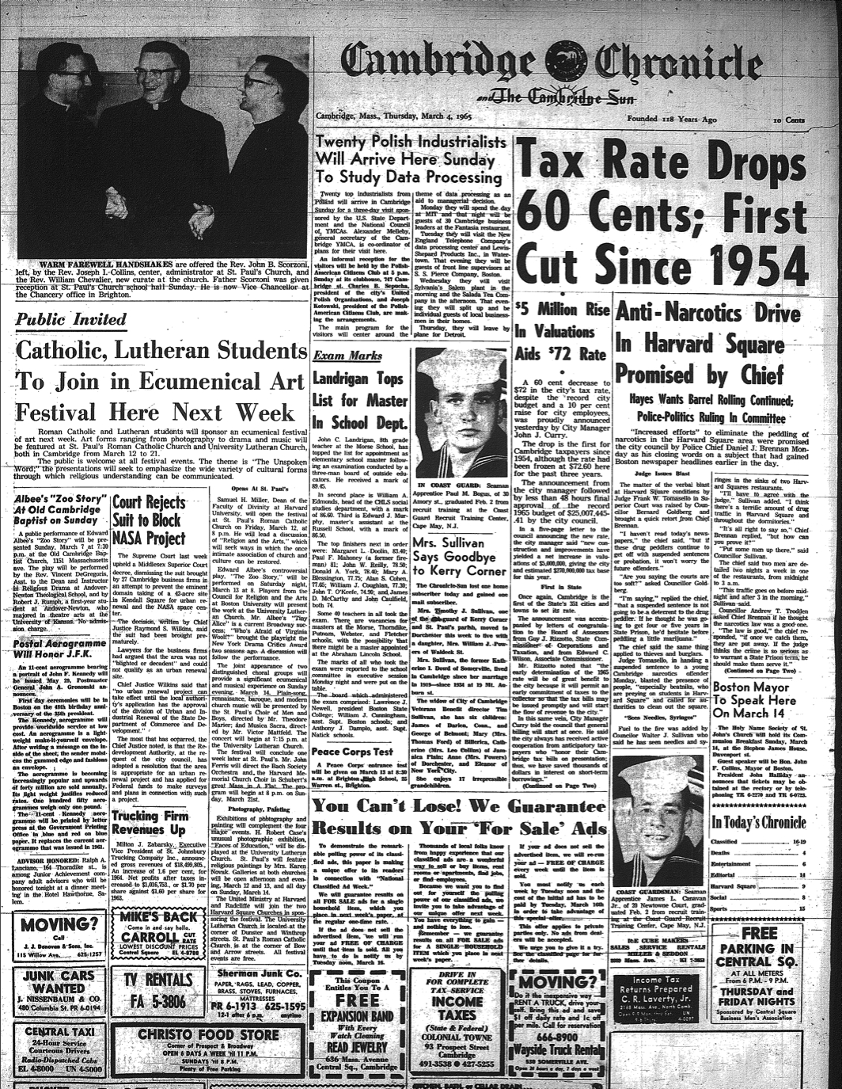
Many Research Methodologies
Archival analysis
Oral interviews
GIS: integrated into the course

Slide 3
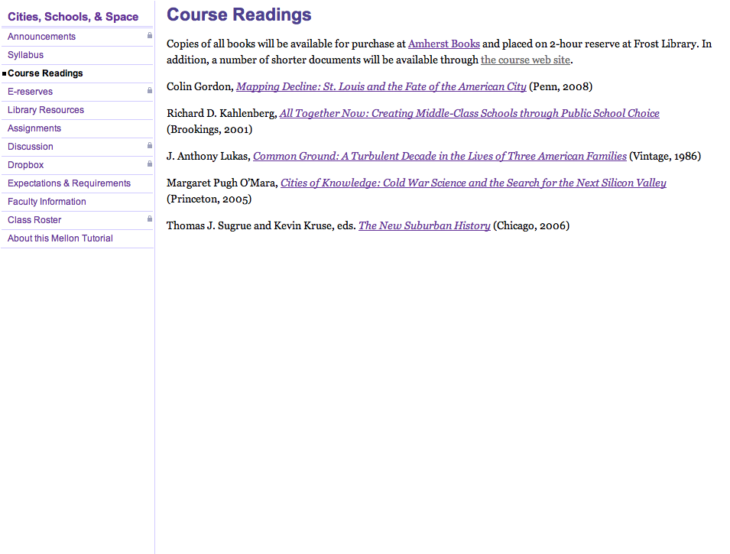
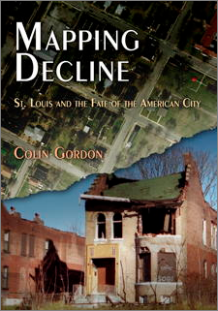
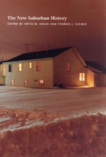
Web Page

Slide 4
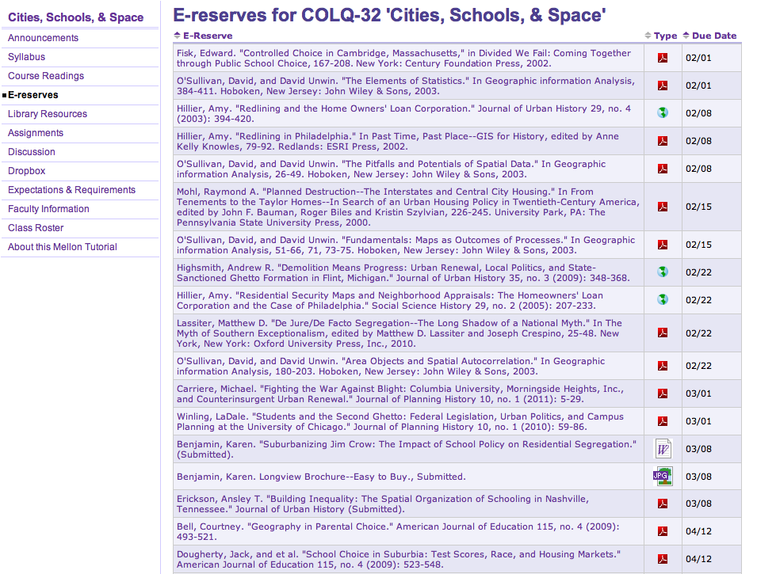
Students and parent at Tobin School, Cambridge
Web Page
(Restricted)

Slide 5
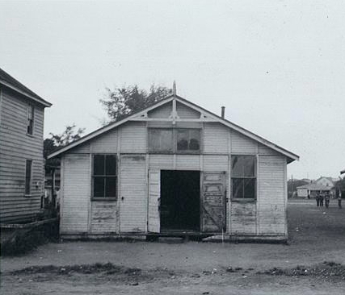
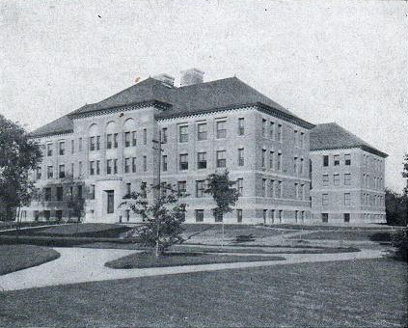
In America, a child’s address, more than any other factor, often determines what kind of public education he or she will receive.
Black School in Louisa County, Virginia, ca. 1935 (LOC/NAACP)
Cambridge, Massachusetts Latin School, 1916
(CHLS Yearbook)

Slide 6
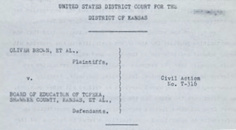
De Jure Segregation
Legal segregation of public schools by race banned nationwide in 1954 — separate, not equal
Unequal educational opportunities still exist for a variety of reasons

Slide 7
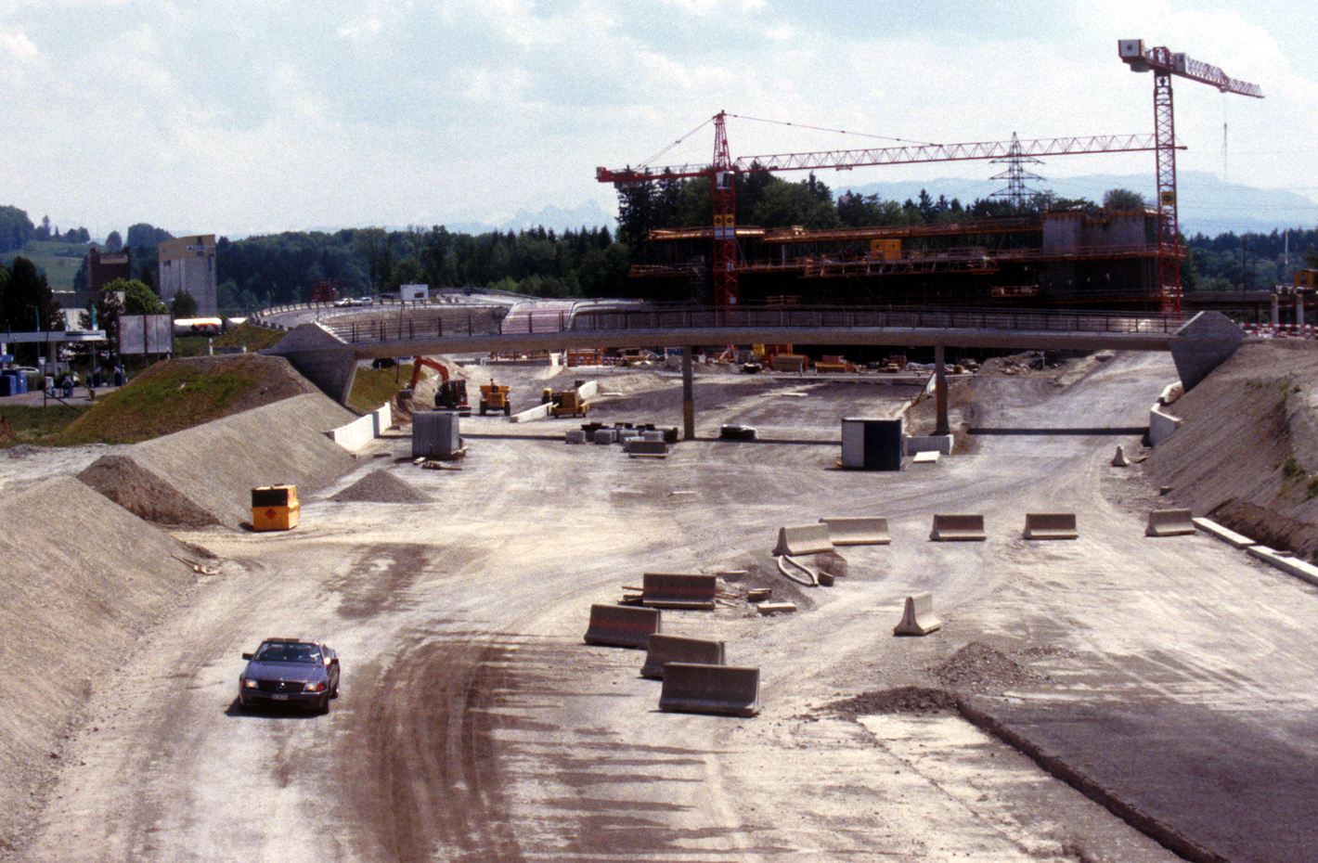
De Facto Segregation
Federal policies that expanded suburbs and facilitated “white flight” and job loss:
Mortgage assistance
Investment depreciation
Highway construction
Public housing
Urban renewal

Slide 8
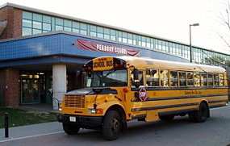
Disguised Segregation
Subtle school segregation can still exist:
Shifting school catchment areas
Building new schools in white/upper-class areas at the expense of existing facilities
Educational tracking of students

Slide 9
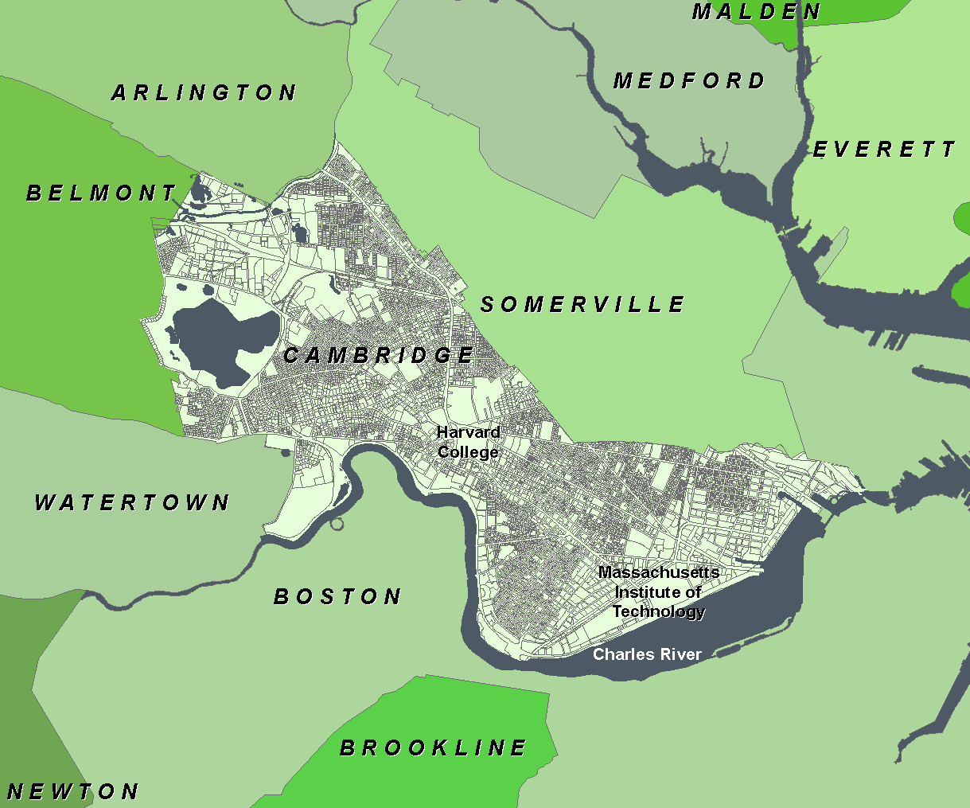
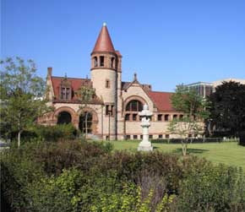
Cambridge, Massachusetts
A progressive city of 110,000 people
Black and Hispanic populations substantially increased in the late 20th century
1965: Schools already racially imbalanced
Year | Black Population
1940 | 4%
1960 | 5%
1970 | 7%
1980 | 11%
2000 | 12%
Cambridge Public Library

Slide 10
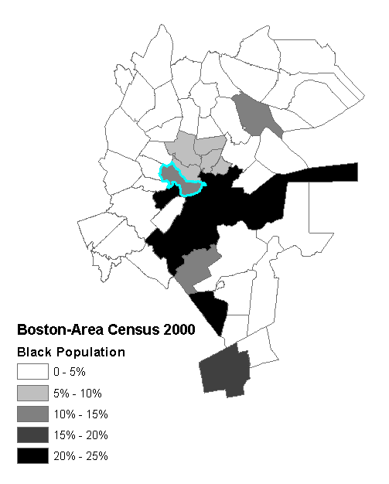
Learning GIS: Basic Skills
How does Cambridge compare to nearby communities?
Census.gov 1990 - 2010
NHGIS.org ≤ 1980

Slide 11
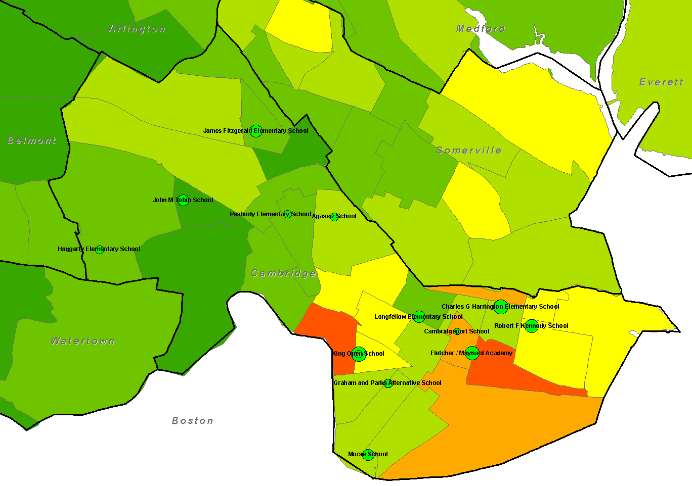
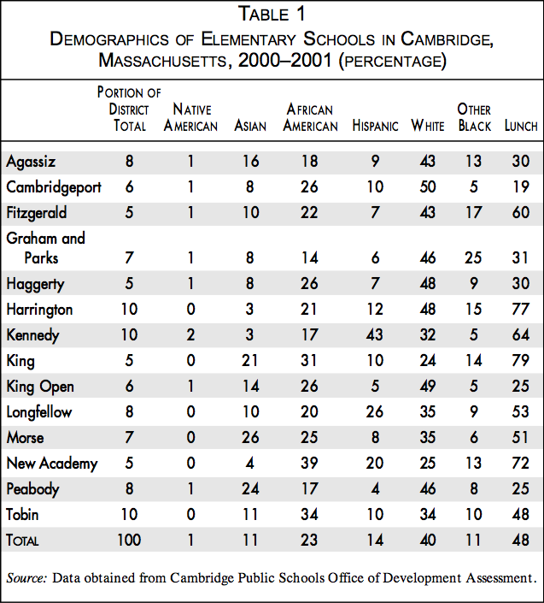
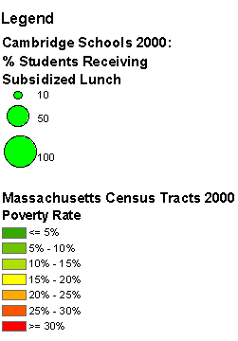
Creating GIS Data from Text

Slide 12
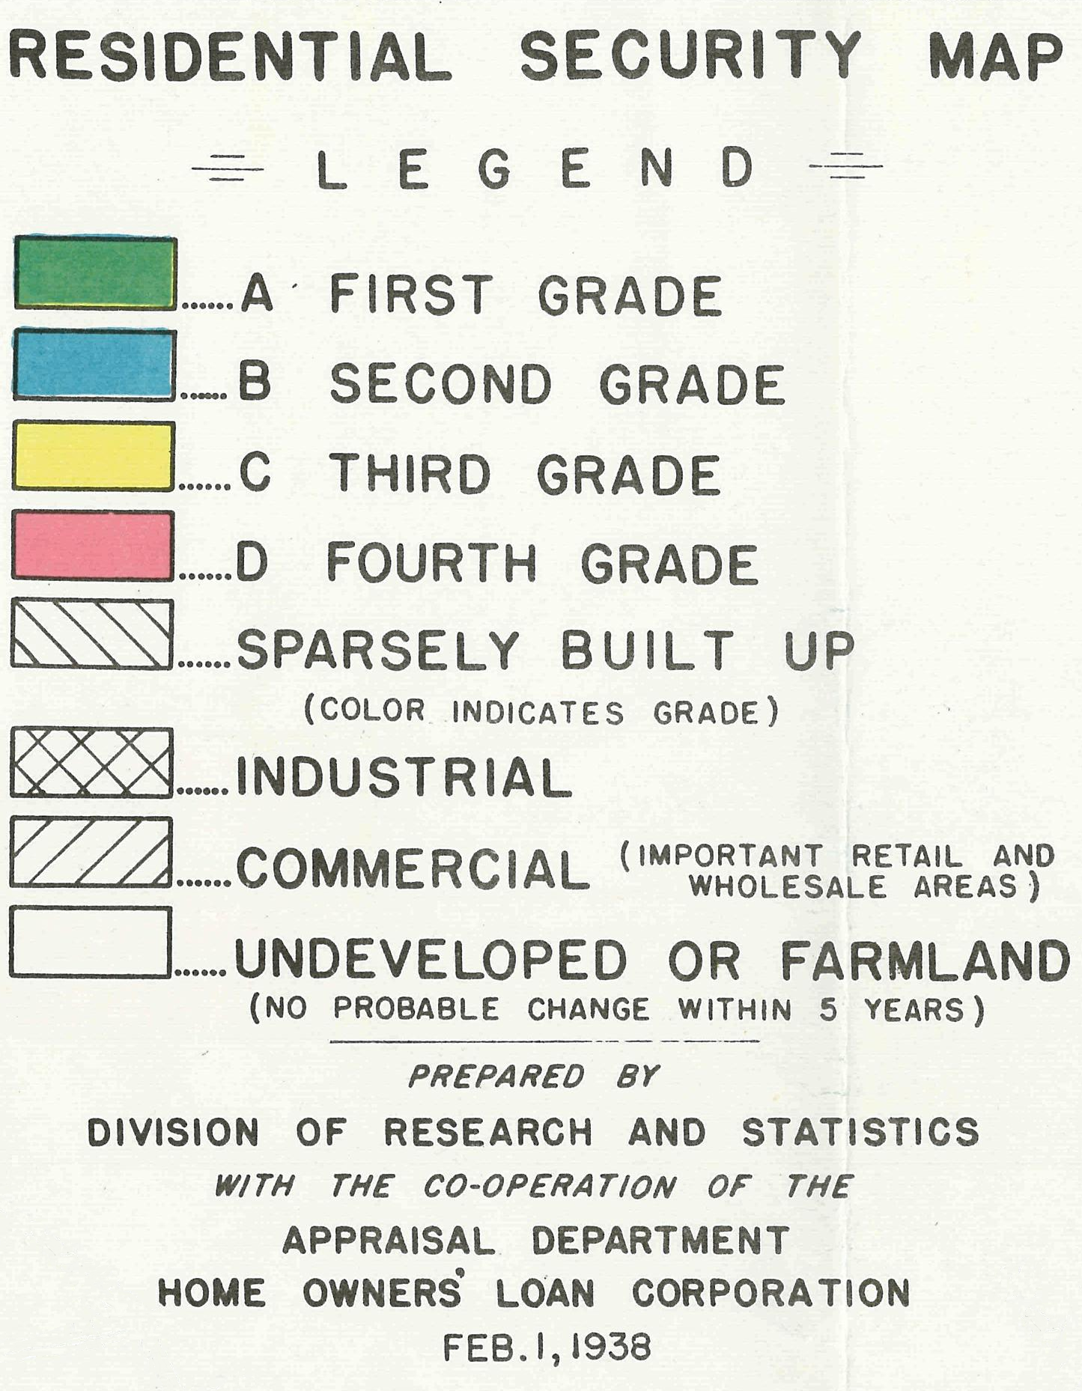
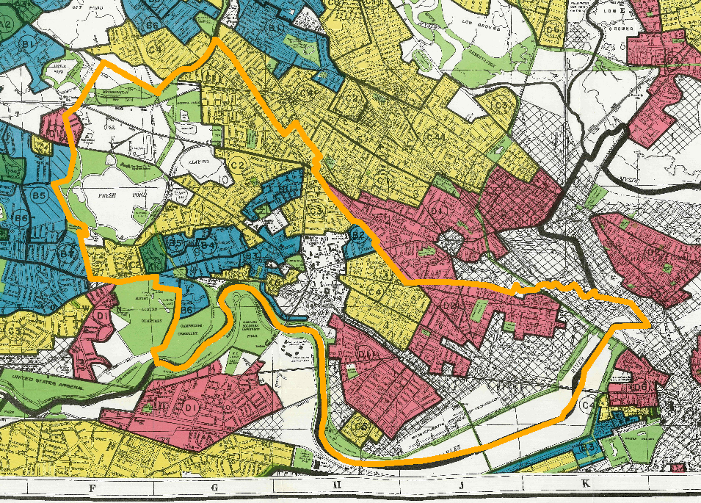
Georeferencing Historical Maps

Slide 13
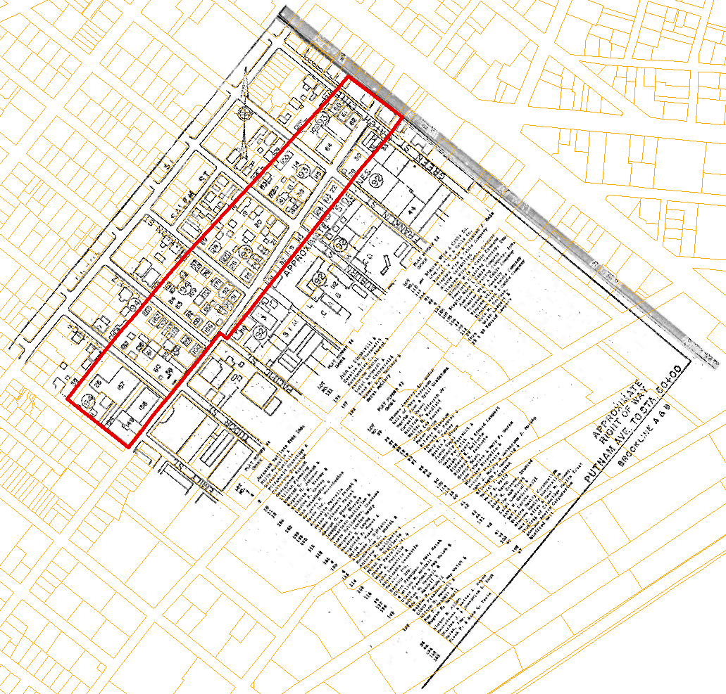
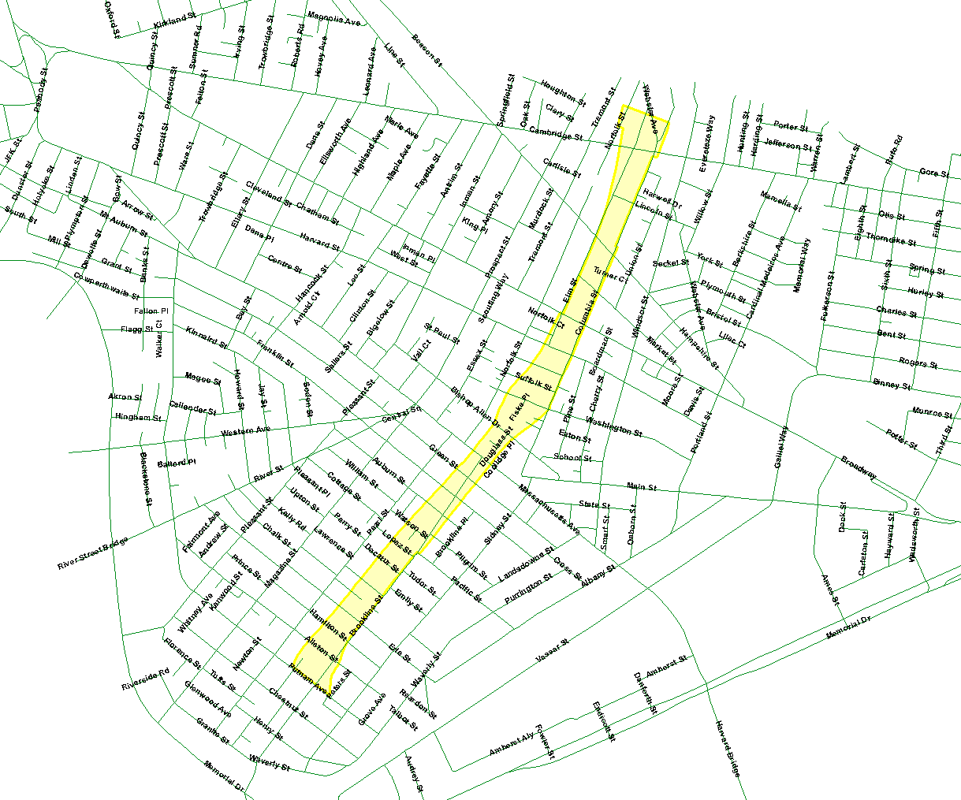
Extracting Map Features
Interstate 695: The “Inner Belt” through east Cambridge
1967 map of properties affected
Stopped in 1971

Slide 14
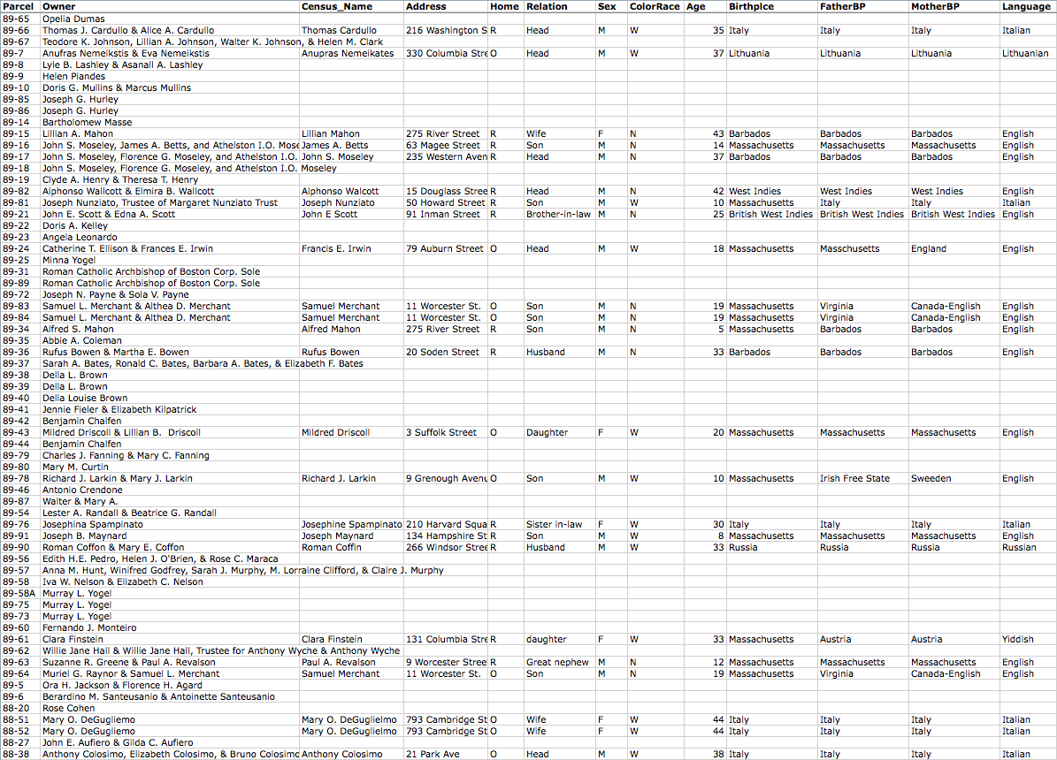
Compare families to the 1930 census!

Slide 15
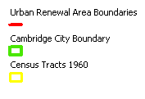
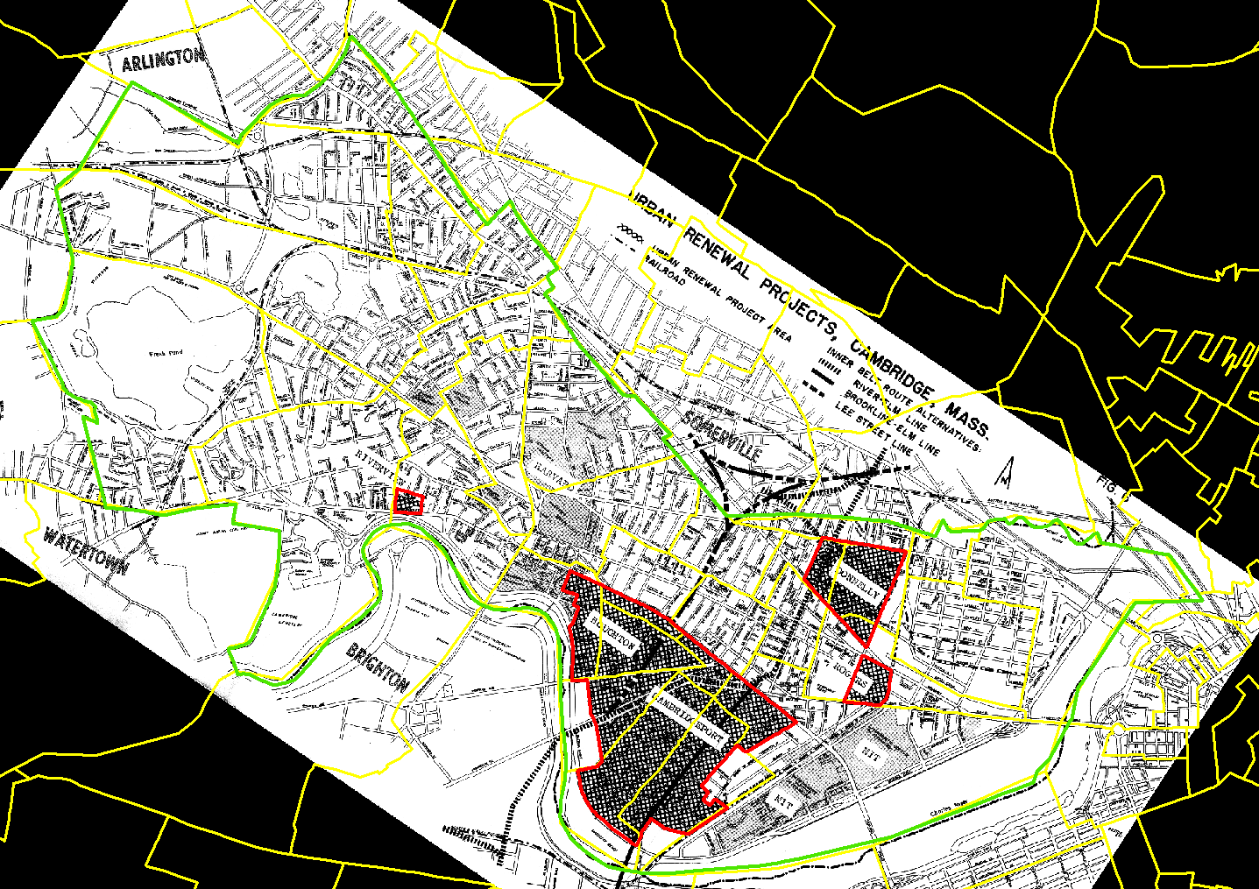
What Influences Urban Renewal?
Union
Dissolve
Area Calc

Slide 16
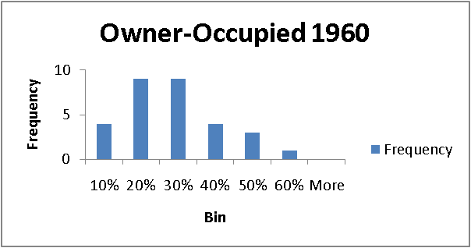
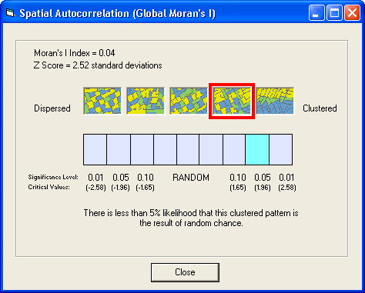
Possible Inputs to Urban Renewal
Data from the 1960 census:
Older Housing (Before 1940)
Housing Value
Owner-Occupied Housing
Negro Population
Data requirements:
Not cross-correlated: use Excel’s CORREL
Spatially auto-correlated: use ArcGIS’ Moran’s I
Negro Population 1960

Slide 17
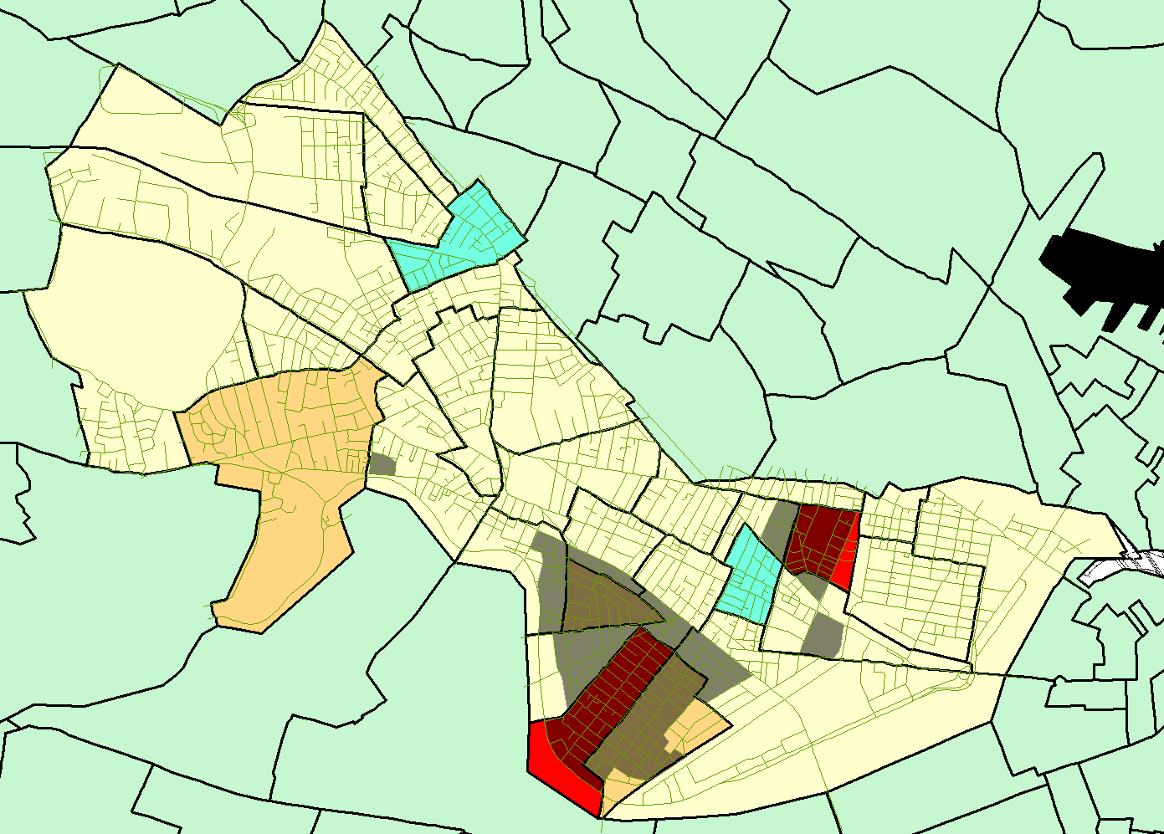
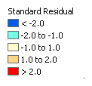
Geostatistical Analysis

Slide 18
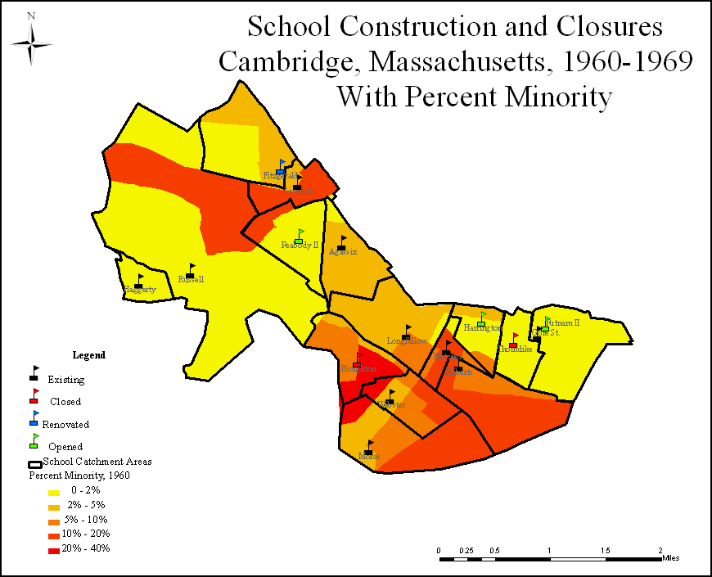
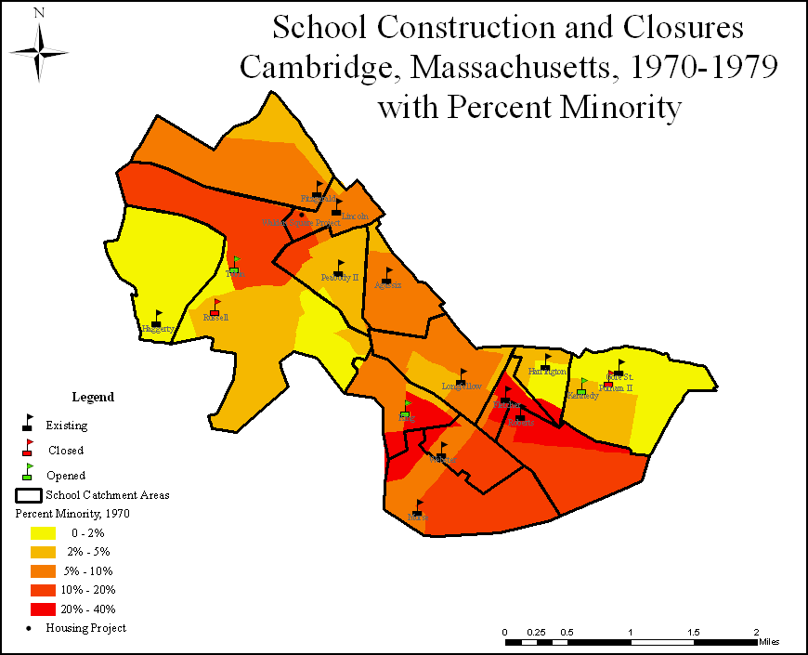
What Influenced School Building?
One of the eight student projects
Six new or reconstructed schools
Worst school, Fletcher, untouched

Slide 19
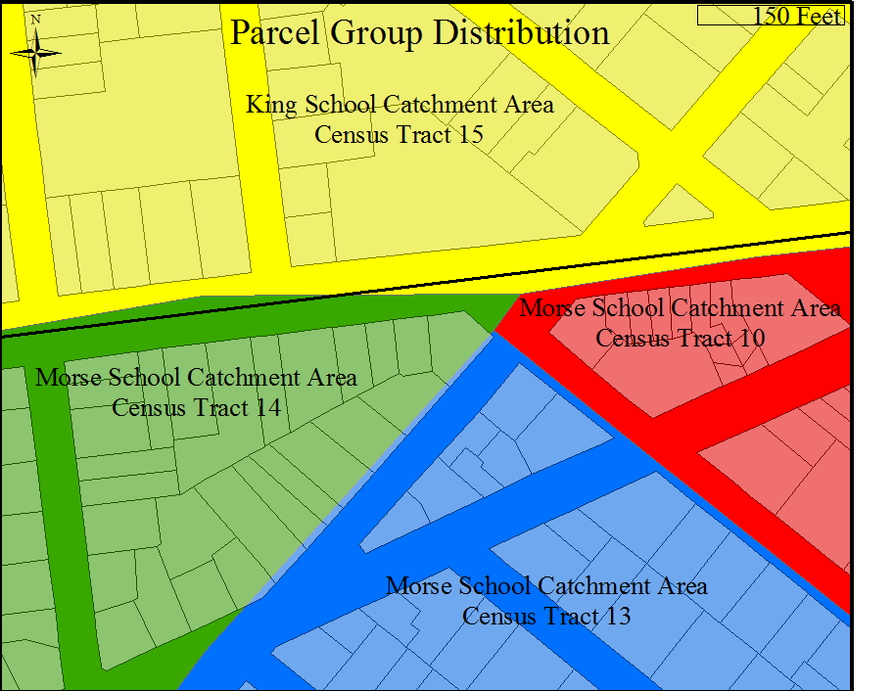
What Influenced School Building?
Parcel Analysis
Distribute census info by housing type on parcels
School District | Minority Reported | Minority from Census Analysis | Difference from Census Analysis
Putnam-Gore St. | 0 | 3 | 100.00%
Thorndike | 0 | 8 | 96.05%
Haggerty | 5 | 4 | -26.35%
Harrington | 47 | 59 | 19.54%
Fitzgerald | 77 | 90 | 14.26%
Longfellow | 65 | 77 | 15.34%
Agassiz | 31 | 30 | -3.63%
Peabody | 80 | 48 | -65.68%
Russell | 85 | 125 | 32.15%
Morse | 95 | 105 | 9.19%
Fletcher | 72 | 126 | 43.16%
Lincoln | 50 | 64 | 21.76%
Roberts | 191 | 74 | -157.95%
Webster | 152 | 110 | -38.59%
Houghton | 273 | 299 | 8.78%
Total | 1224 | 1222 | -0.14%
School District | Average Income
Russell | $14,339.69
Peabody | $12,250.89
Agassiz | $10,520.23
Haggerty | $8,881.98
Lincoln | $8,714.56
Longfellow | $8,337.93
Fitzgerald | $8,211.01
Webster | $7,613.17
Morse | $7,460.60
Putnam-Gore St. | $7,314.95
Roberts | $7,252.42
Fletcher | $7,239.24
Harrington | $6,960.14
Houghton | $6,959.93
Thorndike | $6,871.54

Slide 20
Thanks!
Cambridge GIS! Jeff Amero, et al.
Cambridge Assessor
Cambridge Historical Society
MIT Archives
National Historical GIS @ U. Minn

