Slide 1
To Plant, or Not to Plant?: That is Question: The Assisted Migration of Torreya taxifolia
http://eitantheactor.com/biopics/HamletSkull.jpg
Eric Pender & Carmella Guiol

Slide 2
Outline
Part I
Background of Torreya taxifolia
Issue at hand
Current events
Arguments for assisted migration
Part II
Advice for The U.S. Forest Service
Critique of Assisted Migration
Policy
Climate
Ecology/Biology
Conclusion
Notes:
EricPart II
Our advice for The U.S. Forest Service
Critique of pro assisted migration
Policy
Climate
Ecology/Biology
Conclusion

Slide 3
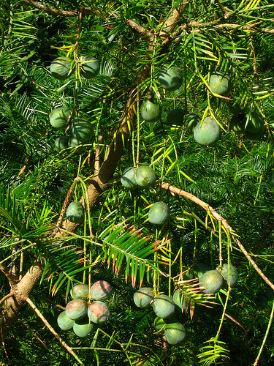
Background
Torreya taxifolia:
Endangered species of the genus Torreya, commonly referred to as the Stinking Cedar
Endemic species located in northern Florida, and southwestern Georgia
Notes:
(Carmella)

Slide 4
Issue at hand
The U.S. Forest Service is considering a proposal to begin planting Torreya seedlings on federal lands in North Carolina and Tennessee
Should this proposal be realized?
Notes:
(Eric)

Slide 5
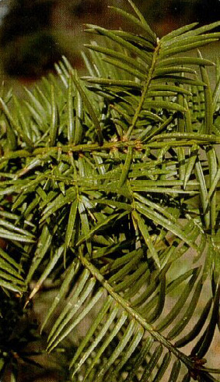
Current Events
The Torreya Guardians have begun planting Torreya taxifolia in forests of Georgia and North Carolina
Why? In attempts to restore the population of this endangered species
Notes:
(Carmella)

Slide 6
Arguments for Assisted Migration
Why is assisted migration a good idea for Torreya taxifolia (specifically):
Escape the tree fungus present in Florida
Expand the distribution of the tree North, as it is currently confined to Florida
The current threat of extinction due to global warming
Torreya taxifolia has low chance of becoming an invasive species
Notes:
(Eric)
It is thought that a tree fungus is responsible for the species’ dwindling numbers
The trees may be better adapt to the cooler climate of the northern east coast
slow growth rate

Slide 7
Part II: Advice for The U.S. Forest Service
Avoid assisted migration!
Do not begin planting Torreya seedlings on federal lands in North Carolina and Tennessee
Notes:
(Eric)

Slide 8
Critique of Assisted Migration: Policy
Implementation
Lack of regulation
The need to develop a criteria to measure success of future migrations
No extensive control assurances or monitoring systems
Sets a risky precedent for other species possibly in need of assisted migration.
Notes:
(Carmella)
Assisted migration has not been thoroughly implemented as of yet.
There is a lack of policy to regulate the introduction of new species into an area.
Must develop a criteria to justify future migrations and guidelines for appropriate assisted migration in order for this procedure to be successful in terms of biological diversity.
Necessary to implement extensive control assurances and monitoring systems

Slide 9
Critique of Assisted Migration: Climate
Based on unproven assumption about the species range & climate change
How can one predict regional climate changes?
What if species still die out?
Other possible environmental limiting factors
Notes:
(Carmella)
No empirical data to determine to what extent distribution is limited, questions the ideology behind assisted migration
Impossible to accurately predict regional climate changes.
Even optimistic estimates of natural movement may be insufficient for species to keep up with the climate.
Other factors should be taken into account, not just cool climate ex. (environmental, soil systems, disturbance regimes)

Slide 10
Critique of Assisted Migration: Ecology/Biology
Uncertain to the cause of species decline
Disease/global warming?
Unintentional Impacts on recipient ecosystem
earthfirst.com
Notes:
(Eric)
Still unsure about the initial culprit of extinction
-Not a good argument: the species is not overly susceptible to to any disease THEREFORE no guarantee that translocation will help
-This disease agent may still exist in new region of migration
Conservation concerns need to be taken into account for the recipient ecosystem (effects on food web/ competition with local specie/ spread of disease etc.)

Slide 11
Critique of Assisted Migration: Ecology/Biology
Extensive data is necessary (costly)
Possibility of becoming invasive
boxcarnv.blm.gov
boxcarmarketing.com
Notes:
(Carmella)
Need to develop a deeper understanding of the ecological dynamics that are at play here and which would therefore be disturbed by this introduction.
-Historical records should be consulted, a baseline for the forest community should be developed, and a target should be set. This would minimize or control the loss of native species.
2) No assurance that this species will not become invasive into the new habitat
-No way to recognize an invasion threat?
-Invasive species may not be detected for many years – there can be a lag of several decades between introduction and population explosion

Slide 12
Conclusion
Assisted migration is not the answer!
Alternative route
The drivers of Torreya taxifolia extinction are speculative
The potensial costs action > cost of inaction
Risks for recipient ecosystem are too great
Are you willing to gamble the health of the
ecosystems in North Carolina and Tennessee for
the off chance that Torreya taxifolia species will
recover?
Notes:
(Carmella) Efforts can and should be made to preserve isolated populations and design landscapes which facilitate the natural spread of the species
(Carmella) We do not know if the fungus or climate change actually effect the species (lack of empirical data)
(Eric) There is no immediate threat of extinction (scientists speculate the species will be around for 50-100 years)
(Eric)The health of the recipient ecosystem is arguably more important/valuable (intrinsically and extrinsically) that that of one individual species.

Slide 13
Thank You

