Slide 1
Cityscapes: An Online Discovery Tool for Urban and Cultural Studies
Harvard University Center for Geographic Analysis Annual Conference 2011
Andy Anderson
Academic Technology Services

Slide 2
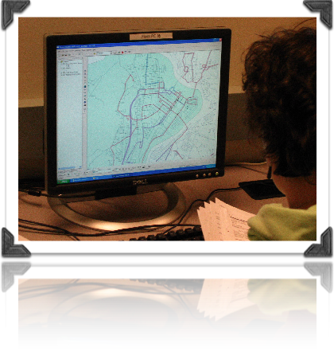
Presentation Overview
Amherst College & GIS
Cityscapes
Reinventing Tokyo
Imagining Paris
Image Processing
Georeferencing
Google Maps Tiling

Slide 3
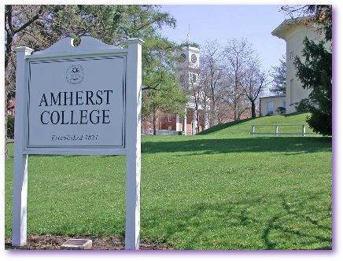
Amherst College and GIS
A liberal-arts college
1600 students, most in residence
1:8 faculty-student ratio
GIS Education:
Interterm Community-Based Course (9 in Jan. 2010, 3 in 2011)
Minor use regular in geology classes until last year (a visitor!)
Occasional use of Google Earth for classes and projects
Heaviest use for research, ~one thesis student a year

Slide 4
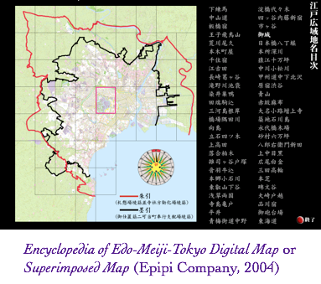
Simplifying Geographic Discovery
Most of our professors feel GIS is too time-consuming for casual use during a semester.
Some professors do understand the value of thinking geographically.
Could we provide an easier-to-use mapping app such as this one for Tokyo? ⊕ zooming ⊕ layering ⊖ CD-based ⊖ in Japanese ⊖ ¥¥

Slide 5
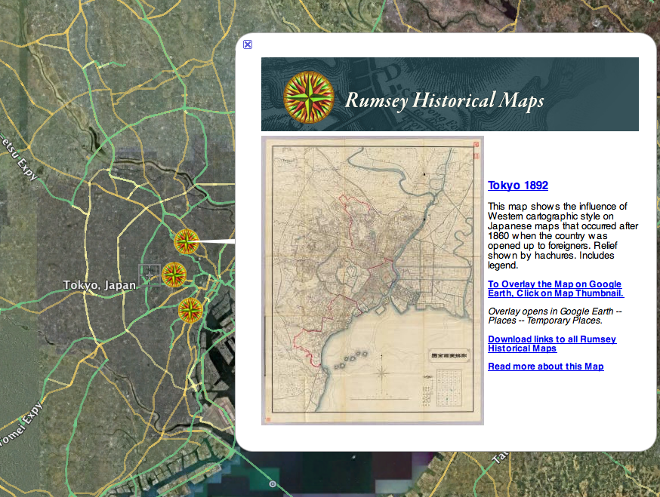
Google Tokyo
Could Google Earth and its Rumsey Historical Maps provide a similar service?
Students could also use it to build presentations with added content such as images, audio, and video.
⊕ zooming ⊕ layering+transparency ⊕ multimedia balloons ⊕ 3D buildings ⊕ semi-web-based ⊙ semi-georeferenced ⊖ HTML formatting

Slide 6
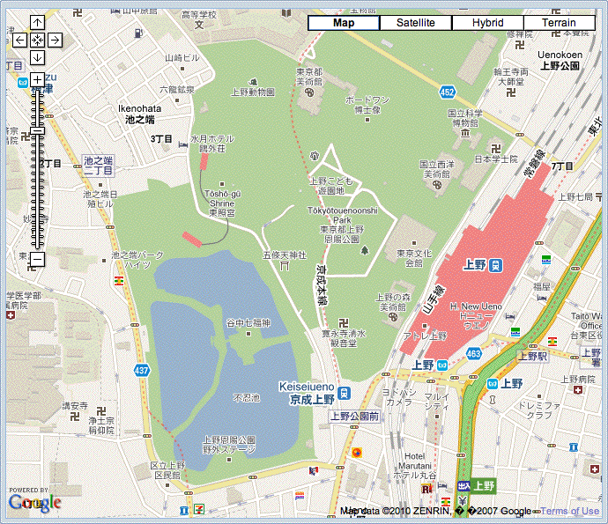
Cityscapes Map Platform
Google Map Open API:
Web-based
Zooming
Layering
Transparency
Markers
Satellite/Terrain

Slide 7
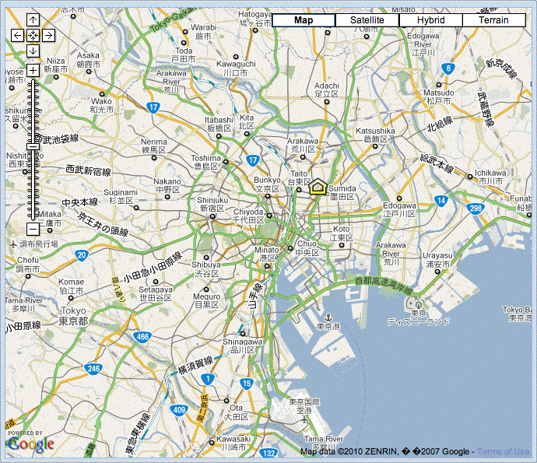
Cityscapes is Geohistorical
Allow students to investigate a city over time, e.g. Tokyo:
1680
1799
1858
1892
1945

Slide 8
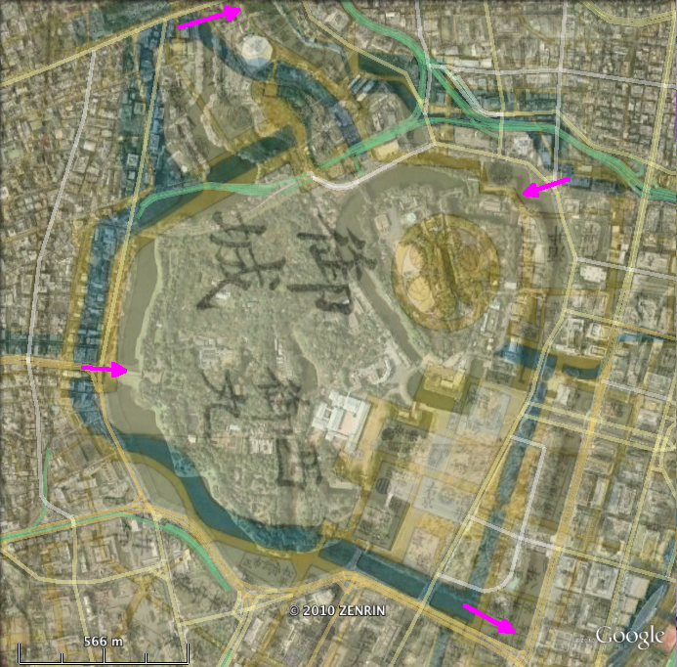
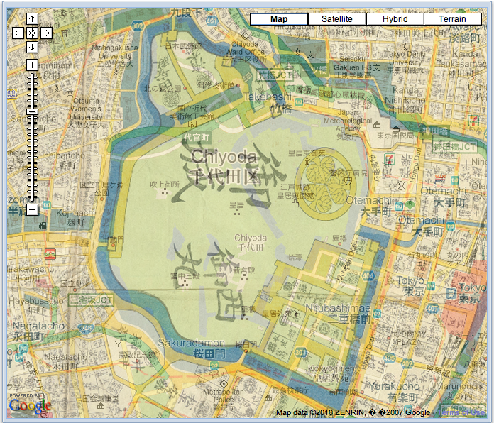
Cityscapes Historical Maps
Historical maps are closely georeferenced using ArcGIS Google Earth: Cityscapes:
Converted to Google format with open source Amherst GTiler

Slide 9
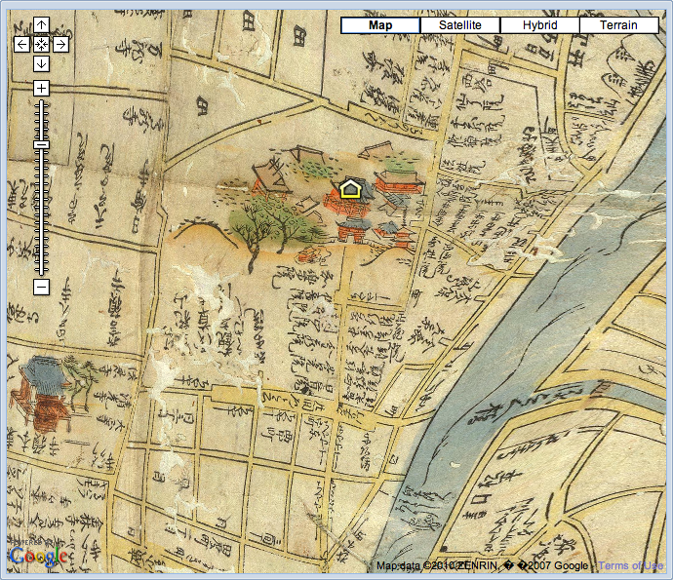
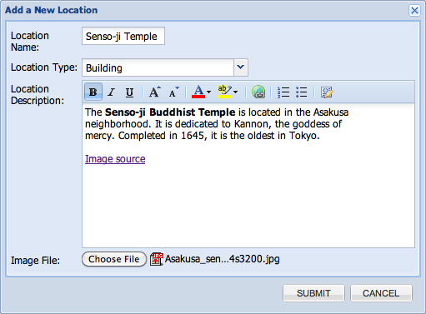
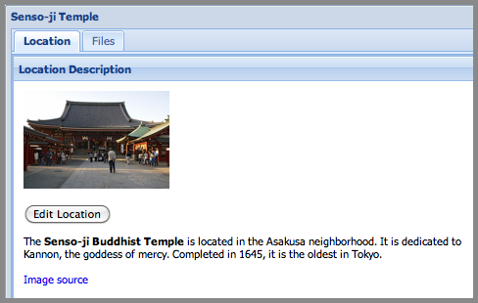
Cityscapes Location Balloons
Location balloons provide structured media inclusion
Dialogues don’t require knowledge of HTML.
Open source: Amherst aMapApp; Ext JS, PHP, and MySQL.
Notes:
9
The State of Open Source GIS, by Paul Ramsey 2007
These next few slides are taken from Paul Ramsey’s “The State of Open Source GIS”
Paul is very articulate in his explanation of OS Geospatial.
Fundamentally, successful OSS projects are not created by releasing free source code – they are created through the growth of communities
of shared interest.
The Open Source GIS space includes products to fill every level of the OpenGIS spatial data infrastructure stack. Existing products are now entering a phase of
rapid refinement and enhancement, using the core software structures that are already in place. Open Source software can provide a feature-complete alternative to proprietary software in most system designs.
Most of these applications are Free.
Free tools give you a proverbial fish; Open Source Tools teach you how to Fish
a key difference between geospatial software and other open source initiatives is that the software is no use without data, so looking at ways to create and maintain, share, and enable users to find, freely available geodata is also an important element of OSGeo's work, in addition to software.

Slide 10
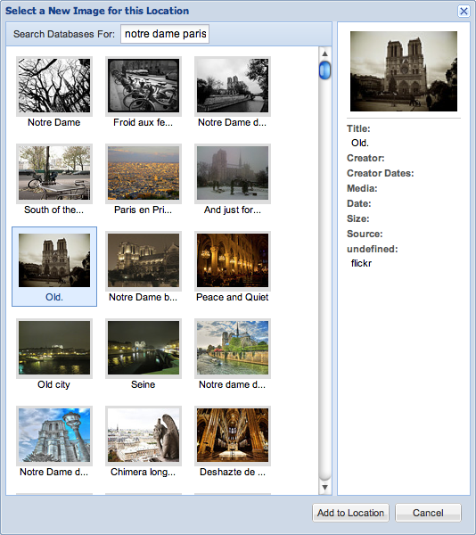
Cityscapes Multimedia
Location balloons link to an image database using thumbnails, and display them in a dedicated viewer.
Images can be from different collections:
DigiTool (Amherst)
Luna (Smith College)
Flickr (students & others)
Notes:
10
The Open Geospatial Consortium (OGC) is an international voluntary consensus standards organization. In the OGC, more than 330 commercial, governmental, nonprofit and research organizations worldwide collaborate in an open consensus process encouraging development and implementation of standards for geospatial content and services, GIS data processing and exchange. It was previously known as Open GIS Consortium.
The Open Source Geospatial Foundation (OSGeo), is a non-profit non-governmental organization whose mission is to support and promote the collaborative development of open geospatial technologies and data. The foundation was formed in February 2006 to provide financial, organizational and legal support to the broader Free and open source geospatial community. It will also serve as an independent legal entity to which community members can contribute code, funding and other resources, secure in the knowledge that their contributions will be maintained for public benefit.
OSGeo Educational Community is busy developing, collecting, and cataloging educational content
FOSSS4G: Free and Open Source Software for Geospatial
EPSG: European Petroleum Survey Group - provides code numbers for spatial projections. For example, 26986 = Massachusetts State Plane Mainland 1983 meters. 4326 = latitude/longitude

Slide 11
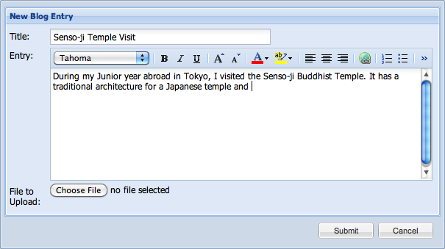
Cityscapes Location Blogging
Location balloons can have blogs associated with them, letting students converse about the location and included media.
Notes:
http://opengeo.org/publications/opengeo-architecture/

Slide 12
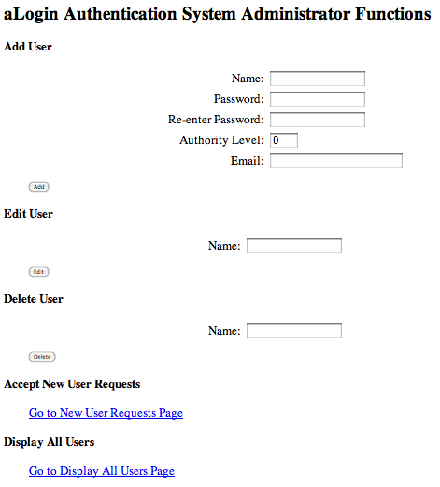
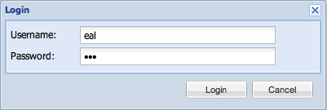
Cityscapes Access Control
Privacy of student projects is important.*
aMapApp location balloons are created outside of Google maps, so their content is not web-searchable.
Built-in access control and groups for classes.
* e.g. Family Educational Rights and Privacy Act (FERPA)
Notes:
http://opengeo.org/publications/opengeo-architecture/

Slide 13
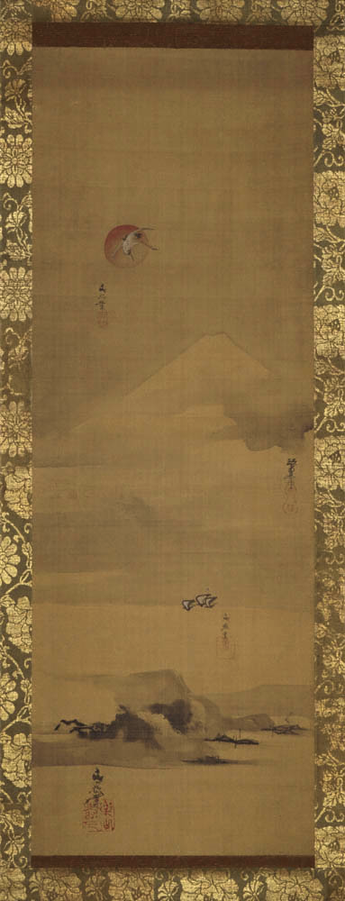
Cityscapes Tokyo http://ats.amherst.edu/tokyodemo
Reinventing Tokyo: The Art, Literature, and Politics of Japan's Modern Capital
“Tokyo is the political, cultural, and economic center of Japan, the largest urban conglomeration on the planet, holding 35 million people…. Since its founding 400 years ago, when a small fishing village became Edo, the castle headquarters of the Tokugawa shoguns, the city has been reinvented multiple times…”
Amherst College Professors Morse, Maxey, Van Compernolle
Fishing Village, Flying Crane,
and Mount Fuji
Notes:
http://opengeo.org/publications/opengeo-architecture/

Slide 14
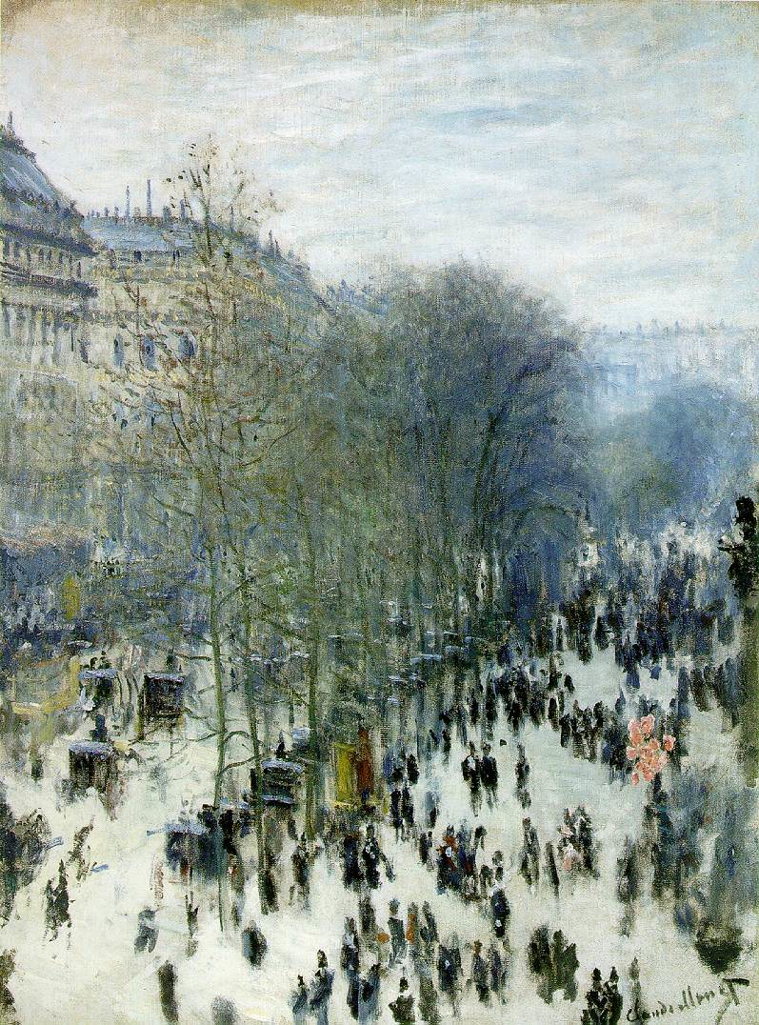
Cityscapes Paris http://ats.amherst.edu/parisdemo
Colloquia in French Studies: Paris, a Multi-Layered City
“An exploration of the cultural and urban development of Paris across time and in space with an emphasis on the 19th and 20th centuries. We will use an interactive digital platform to reconstruct the spaces, both real and imaginary, featured in novels, poetry, short stories, popular songs, visual documents, and maps that have evoked the city throughout its history. Works by Corneille, Maupassant, Baudelaire, Apollinaire, Desnos, Modiano, Vargas, Gavalda.”
Smith College Professor Visentin
Boulevard des Capucines, Paris
Claude Monet, 1873
Notes:
http://opengeo.org/publications/opengeo-architecture/

Slide 15
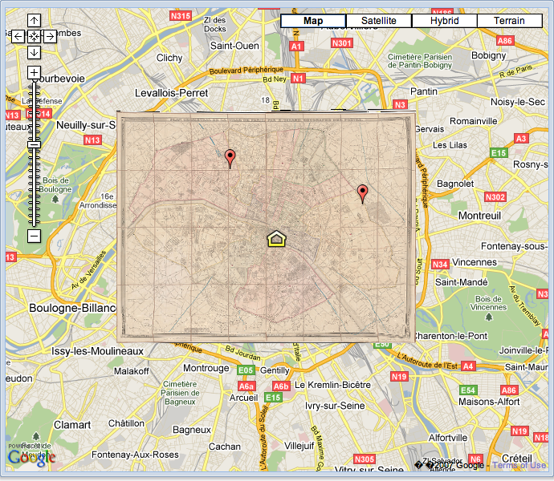
Cityscapes Paris http://ats.amherst.edu/parisdemo
Pariscape: Imagining Paris in the Twentieth Century
“Paris has been for centuries one of the exemplary sites of our urban sensibility, a city that has indelibly and controversially influenced the twentieth-century imagination. Poets, novelists and essayists, painters, photographers and film-makers: all have made use of Paris and its cityscape to examine relationships among technology, literature, city planning, art, social organizations, politics and what we might call the urban imagination.”
Amherst College Professor Rosbottom
Notes:
http://opengeo.org/publications/opengeo-architecture/

Slide 16
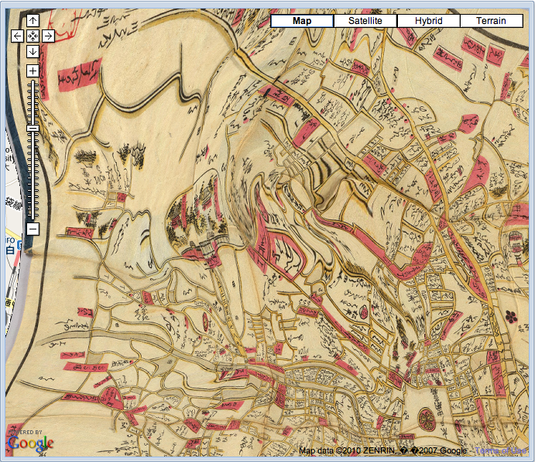
Cityscapes Issues
Some negatives of the platform: ⊖ many staff hours ⊖ occasional bugs ⊖ no 3D buildings (as of yet) ⊖ some maps are topologically incorrect (e.g. see the right). ⊖ many digital images obtained from other libraries, who sometimes claim copyright — getting permission to open to the public is problematic.
Notes:
http://opengeo.org/publications/opengeo-architecture/

Slide 17
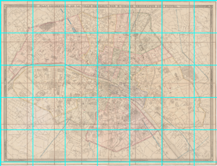
Map Image Processing
Images were downloaded at the highest available resolution.
Typically images were limited to disjoint pieces ~2048 pixels², e.g.: http://ids.lib.harvard.edu/ids/view/Converter?id=7157748&c=jpgnocap&s=1&r=0&x=0&y=0&w=2400&h=2400
These needed to be stitched together with Photoshop, etc., and trimmed of unnecessary margins.
The resulting maps were usually on the order of 10K pixels², with a scale of 1-2 meters per pixel.
Notes:
http://opengeo.org/publications/opengeo-architecture/

Slide 18
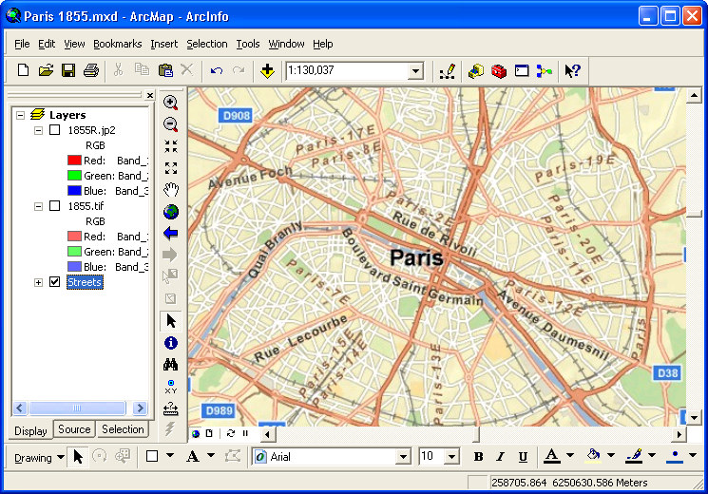
Georeferencing with ArcGIS
ArcGIS is a very convenient platform for georeferencing images to a map background.
Best to use the projection WGS84 Web Mercator (Auxiliary Sphere) to georeference, since that’s what Google uses. Don’t use “Google Mercator”!
As a background, the ArcGIS Map Service World Street Map had great performance.
Notes:
http://opengeo.org/publications/opengeo-architecture/

Slide 19
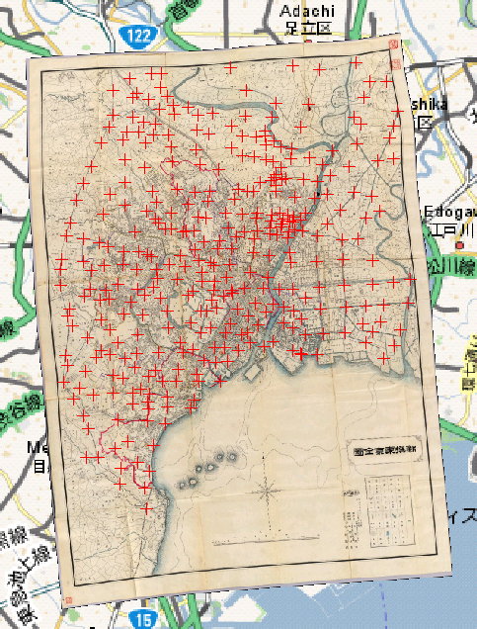
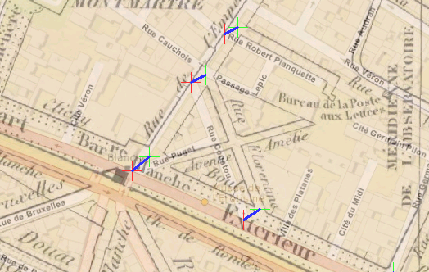
Georeferencing: Control Points
Control points align two maps at locations that are recognizable on both:
The Cityscapes maps varied from having many hundreds to several thousands of control points!
Notes:
http://opengeo.org/publications/opengeo-architecture/

Slide 20
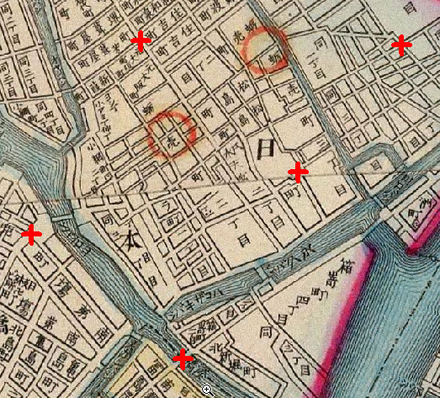
Georeferencing: Link Choice
Streets are recognized by their pattern of connections, so intersections are by far the most important locations to add control points.
Not all intersections necessary, if they’re close enough.
Urban areas require more control points to help distinguish adjacent streets.
Intersections with railroads, rivers, streams, and canals can also be used.
Notes:
http://opengeo.org/publications/opengeo-architecture/

Slide 21
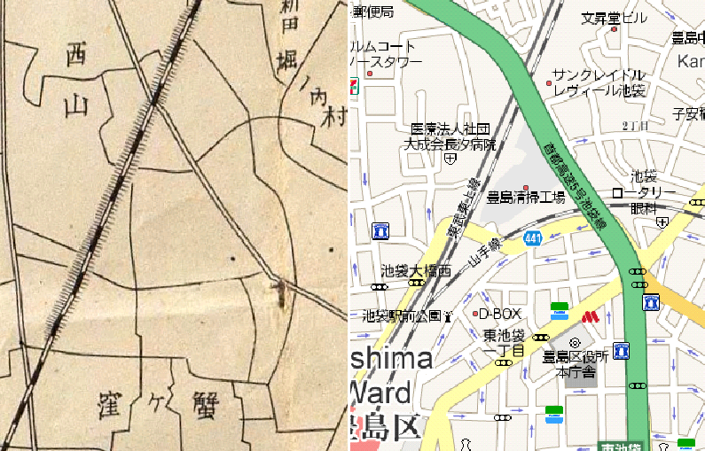
Georeferencing: Cautions
Seldom will streets on two maps completely align; if the difference is small or extreme, leave as-is.
Streets, railroads, and rivers can all change over time!
Streets are often built and rerouted; rivers meander.
Deliberate abstractions are common!
Roads and railroads on a printed map are often widened to be distinguishable, which can “bump” other features.
Notes:
http://opengeo.org/publications/opengeo-architecture/

Slide 22
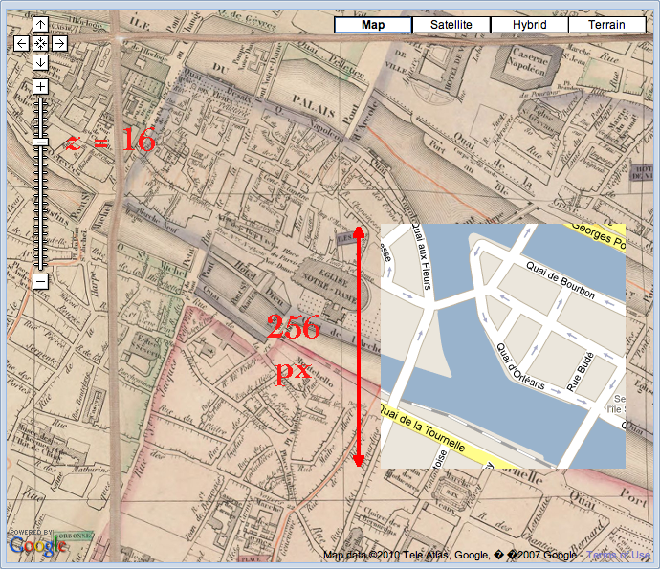
Google Tiles
Google tiles are square and 256 = 2⁸ pixels across.
The Mercator pixel size is: cellSize(z) = 2π r / 2^{z+8} where r = 6378137 m is the equatorial radius, and z is the Google zoom level.
By definition, z = 0 produces a single tile covering the Earth exclusive of the polar regions (a distance of 2π r).
Incrementing the zoom level doubles the number of tiles.
The zoom levels for large cities like Tokyo or Paris range from about 17 (1.2 m/px) to 7 (1.2 Km/px).
Notes:
http://opengeo.org/publications/opengeo-architecture/

Slide 23
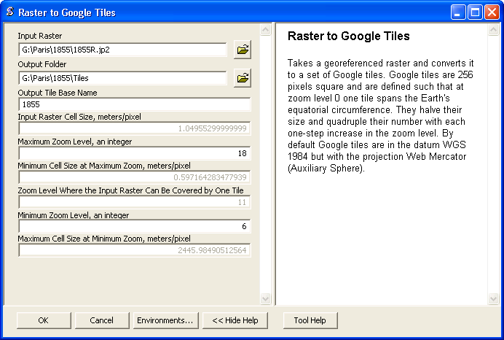
GTiler Script
Tiling a georeferenced and rescaled image can be effected with programs such as Photoshop, etc.
But, to automate the process, I wrote a Python script.
Notes:
http://opengeo.org/publications/opengeo-architecture/

Slide 24
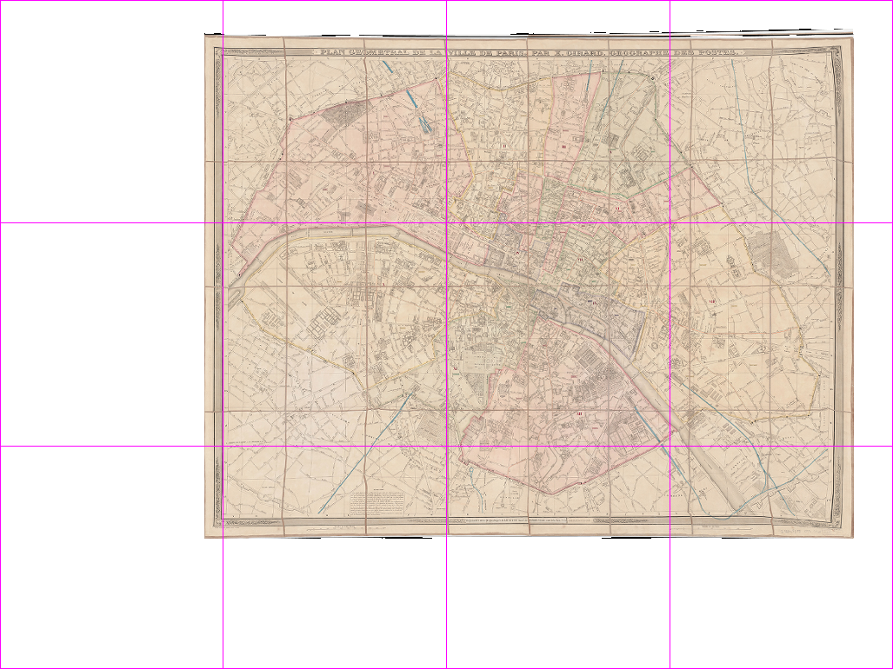
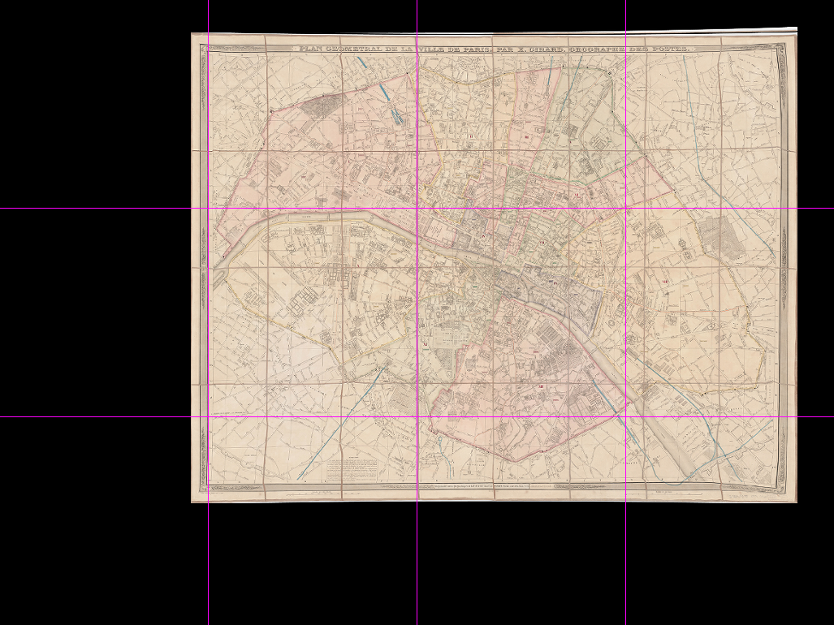
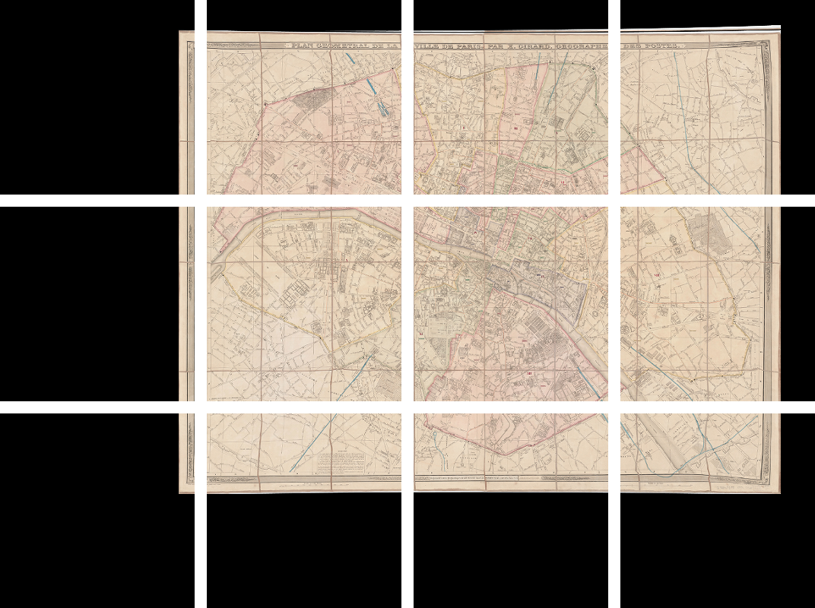
GTiler Procedure
1. User-georeferenced map:
3. Map & background mosaic:
2. Tile-referenced background:
4. Mosaic tiles:
Notes:
http://opengeo.org/publications/opengeo-architecture/

Slide 25
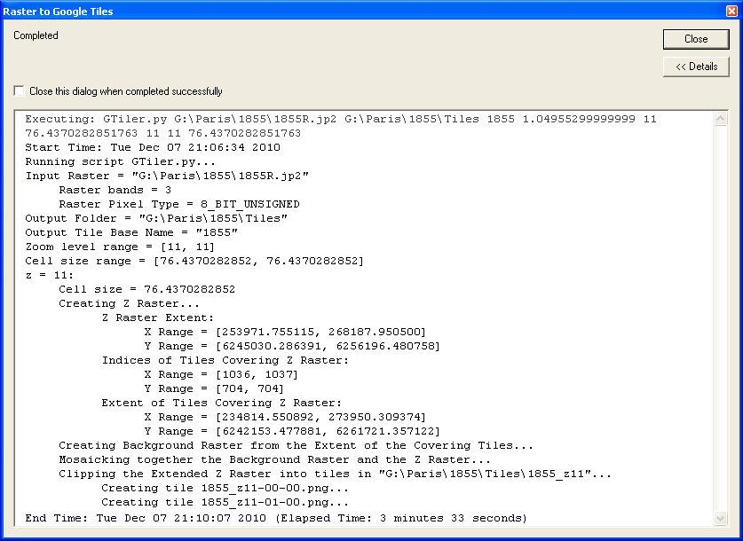
GTiler Execution
Notes:
http://opengeo.org/publications/opengeo-architecture/

Slide 26
Amherst Mapping App
aMapApp uses the Google Maps API, directing it to use the tiles from the local web server to build a combined map.
aMapApp is a light-weight framework, requiring: • PHP • MySQL
A small amount of configuration, e.g. require_once "/path_to_config_file/your_config_file.php";
A simple API — if you want to extend its behavior, e.g. newLocation(configObject)
Notes:
http://opengeo.org/publications/opengeo-architecture/

Slide 27
Cityscapes Team
Inspiration: Professors Sam Morse and Hélène Visentin
Organizer: Scott Payne, Director of Academic Technology Services at Amherst College
Historical Map Georeferencing: Andy Anderson, ATS; Zoë Zaferiou and Jon Caris, Smith College
GTiler Creation: Andy Anderson, ATS
aMapApp Creation: Paul Chapin, ATS
Image Database Interface: Miodrag Glumac, ATS
Historical Maps: Smith College, Harvard University, University of California at Berkeley, David Rumsey Map Collection
Notes:
http://opengeo.org/publications/opengeo-architecture/

