Slide 1
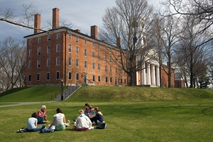
Collaborative Research as Pedagogy Amherst College
Andy Anderson, Academic Technology Specialist
Anston Bosman, Associate Professor of English
Nicola Courtright, Professor of Art History and Associate Dean of the Faculty
Chris Dole, Assistant Professor of Anthropology
Luca Grillo, Assistant Professor of Classics
Hilary Moss, Assistant Professor of History and Black Studies [in absentia]
Boris Wolfson, Assistant Professor of Russian
Liberal Arts Education, Collaborative Research, and the Humanities — Swarthmore College 4/8/2011

Slide 2
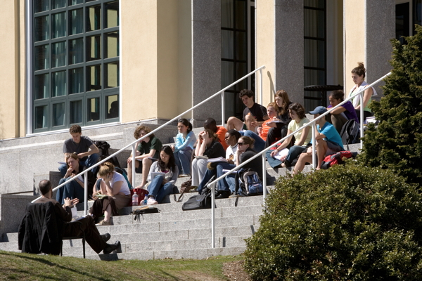
Collaborative Research
as Pedagogy
Overview
Background of the Mellon-funded collaborative research project (Nicola)
The project itself; Two different kinds of courses:
Sophomore Tutorial
Pre-Thesis Research Tutorial
Inventing and teaching our courses:
Current (Luca, Andy)
Future (Chris, Boris)
Discussion: What does collaboration mean for us? Problems, pitfalls, rewards
Liberal Arts Education, Collaborative Research, and the Humanities — Swarthmore College 4/8/2011

Slide 3
Cities, Schools, and Space
A research seminar designed to expose students to a range of methodologies, including archival analysis, oral interviews, and geographic information systems.
Hilary Moss (History and Black Studies)
Andy Anderson (Academic Technology Services)
Liberal Arts Education, Collaborative Research, and the Humanities — Swarthmore College 4/8/2011

Slide 4
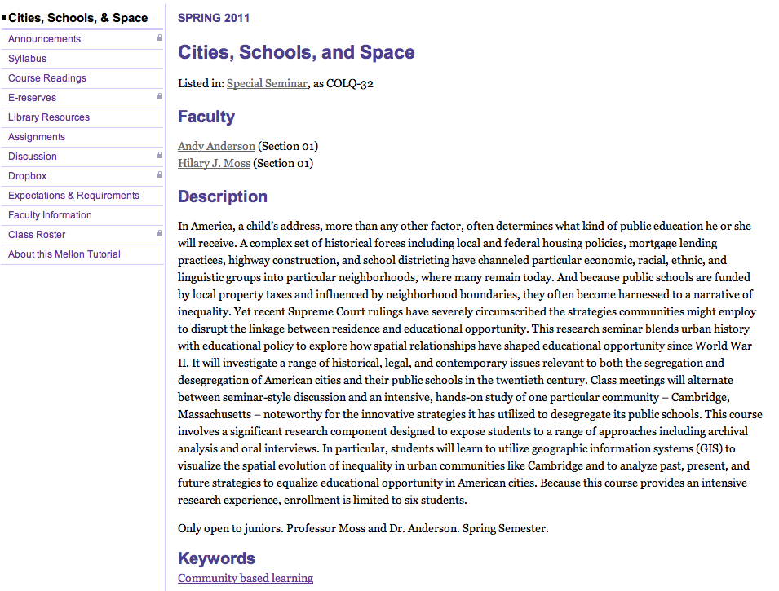
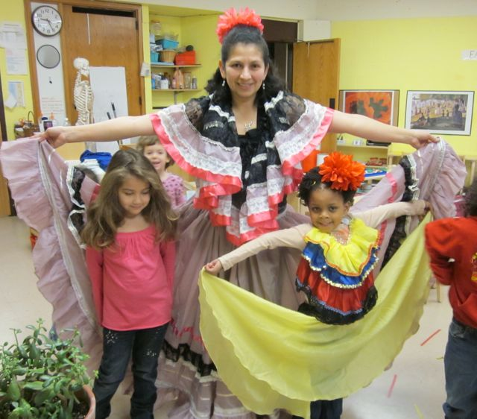
Students and parent at Tobin School, Cambridge
Web Page

Slide 5
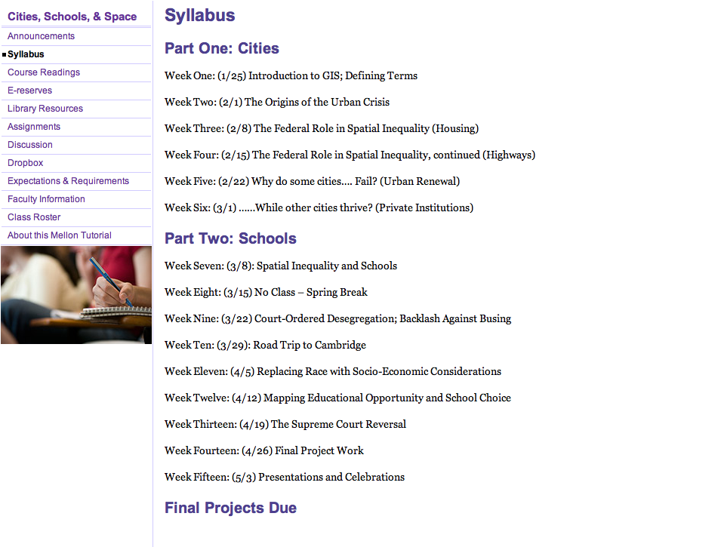
Web Page

Slide 6
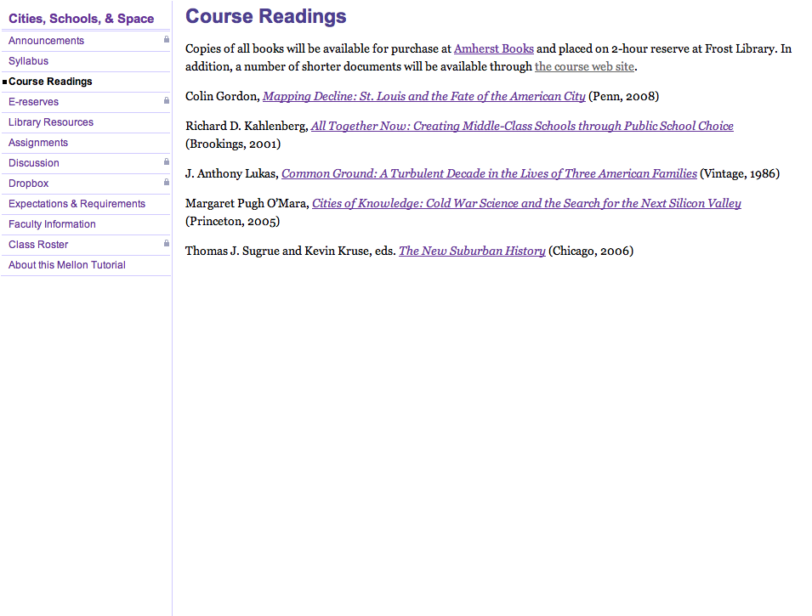
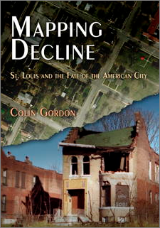
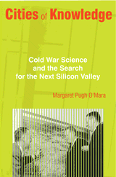
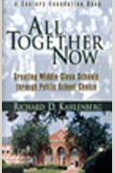
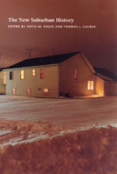
Web Page

Slide 7
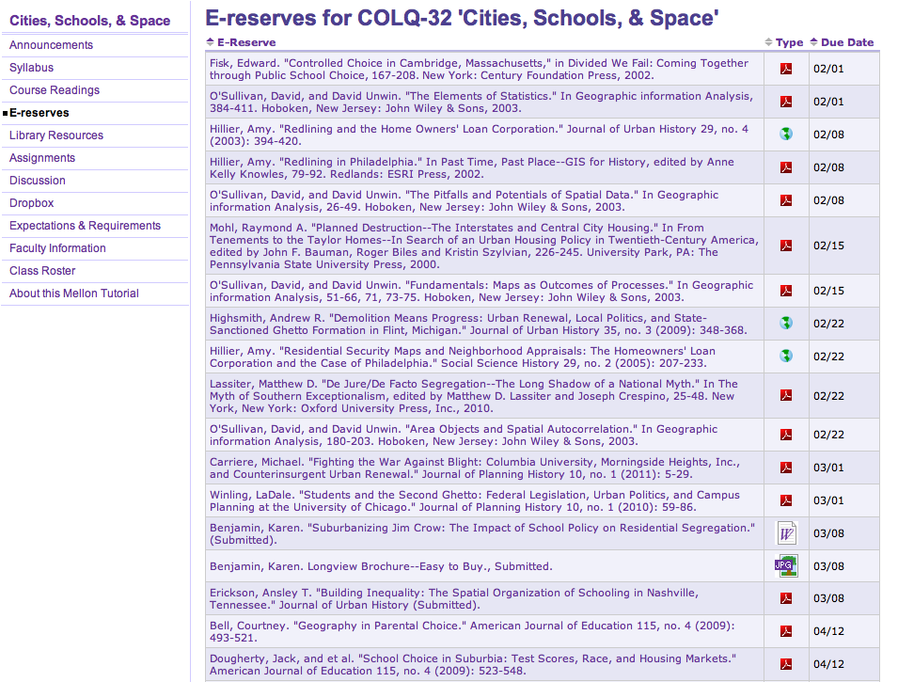
Web Page
(Restricted)

Slide 8
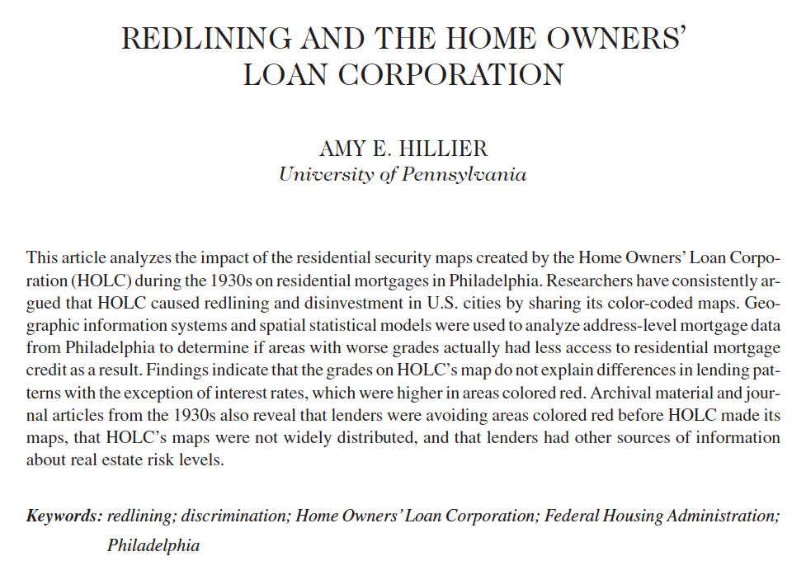
Web Page

Slide 9
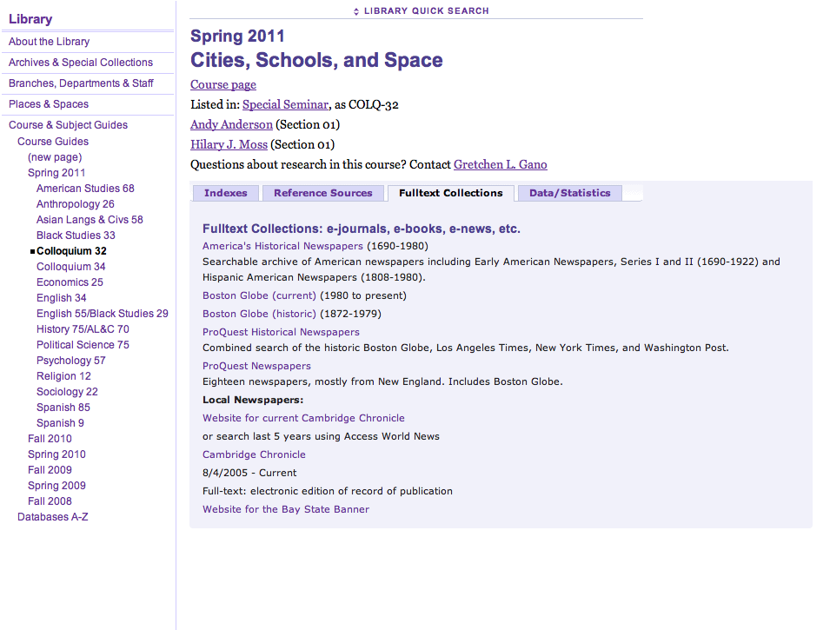
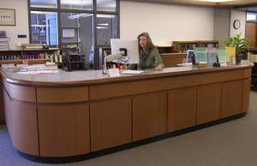
Web Page

Slide 10
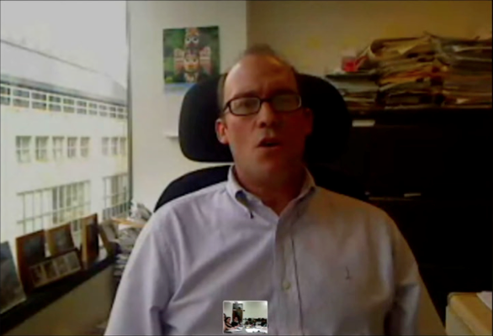
Richard Kahlenberg
The Century Foundation
Click on the image to the left to start a video snippet of a student interview in a web browser (if gibberish appears, reload the page).
Web Page

Slide 11
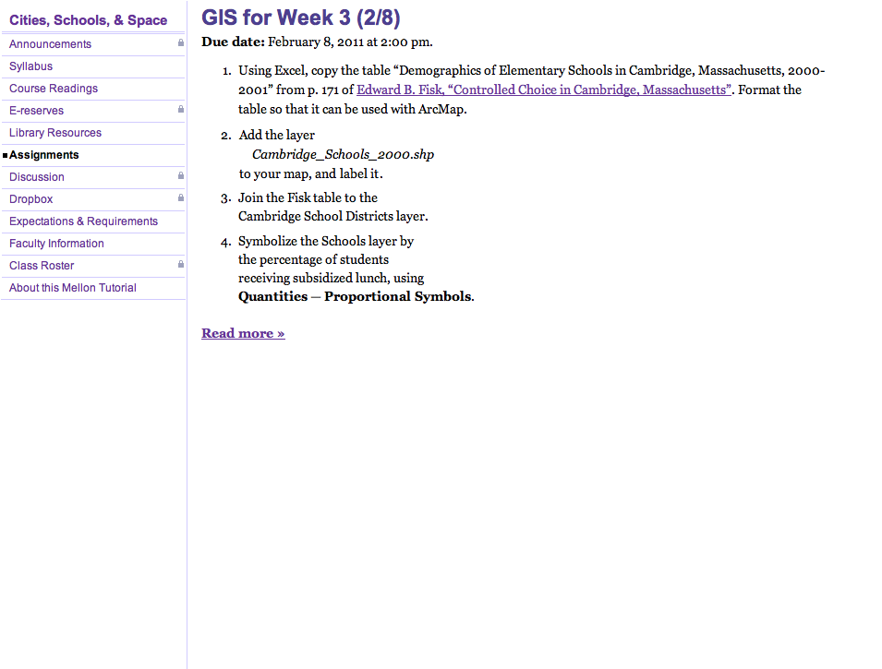
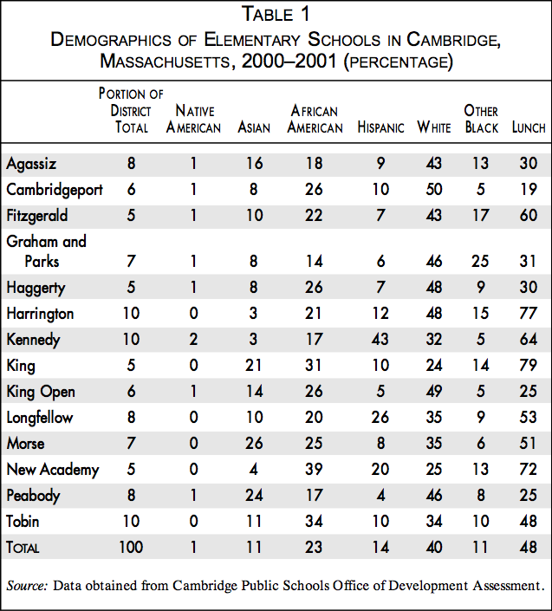
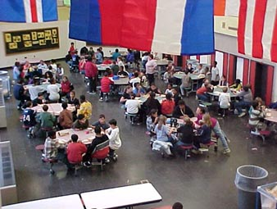
Tobin School Cafeteria, Cambridge
Web Page

Slide 12
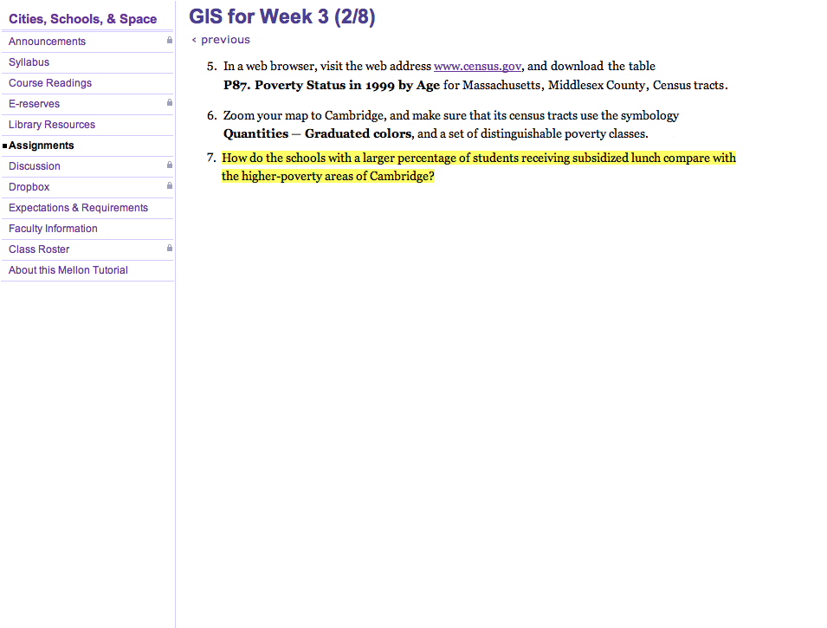
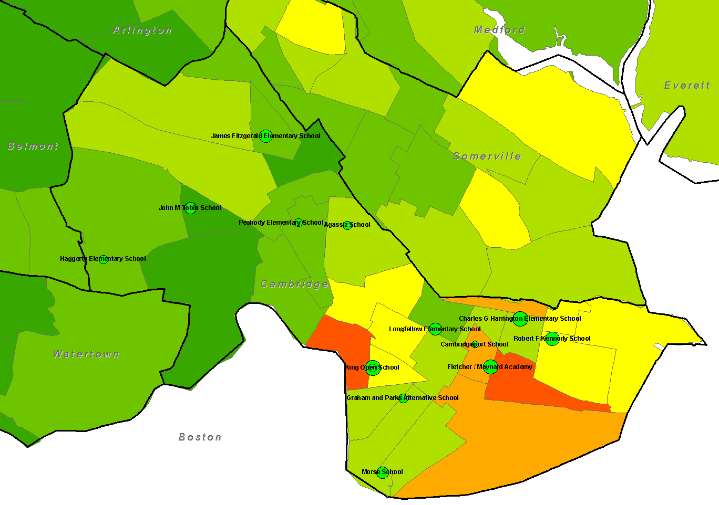
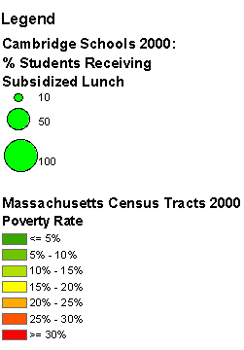
Web Page

Slide 13
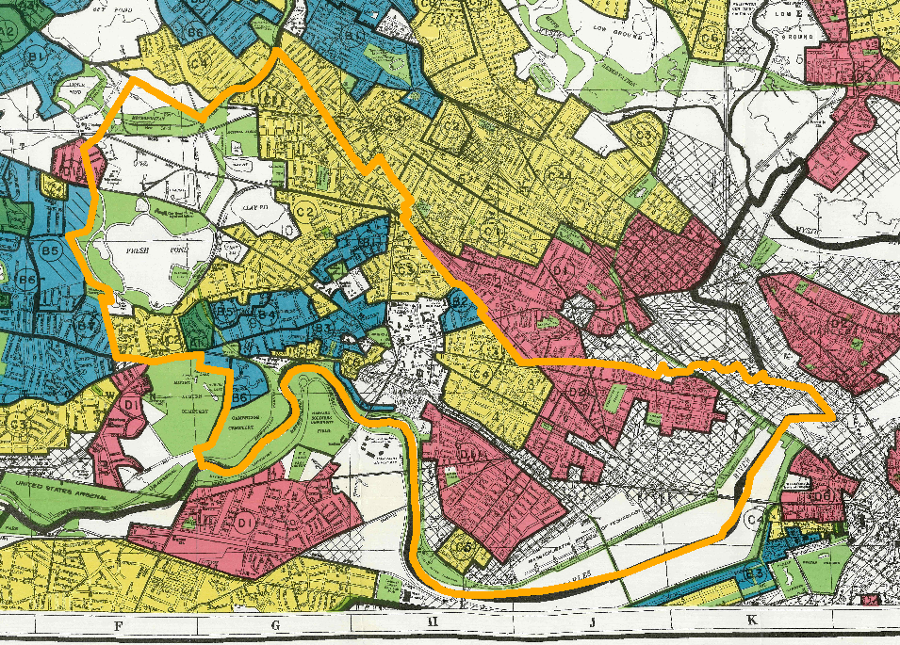
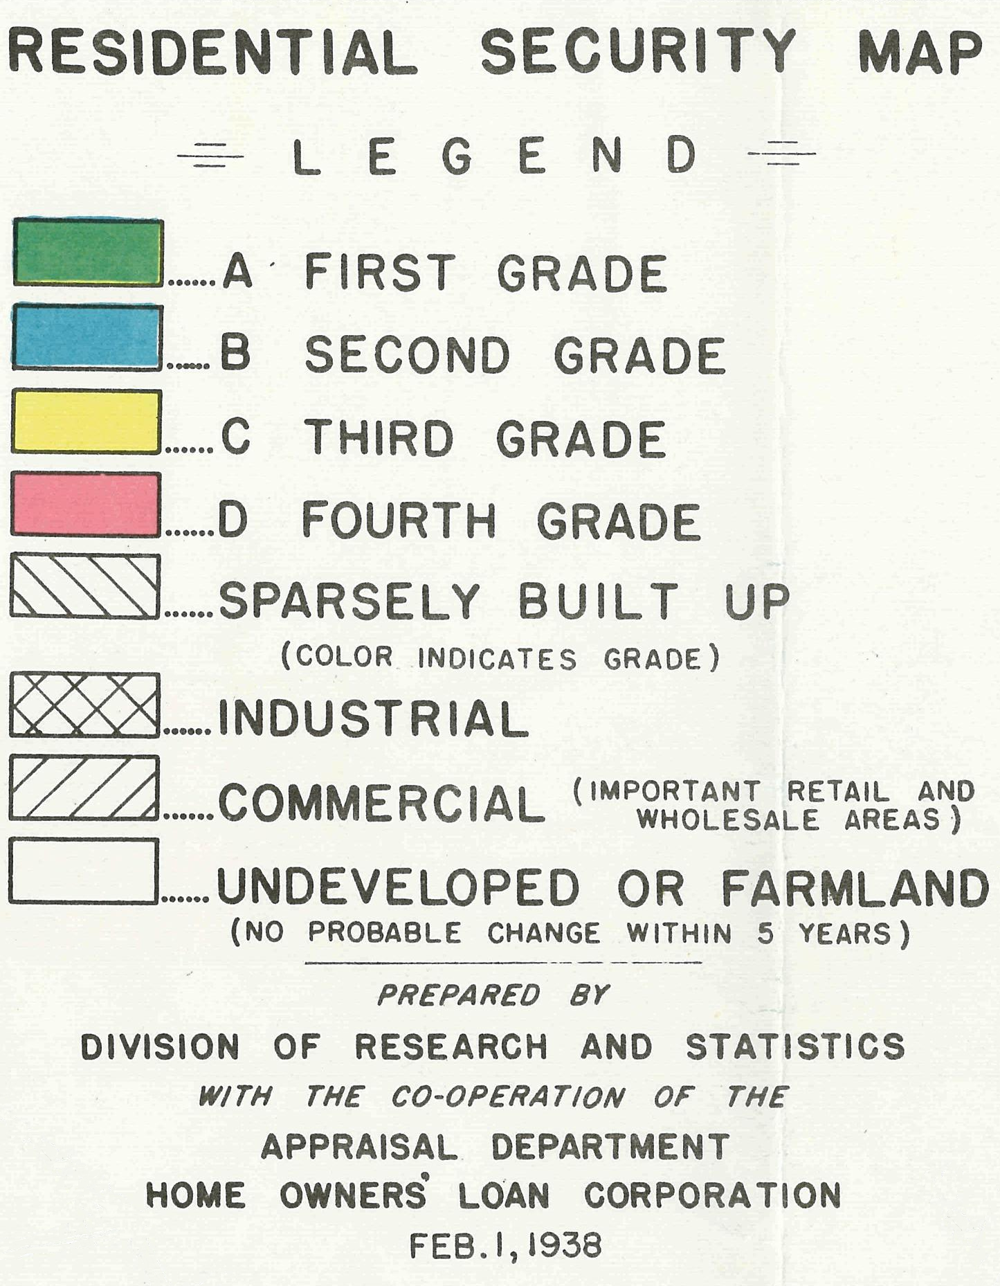
Web Page

Slide 14
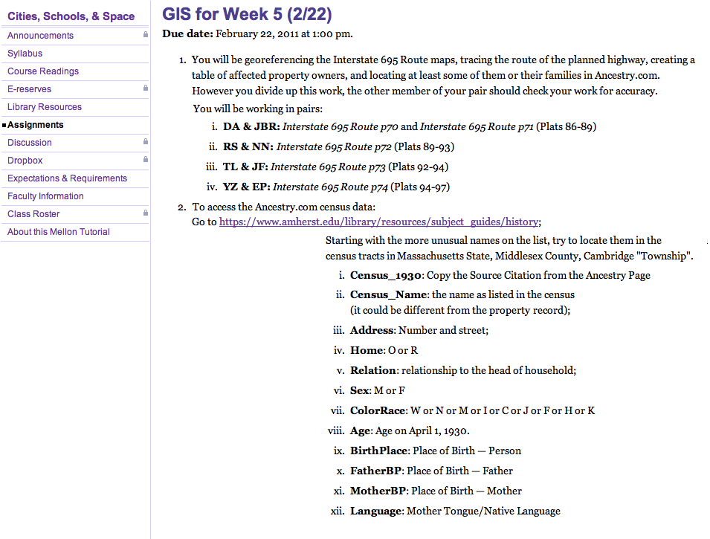
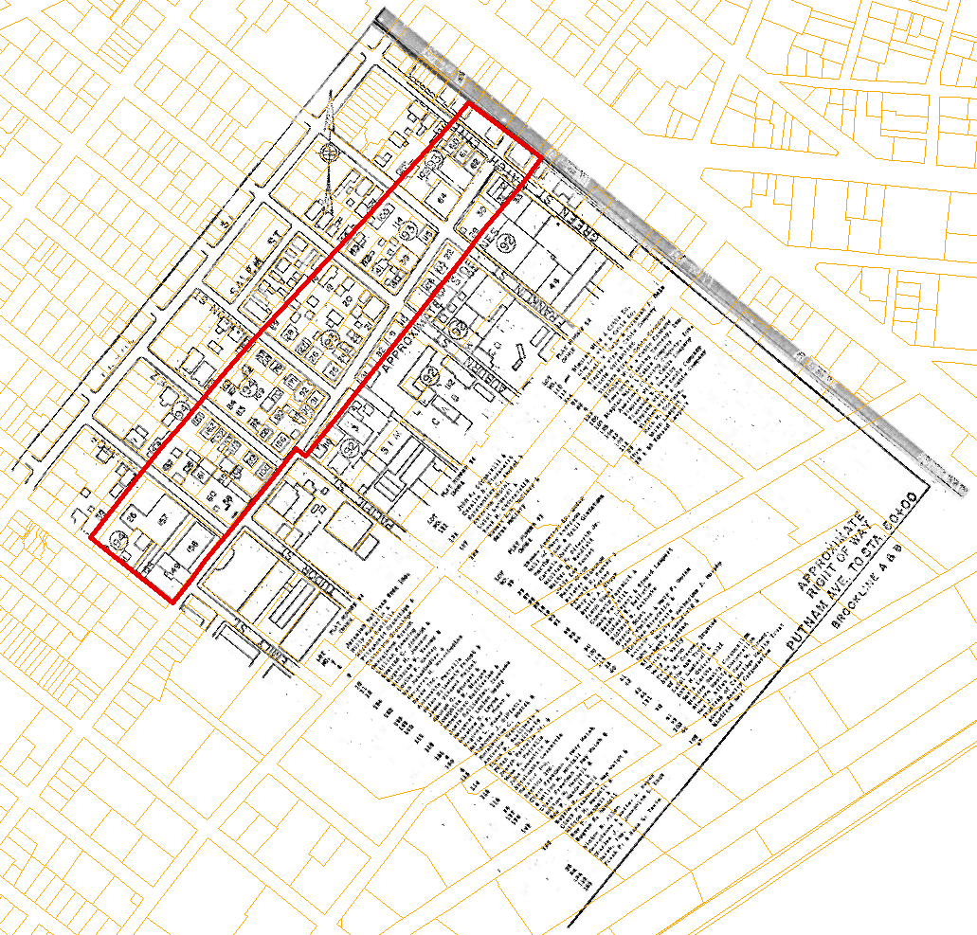
Web Page

Slide 15
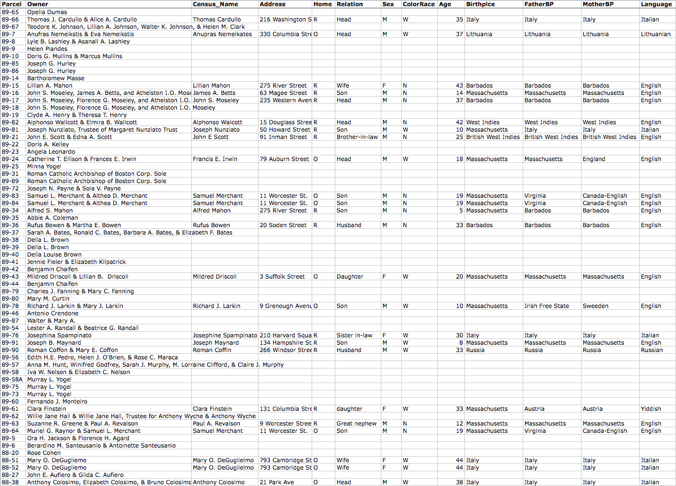

Slide 16
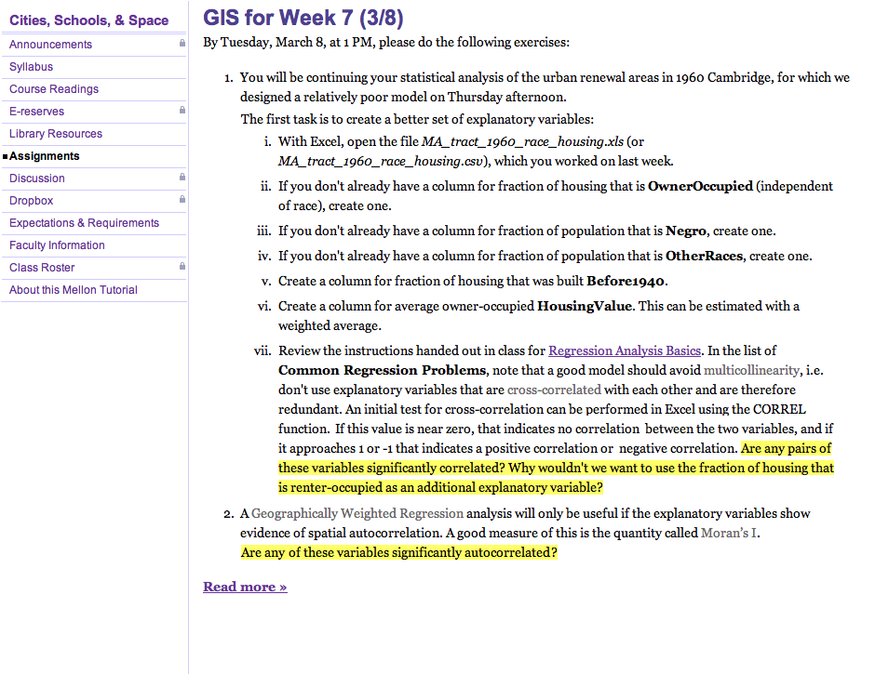
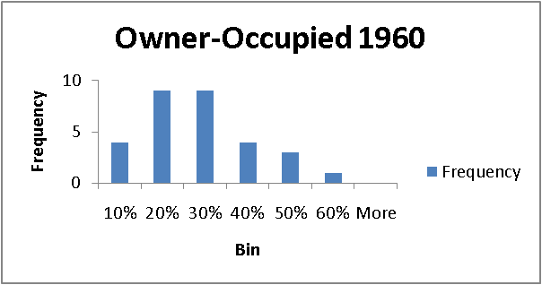
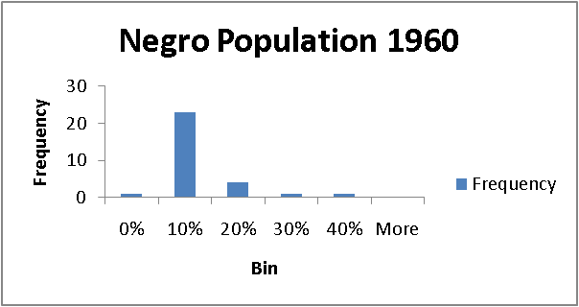
Web Page

Slide 17
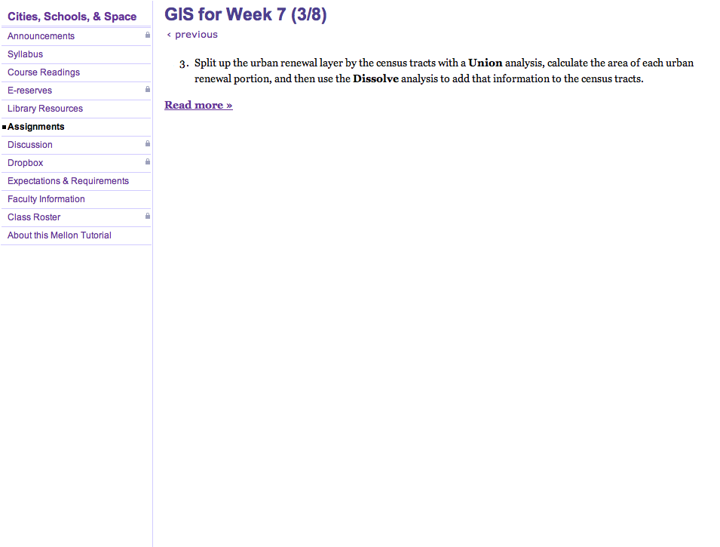
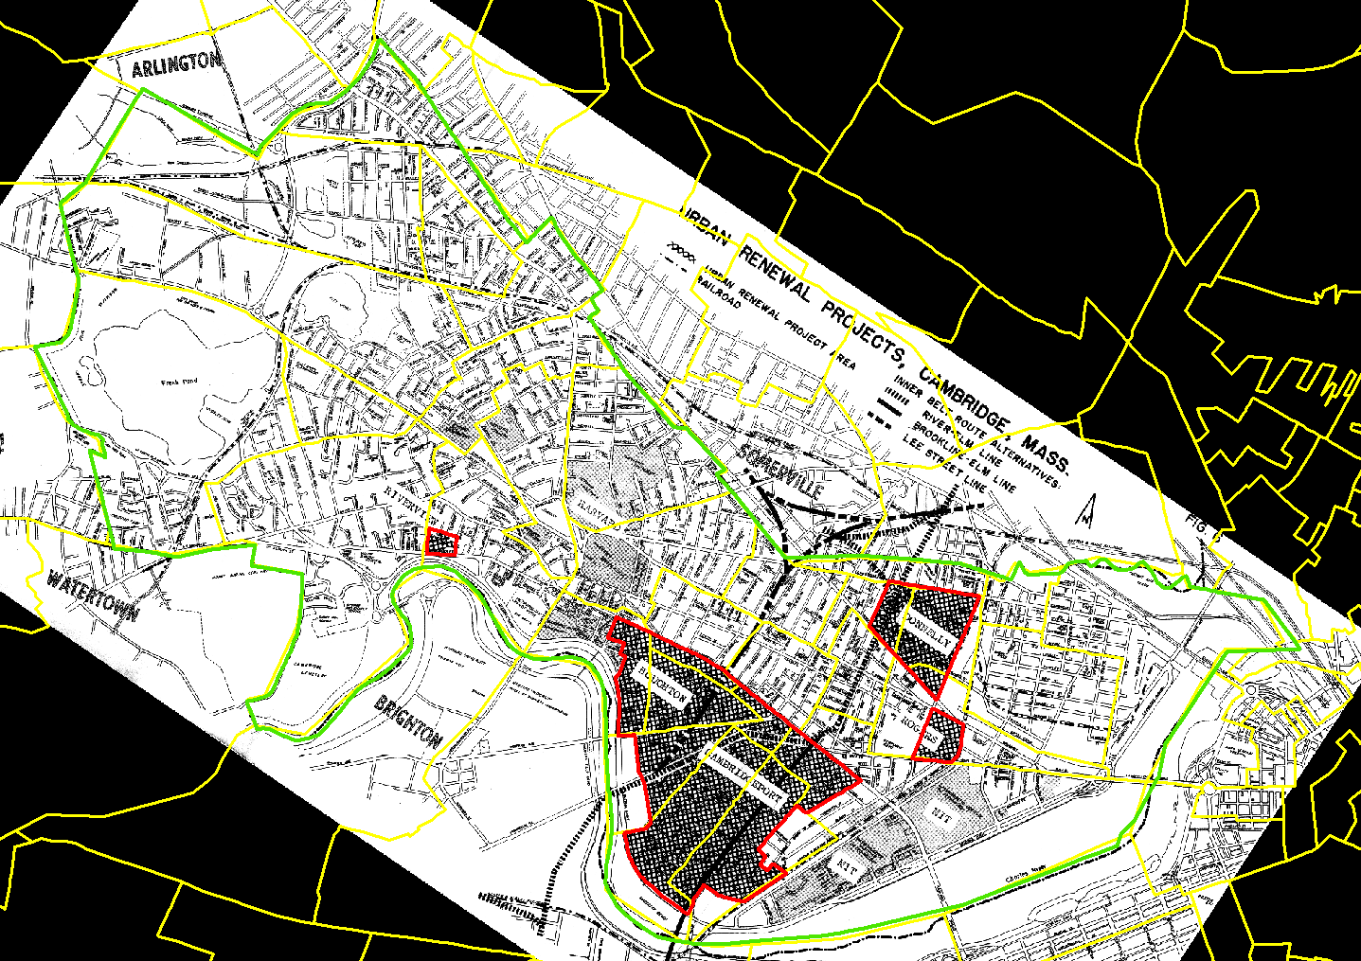
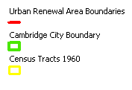
Web Page

Slide 18
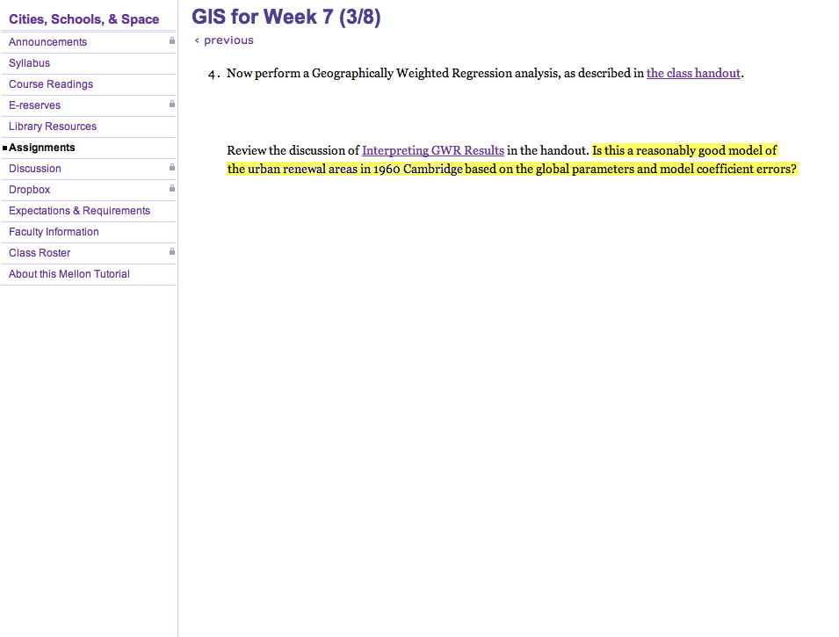
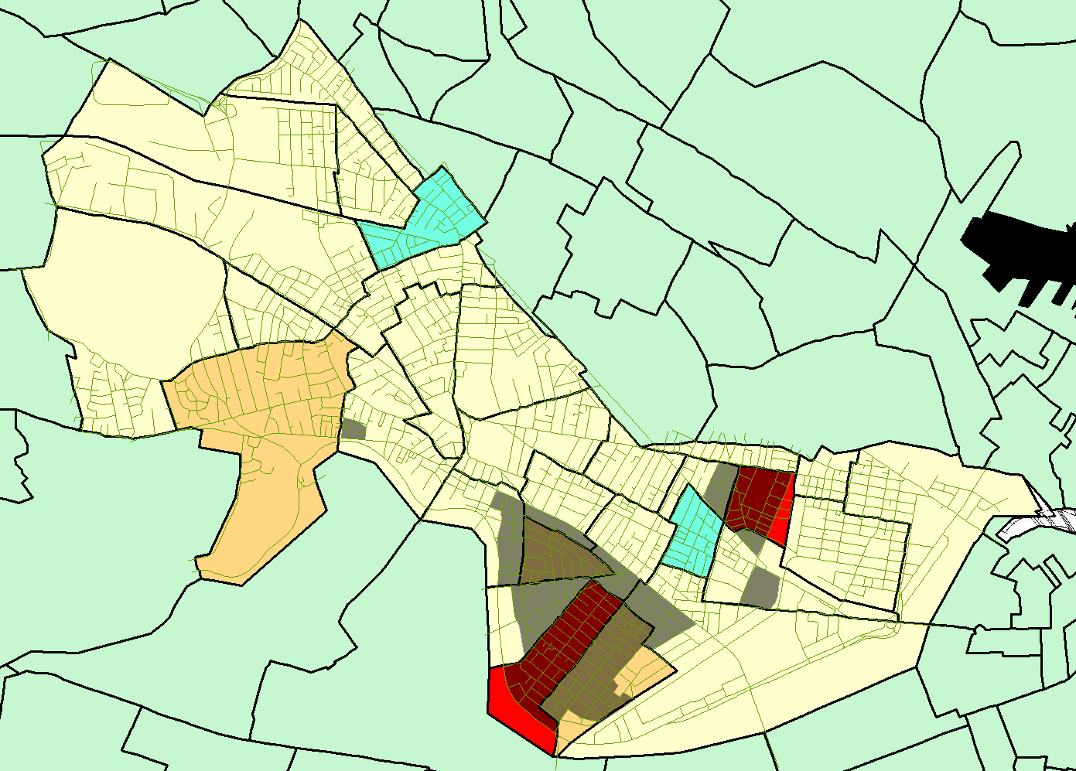
Web Page

Slide 19
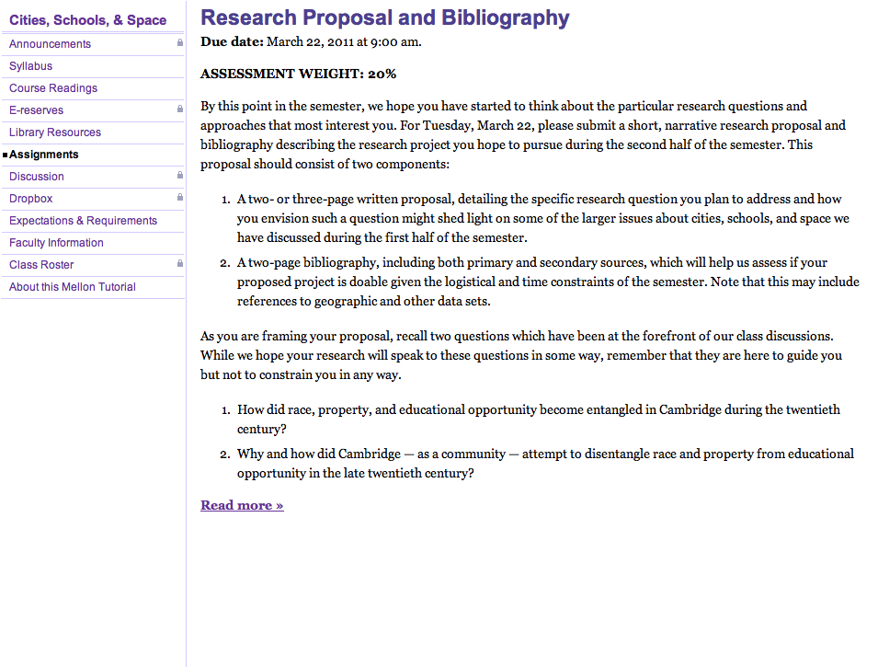
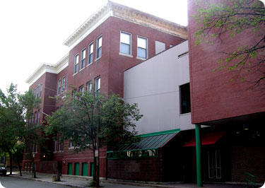
Cambridgeport School, Cambridge
Web Page

Slide 20
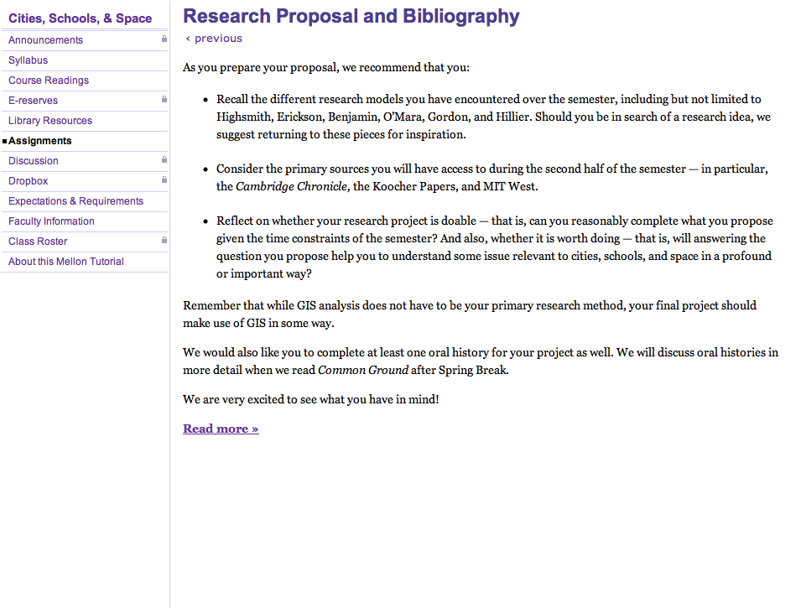
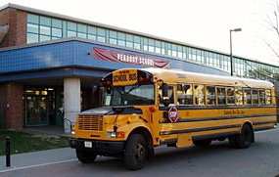
Peabody School, Cambridge
Web Page

Slide 21
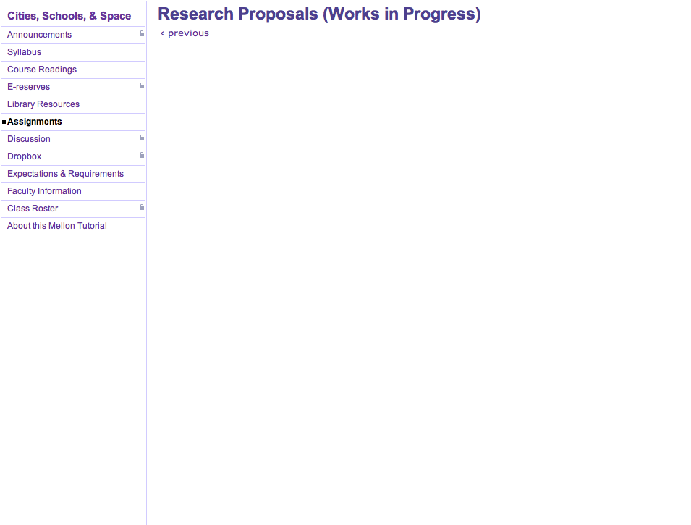
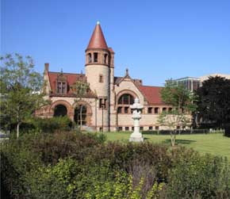
Why were the West Cambridge enrolment projections reported in the 1970 Elementary Schools Building Study so off-base?
Did race and/or class influence decisions about where to build new schools, renovate existing ones, or to close schools in the decade(s) before the implementation of controlled choice in Cambridge?
Considering the original demographics of Cambridge High and Latin School and Rindge School of Technical Arts, how did the merging of these two educational institutions effect the overall enrolment of the high school and the social, racial, and spatial make-up of the new integrated student body?
What motivated the reorganization of Cambridge High and Latin School and Rindge School of Technical Arts, and what issues were those who were involved in planning the reorganization considering?
What were the social, spatial and political tensions that caused the racial integration and linguistic integration movements to become counterproductive to one another, culminating with the failure of Bilingual Education within the Cambridge Public schools?
Why was the Kendall Square Urban Renewal Project controversial?
How did M.I.T. use its political leverage to influence the geographic choices of Inner Belt and how were M.I.T. students, faculty, and local community involved in the anti-Inner Belt campaign?
What role did MIT have in shaping Cambridge as a city in terms of race and space?
Cambridge Public Library
Web Page

Slide 22
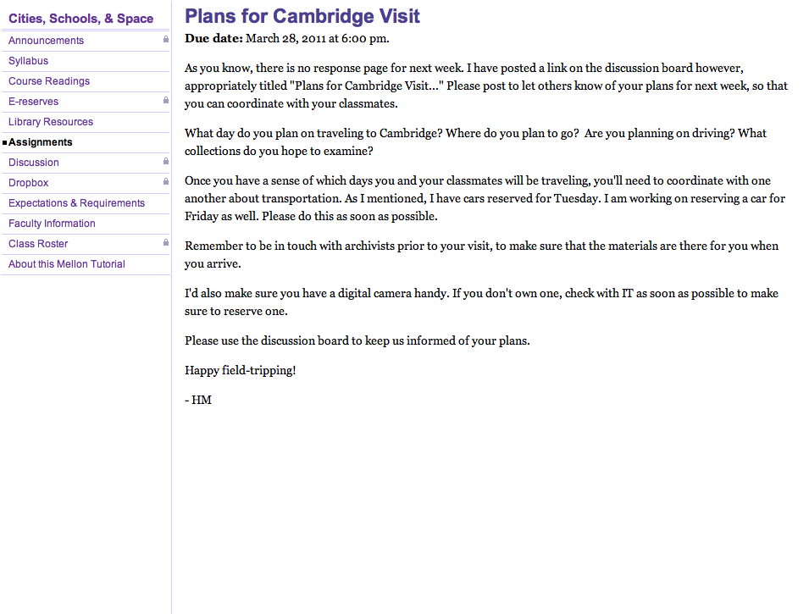
Web Page

