Slide 1
Tradition and Modernity

Slide 2
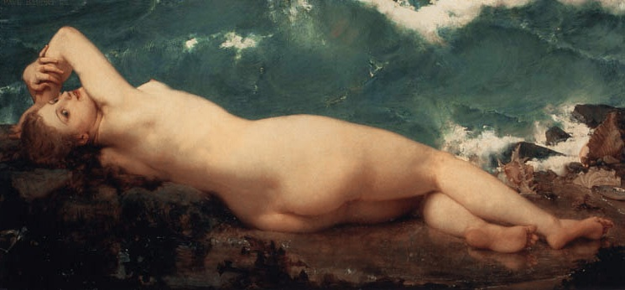
Baudry, The Wave and the Pearl

Slide 3
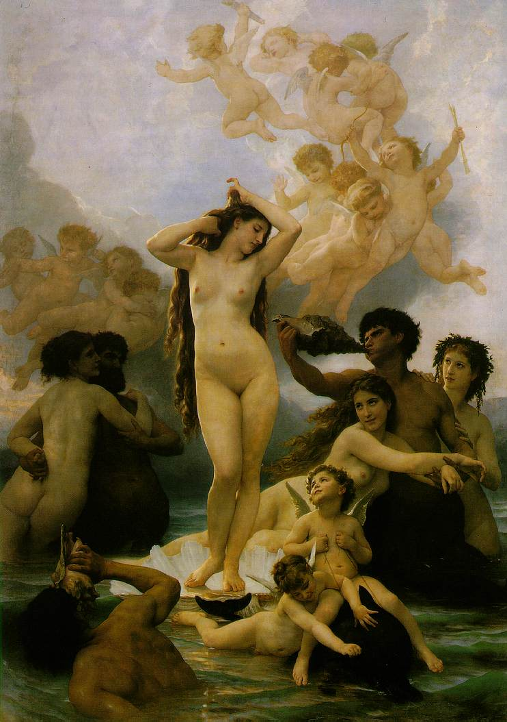
W. Bouguereau, The Birth of Venus

Slide 4
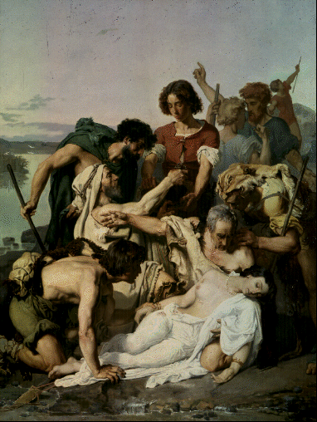
Baudry, Zenobia Found by the Shepherds

Slide 5
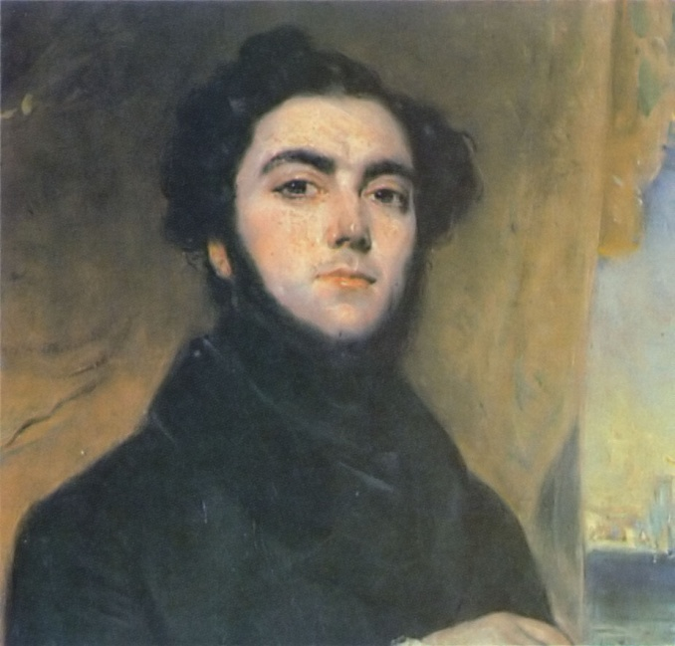
Les Mysteres de Paris: Eugene Sue

Slide 6
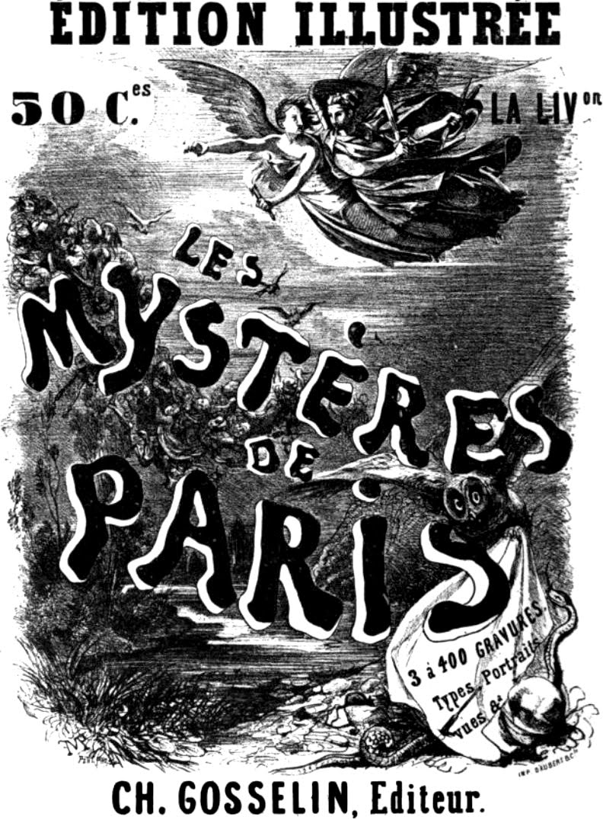
Book Cover

Slide 7
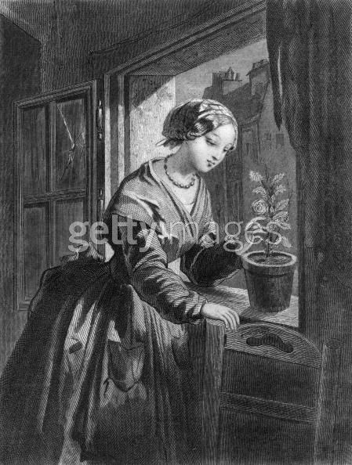
Fleur de Marie

Slide 8
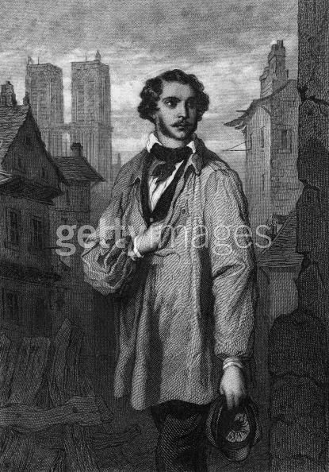
Rodolphe

Slide 9
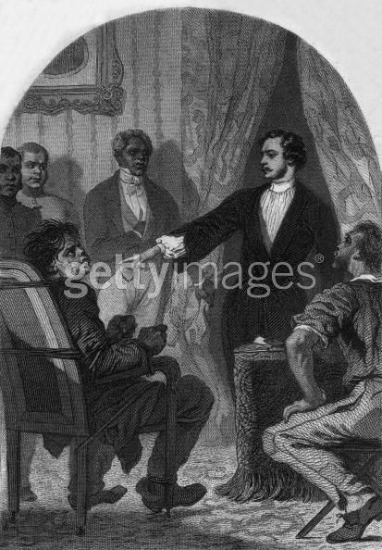
The School Teacher is Blinded

Slide 10
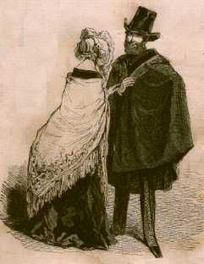
Paul Gavarni, Les Lorettes (prints)

Slide 11
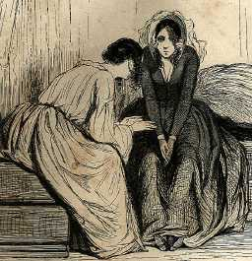
Gavarni

Slide 12
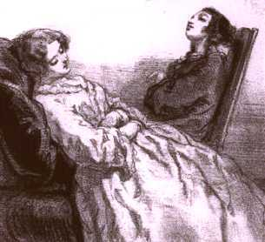
Gavarni

Slide 13
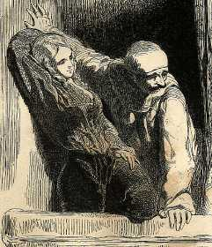
Gavarni

