Slide 1
Brave-ish New World:
A Practical Roadmap For Bringing the Benefits of Cancer Science to Everyone
Amherst College Commencement
Barrett J. Rollins, MD, PhD
Chief Scientific Officer, Dana-Farber Cancer Institute
Linde Family Professor of Medicine, Harvard Medical School
May 20, 2017

Slide 2
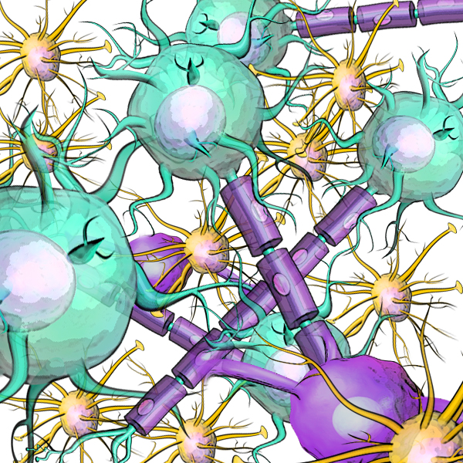
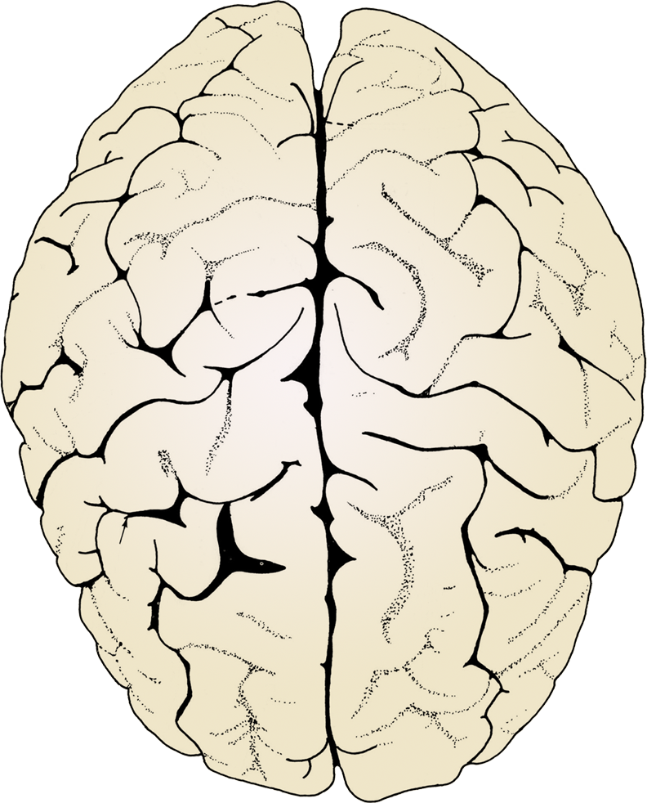
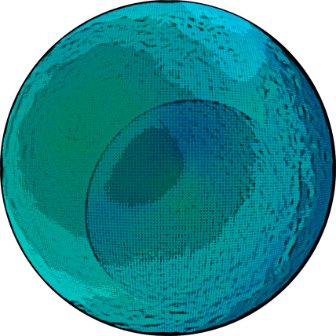

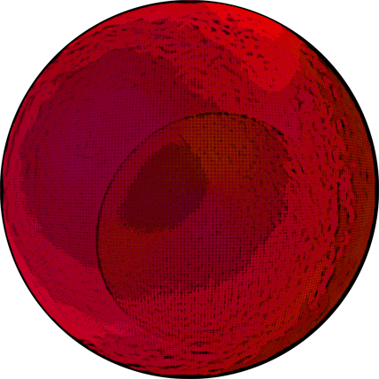
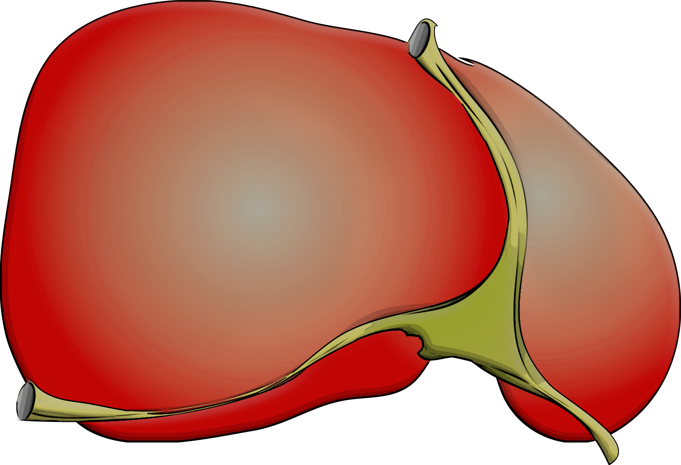
Normal Organs Know When to Stop Growing
Brain
Liver
Stem Cell
Balanced Cell Growth
and Differentiation
Healthy Organ
Organs are made of individual cells, so this means that normal cells know when to stop dividing

Slide 3
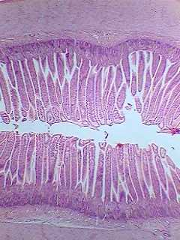
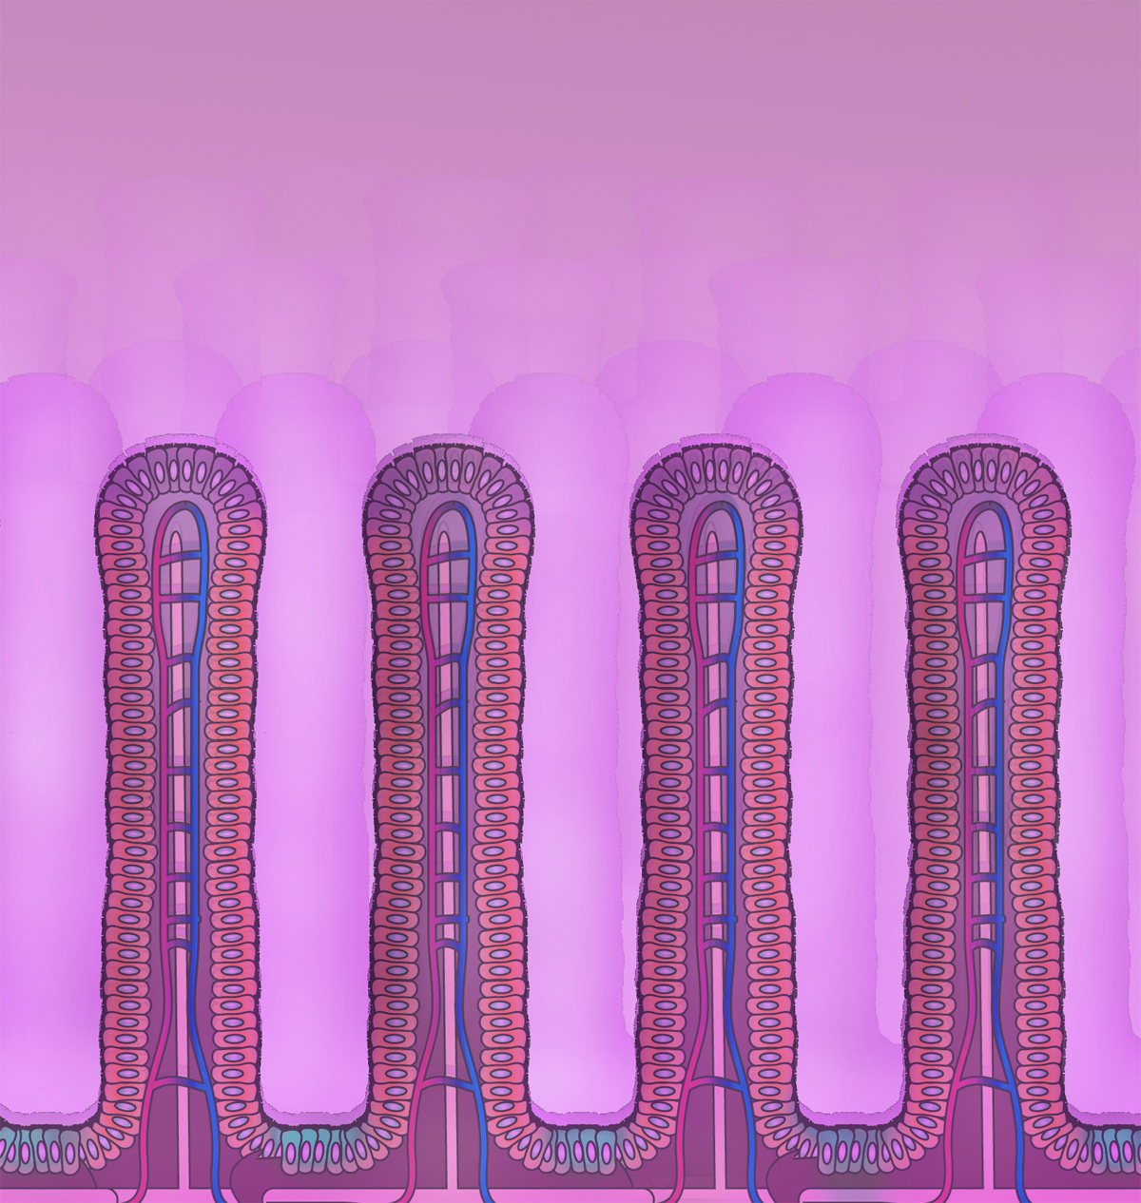
Normal Cells Know When and How Often to Divide
Dying Cells
Stem Cells
Intestinal cells divide just often enough to exactly replace
the dying cells.

Slide 4
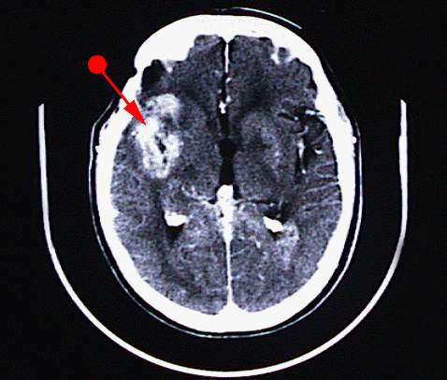
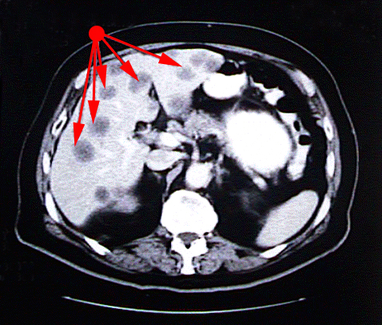
Cancer Occurs When Cells Bypass the Normal Signals to Stop Dividing
Brain Cancer
Liver Cancer

Slide 5
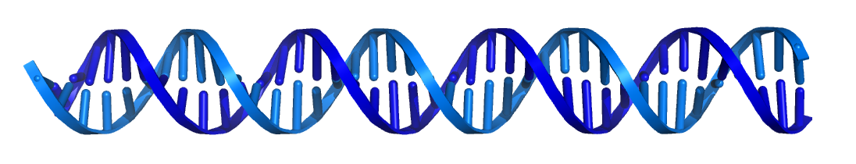
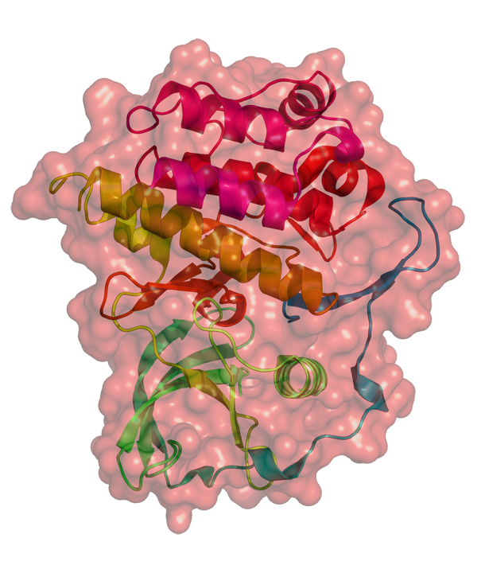
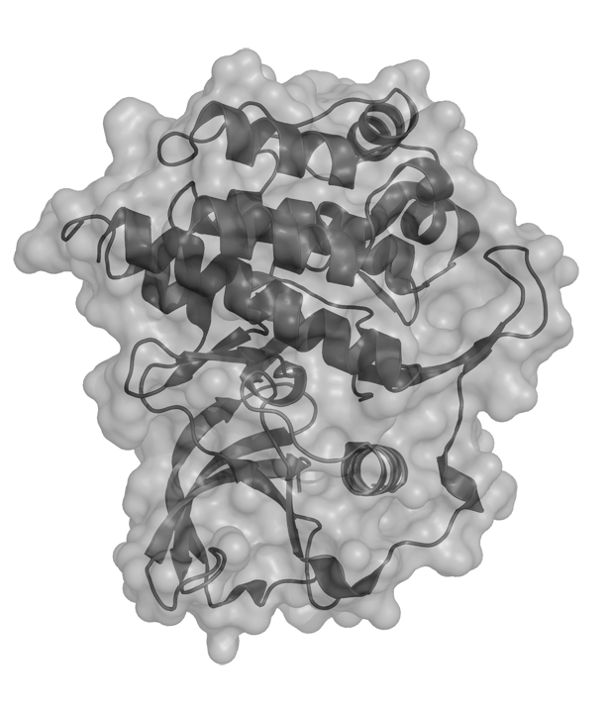
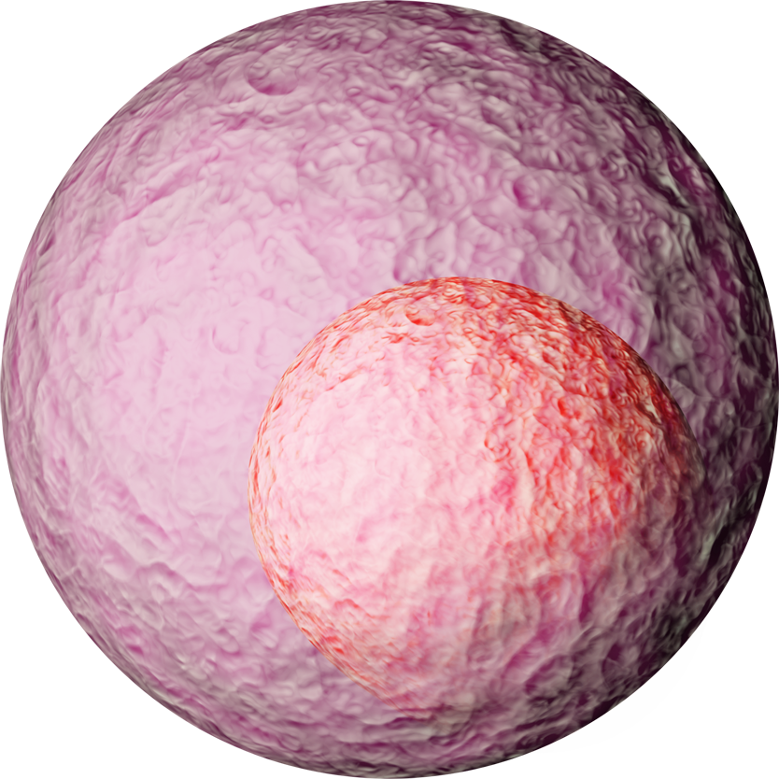
Cell Growth & Division is Controlled by Genes
25,000 human genes;
About 1000 are involved in cell growth
DNA
(Genes)
DNA
(Genes)
Genes are made of DNA
Sequence of DNA subunits contains the “blueprint” for proteins
Proteins do the work of making a cell grow & divide
Inactive
Proteins
Active
Cell growth proteins toggle back & forth between being “active” & “inactive”
Cells
When the proteins are “inactive” cells don’t divide
When the proteins are “active” cells divide

Slide 6
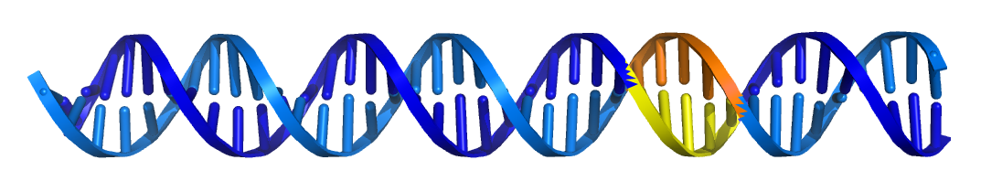
Mutations in Cell Growth Genes Cause Cancer
DNA
(Genes)
Mutations in genes change the blueprint for the proteins they make
Cancer-related mutations in growth genes keep growth proteins in their “active” form
Proteins
X
Mutated proteins no longer toggle between active & inactive forms
Mutated proteins send continuous signal for cells to grow
This is cancer
Active
Inactive
Cells

Slide 7
Targeted Therapies Can Reverse the Effects of Mutated Genes in Cancer
DNA
(Genes)
A drug targeted specifically at the mutated protein can flip it into its inactive form
Proteins
The growth protein no longer stimulates tumor cells to grow & divide
The tumor shrinks & disappears
Cells

Slide 8
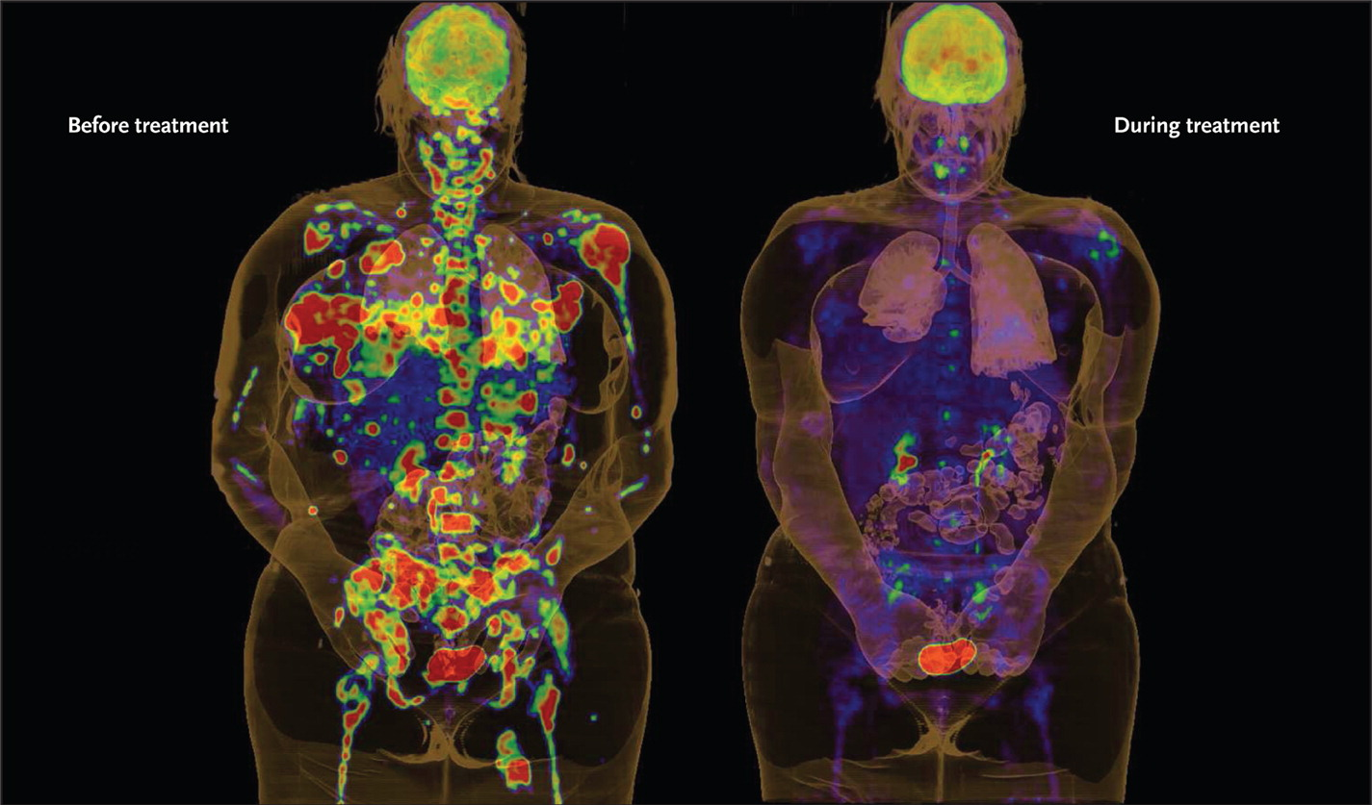
BRAF Inhibitor Shrinks Metastatic Melanoma
McDermott U et al. N Engl J Med 2011;364:340-350.
BRAF Inhibitor Prolongs Survival in Patients with Metastatic Melanoma
But ONLY in patients whose tumors have the BRAF mutation

Slide 9


Targeted Treatments Require Knowledge of the Mutation – Precision Cancer Medicine
Patient A
Mutation A
Drug A
A
X
Malignant Cell Growth
Patient B
Mutation B
Drug B
B
X
Malignant Cell Growth
Patient C
Mutation C
Drug C
C
X
Malignant Cell Growth

Slide 10
Precision Cancer Medicine
Challenges
  Our vision has outstripped our capabilities
  But this is clearly the future of cancer care
The pressing questions
  Is universal genetic testing for cancer patients practical?
  Is universal genetic testing for cancer patients valuable?
    Does it improve outcomes?
    Does it provide scientific value?

Slide 11
PROFILE
• Obtain a broad genetic test (“genotype”) on all patients at our hospitals with cancer
• Return “clinically actionable” results to providers
• Link to clinical data & make available for research

Slide 12
Who is this?
All of our patients with cancer
(16,000 new patients each year)

Slide 13
What will we test?
Clinical samples
All patients with cancer

Slide 14
What kind of genotyping will we perform?
Somatic genotyping
Clinical samples
All patients with cancer

Slide 15
Cancer Patients Have Two Genomes
Somatic
In the cancer;
Mutations usually not in the germline;
These are the “drivers” that predict response to targeted therapies
Germline
In all cells;
Passed on to children;
Genes may impart cancer risk

Slide 16
What kind of genotyping will we perform?
Somatic genotyping
Clinical samples
All patients with cancer

Slide 17
OncoMap & OncoPanel
can test clinical samples
What testing platform can we use?
Somatic genotyping
Clinical samples
All patients with cancer

Slide 18
What Testing Platform Can We Use?
Genotyping platform must work robustly on archived, clinical samples
Whole genome sequencing
  Expensive, performs poorly on archived specimens
  Value for managing cancer patients unclear
Whole exome sequencing
  Performs well on archived specimens, tests genetic material relevant to cancer
  Expensive, value for managing cancer patients unclear
Panel testing
  Performs well on archive specimens, relevant to cancer, affordable
OncoPanel -- >400 genes tested

Slide 19
OncoPanel, cost-effective,
tests clinical samples
What testing platform can we use?
Somatic genotyping
Clinical samples
All patients with cancer

Slide 20
OncoPanel, cost-effective,
tests clinical samples
Somatic genotyping
Is PROFILE a clinical test or a research test?
Clinical samples
All patients with cancer

Slide 21

Is PROFILE a Clinical or a Research Test?
Clinical Test
Research Test
  Proven clinical value, can be ordered by any physician on any patient, usually reimbursed by insurers
  No known clinical value, can only be performed on consenting participants, not reimbursed
PROFILE was started as a research test
  Consent required for testing
  Results can’t go in patients’ electronic health record (EHR)
  Insurers won’t pay for testing

Slide 23
OncoPanel, cost-effective,
tests clinical samples
Somatic genotyping
Started as a research test; evolving into a clinical test
Is PROFILE a clinical test or a research test?
Clinical samples
All patients with cancer

Slide 24
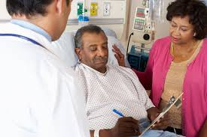
Lessons Learned from PROFILE
Universal
Informed Consent
Universal Genetic Testing
Feasible:
>50,000 participants since 2011
Feasible:
>17,000 OncoPanel profiles
96% success rate on clinical samples
Universal Genetic Testing → Clinically Useful Results
73% of tested patients have “clinically actionable” results

Slide 25
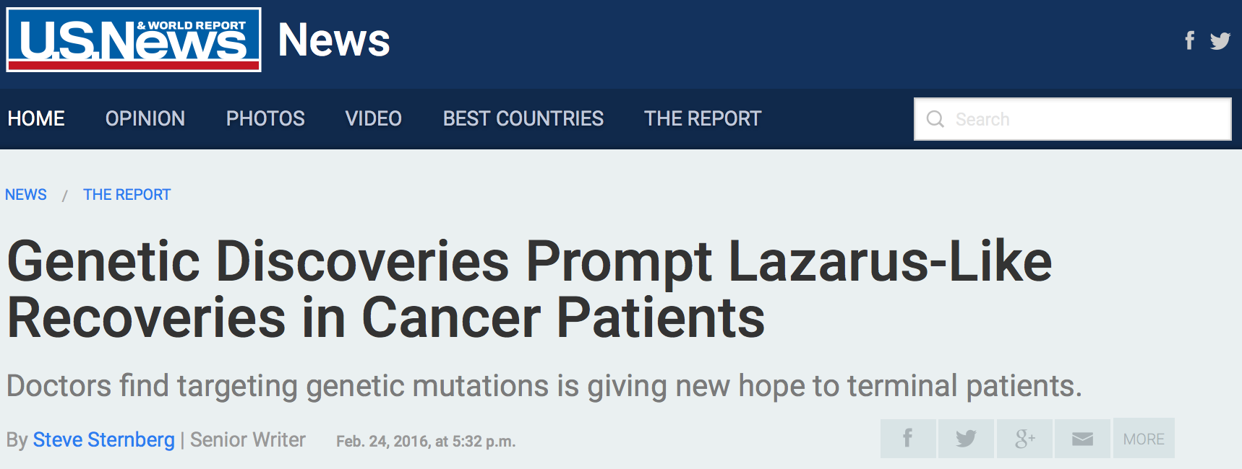
PROFILE Has Impacted Patient Care

Slide 26


Slide 27



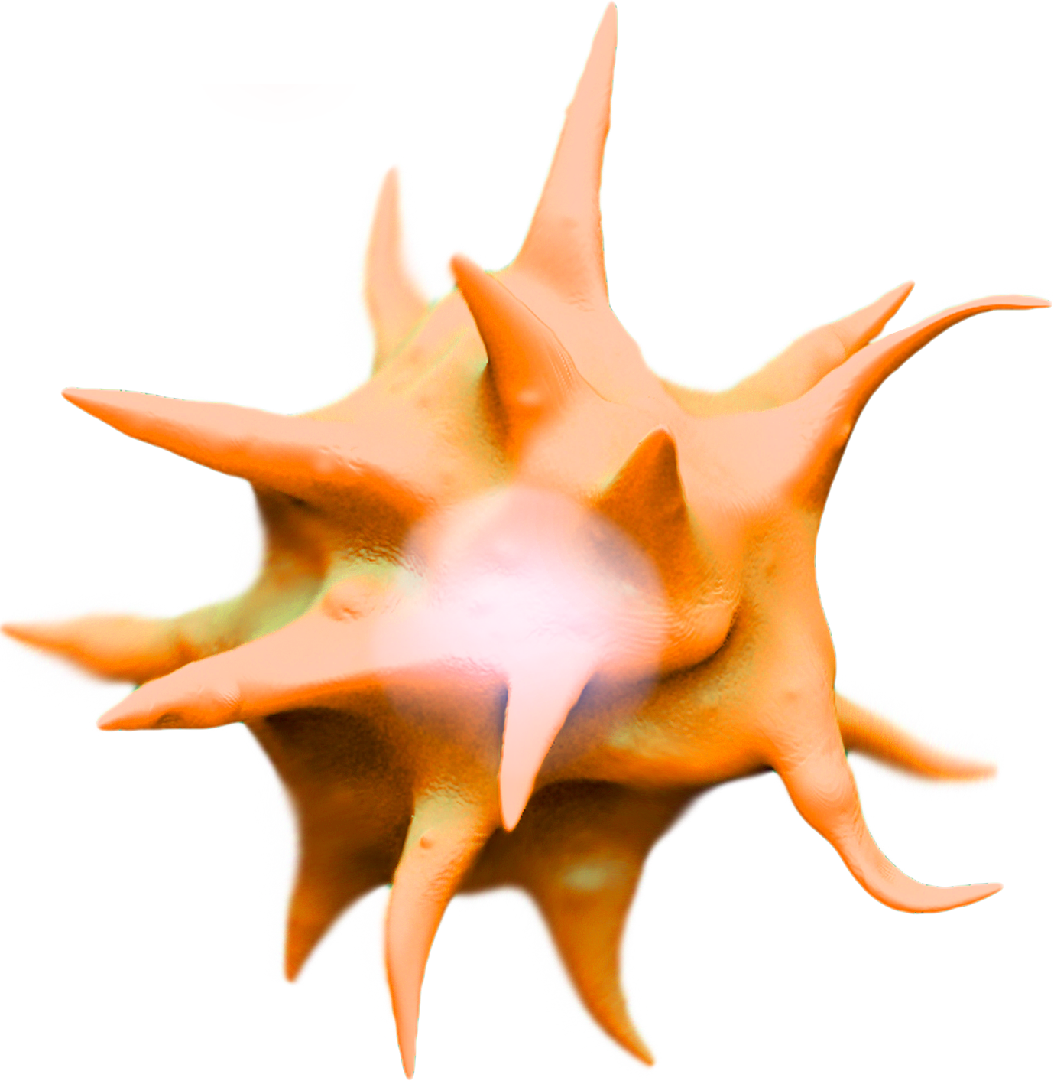
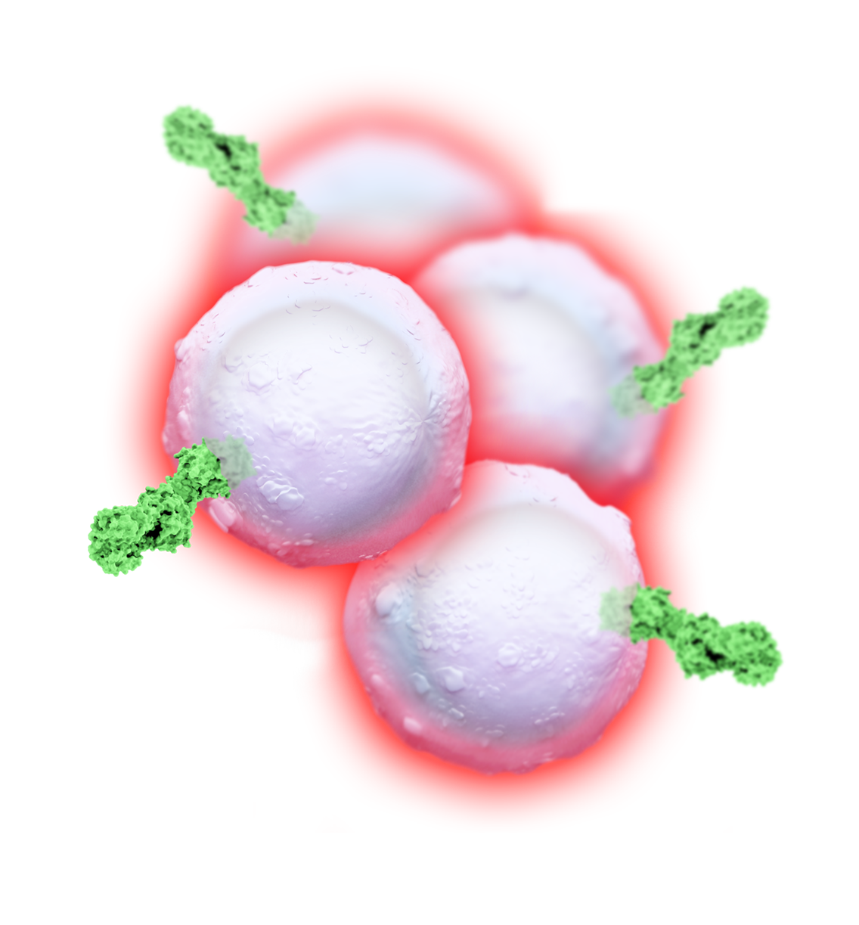



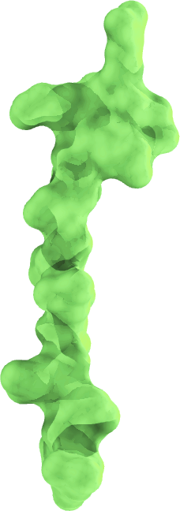
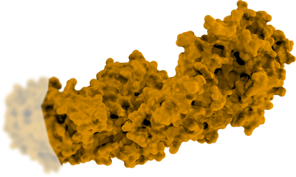
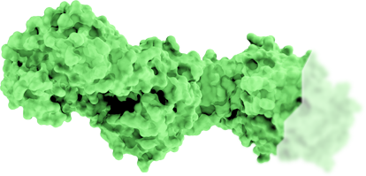
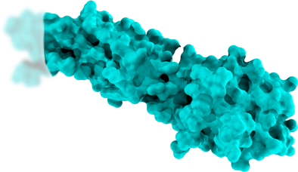
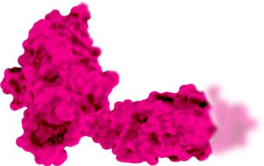

T Lymphocytes Can Be Inactivated Naturally
Viruses
1
T-Cell Proliferation
Antigen Presentation
T-Cell Activation
MHC
T-Cell Exhaustion
(Inflammatory Response “Turned Off”)
Antigens
PD-L1
3
PD-1
appearance
2
Inflammation
Antigen Presenting Cell
(APC)
Cytokines

Slide 28
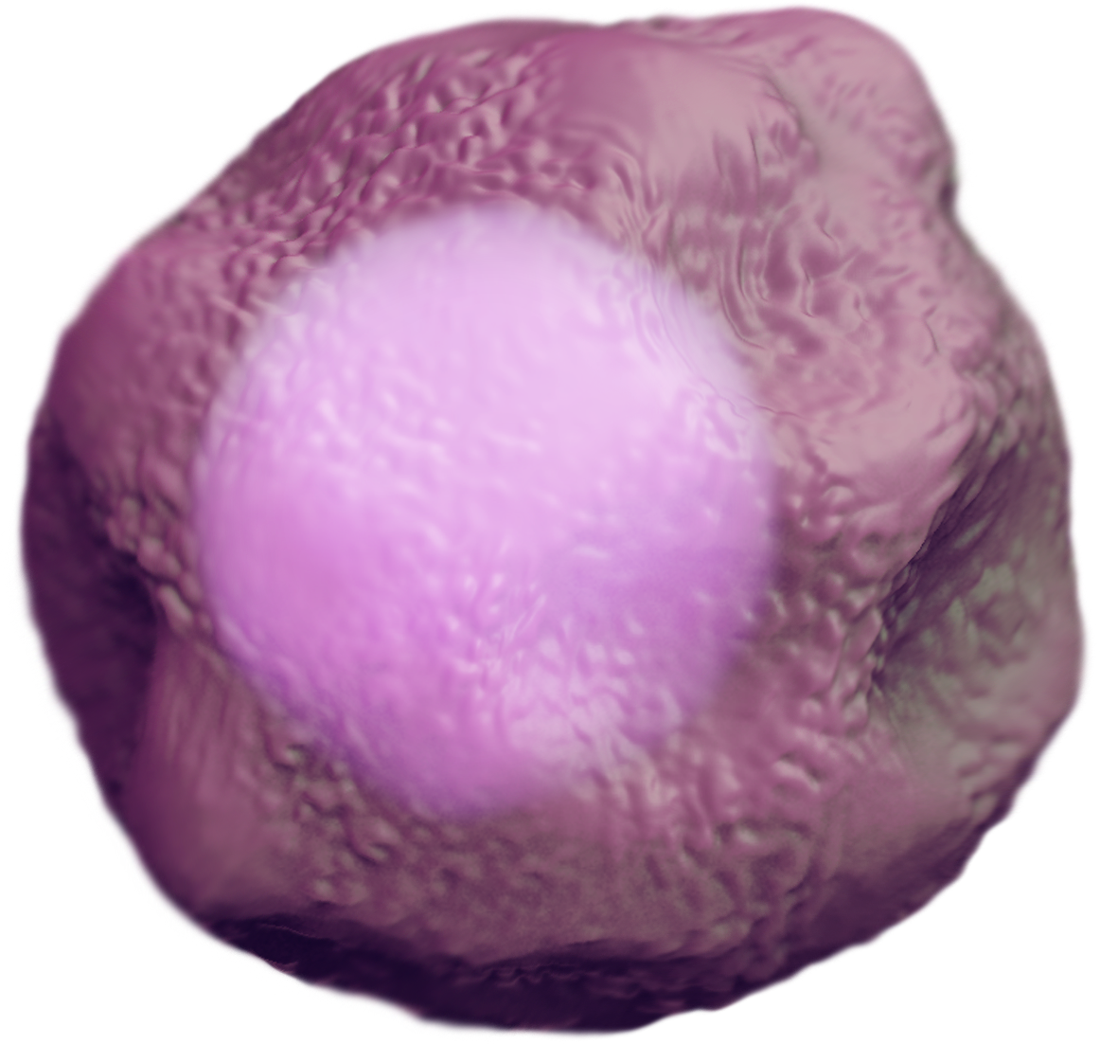
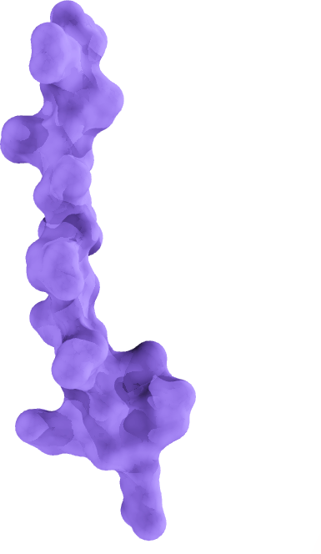
Cancer Cells Can Inactivate T Lymphocytes Using the Same Mechanisms
Antigen Presentation
T-Cell Activation Initialized
MHC
Cancer
Antigens
PD-L1
PD-1
T-Cell Activation Blocked by
PD-L1/PD-1 Interaction
Cancer Cell

Slide 29

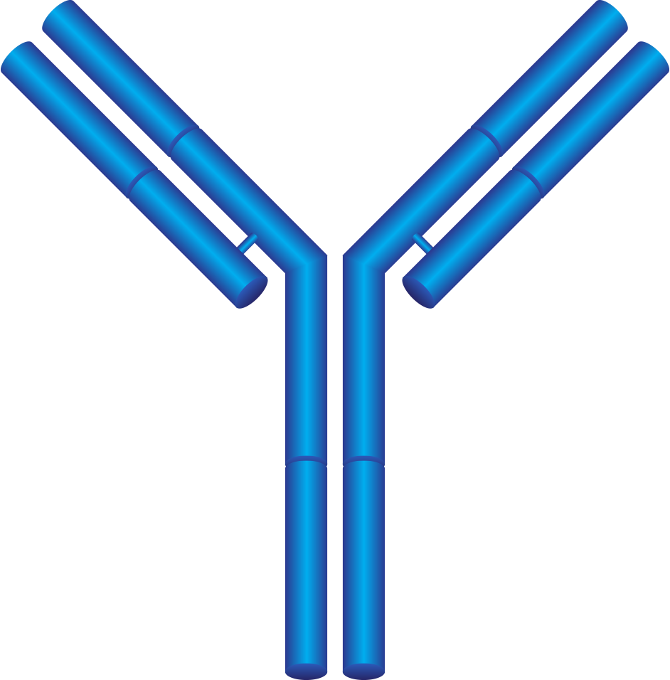
Adding Antibodies that Target PD-L1 and PD-1 can Prevent Inactivation
Antigen Presentation
T-Cell Activation Initialized
MHC
PD-L1
PD-1
Antibodies Target PD-L1
and/or PD-1
Cancer Cell
T-Cell Remains Active
and Attacks Cancer Cell

Slide 30
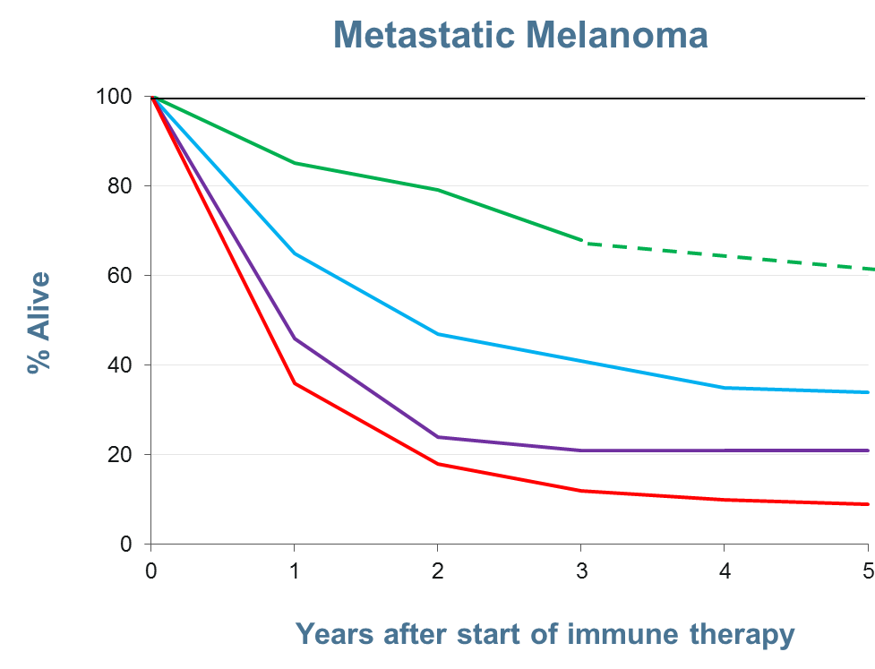
Combination
Blockade
PD-1 Checkpoint blockade
CTLA-4 Checkpoint blockade
Standard of Care

Slide 31

Bringing Basic Research to Patients
Targeted
Therapies
PROFILE
Targeted
Therapies
Patient data
Decision support
Better Outcomes
Research Partners
Tissue samples,
Clinical trial participation

