Slide 1
Global Harmonized System (GHS)
New Classification and Labeling of Chemicals

Slide 2
Hazard Communication
And
Massachusetts
Right – To - Know

Slide 3
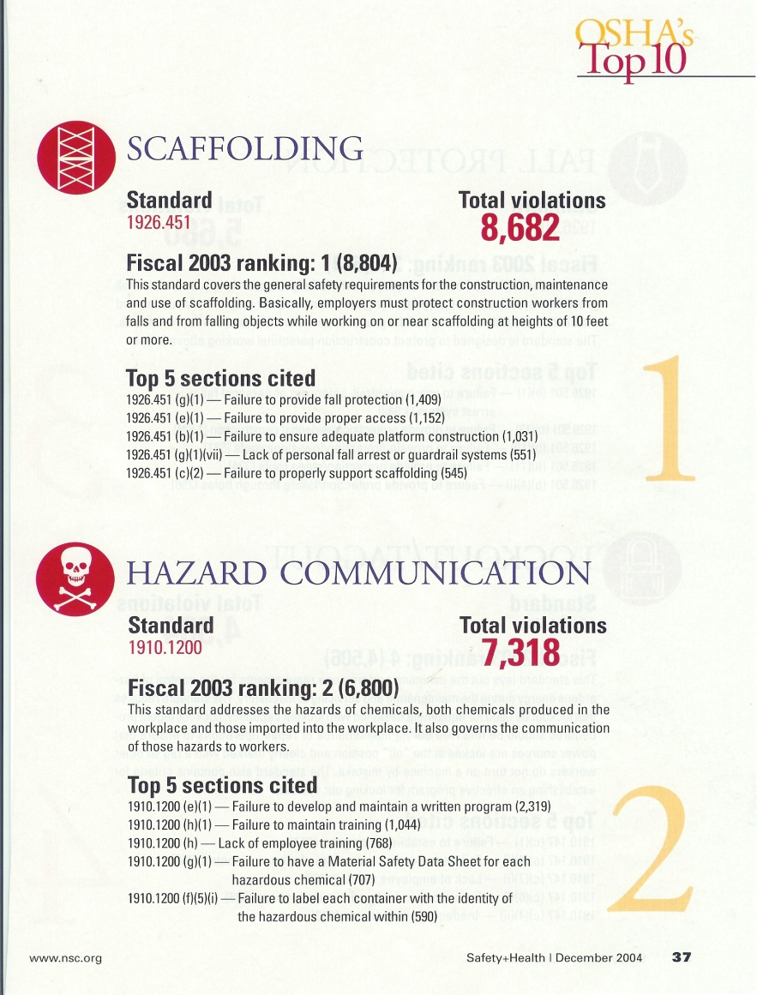
Hazard Communication
Right-to-Know
  1926.59 (Construction) and 1910.1200 (General Industry)
  All hazards produced or imported must be evaluated to protect the employees
    Hazard determination
    Written Hazard Communication Plan
      Site and Project Specific
      Physical and Health Hazards
        Acute vs. Chronic

Slide 4
POLICIES and PROCEDURES
  Requirements
Hazard Communication
  Right to Know Training
    Asbestos
    Bio-Hazardous Material
    Chemicals
    Cleaning Supplies
    Hazardous Materials
    Hazardous Waste
    Radioactive Material
    Universal Waste

Slide 5
Amherst College must:
  Communicate Hazard Information to employees that could be exposed to hazardous or potentially hazardous substances in the workplace
  Develop, implement & maintain written Haz-Com Program, which includes:
    Employee Training and Guideline
    Labeling, Signage and Warning Procedures
    Material Safety Data Sheets (MSDS)
    List of all known hazardous and potentially hazardous materials on site
    Communication procedures to make all employees aware
    Identification of piping and storage systems
    Proper Personnel Protective Equipment
    Engineering Controls, when applicable
    Methods to obtain MSDS from Distributors / Manufacturers
    Methods to convey information to contractors

Slide 6
Employees…
  Must attend classes to gain knowledge of:
    Material Safety Data Sheets
    Label, Signage and Warning Requirements
    Chemical and other applicable hazards in their work environment
    Manufacturer Specifications
    Product Substitution Guidelines
    Engineering Controls
    Personnel Protective Equipment Selection
    EPA and OSHA Requirements
    Emergency Response Procedures

Slide 7
If one is good….
…Two must be better
+
=

Slide 8
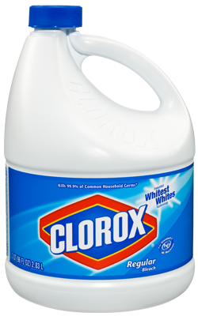
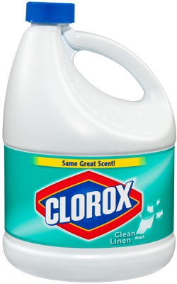
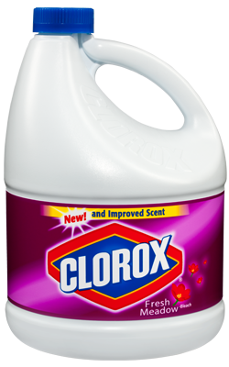
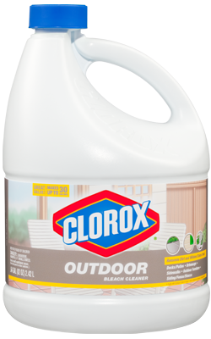
Manufacturer’s Specifications
Proper Mixing Procedure;
¼ cup to 1 gallon of water
24 hour use limit
More concentrated is NOT better

Slide 9
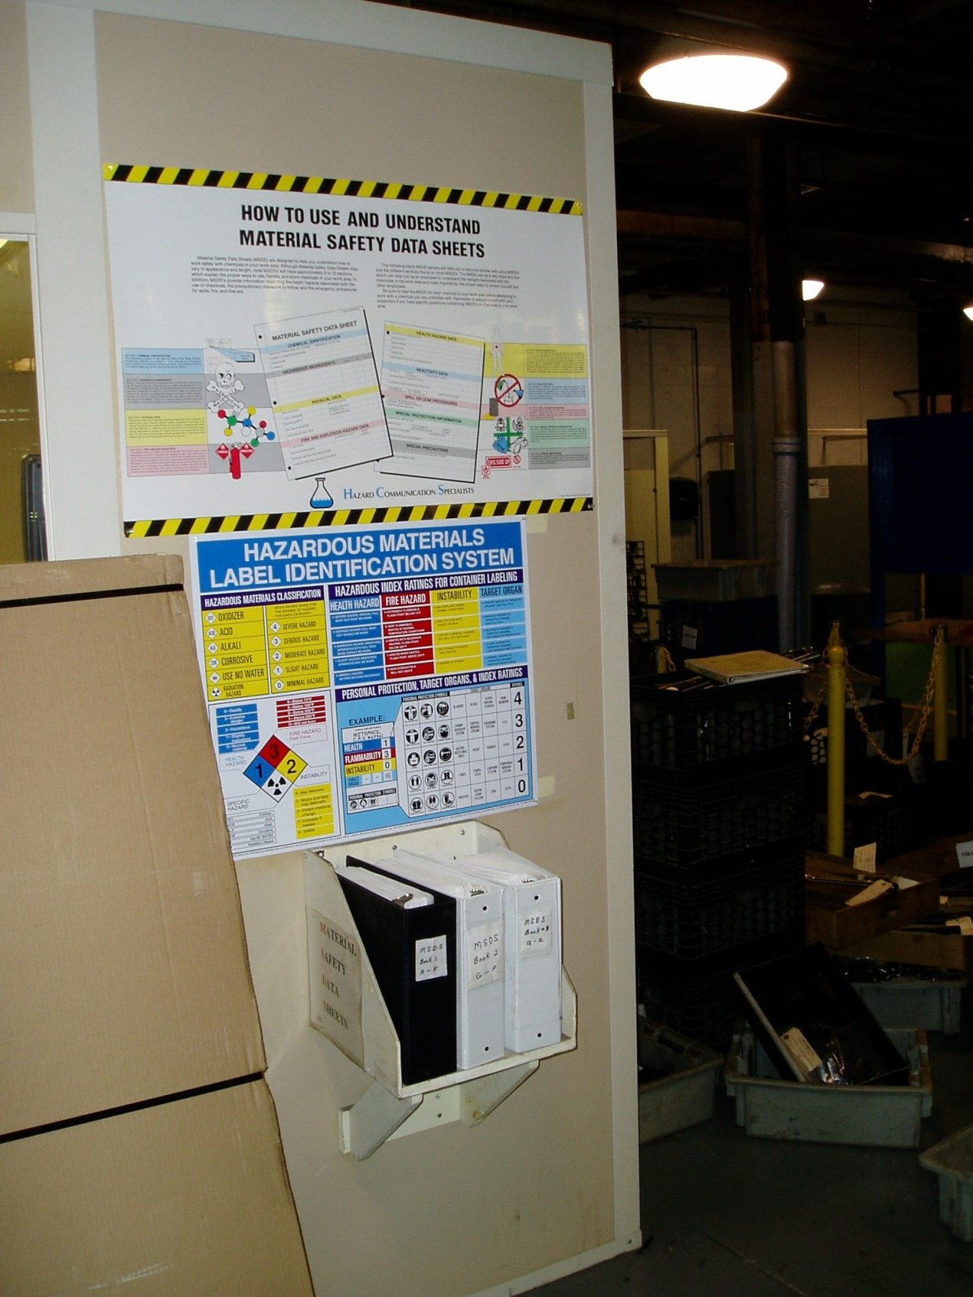
MATERIAL SAFETY DATA SHEETS
Best reference for chemicals and substances
Employees must be able to access
Employees must be trained in their use
Employers must request updates from suppliers
Who else would they benefit?

Slide 10

What is Global Harmonized System (GHS)?
United Nations improvement of our Hazard Communications (Chemical Labeling) Program
  Standardized, universal, world-wide hazard classification system for all chemicals
Define health, physical and environmental hazards of chemicals
  Standardized labeling system with
  visual aids such as pictograms to
  indicate other dangers

Slide 11
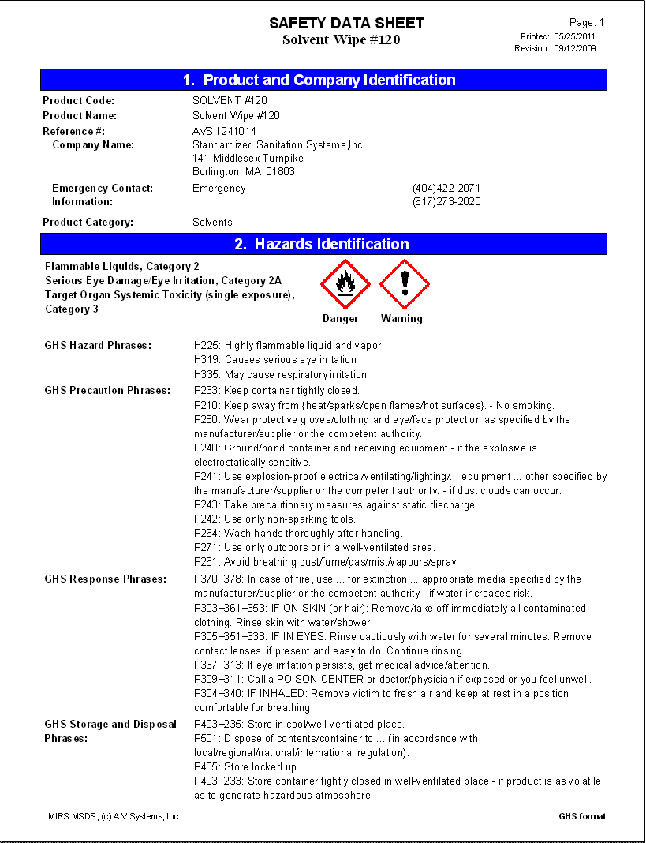
Safety Data Sheets
Safety Data Sheets (SDS) will replace Material Safety Data Sheets (MSDS)
  Standardized format for all Safety Data Sheets
    16 sections
      Product Identification
      Hazards
      Ingredients
      1st Aid and Firefighting Measures
      Accidental Release
      Physical and Chemical Properties
      Exposure Controls and PPE
      Reactivity and Stability
      Toxicological and Ecological Info
      Disposal Considerations

Slide 12

Why was GHS Developed?
Chemicals are utilized all over the world
  Laws and regulations are the same for a few countries, vastly different in most and non-existent in many.
    Currently there are 9 different protocols for Flammability
    Currently, the same product can be hazardous in one country and non – hazardous in another.
  NOW chemicals are shipped from other countries, multiple labels have to be added to the containers to make them appropriate for that country
    often the labels are conflicting
Labels must now include;
  Environmental
  Acute Toxicity
  Target Organ Toxicity

Slide 13

GHS Regulation
Production
Transportation
Agriculture
Workplace
Trades
Consumer Products
  Single Packaging
Disposal

Slide 14
Benefits of GHS
Enhanced health and safety and better protection for the environment around the world
  Pictograms will make it easier to understand
Regulation and setup will be “International”
  All countries will follow the same rules
Chemical hazard identification will be the same around the world
Reduce the need for multiple chemical evaluation and testing around the world
Reduce chemical incidents and accidents
Reduce health care costs
Increase public and worker protection
Increase manufacturer reputation for chemical production

Slide 15
Benefits to Amherst College
Safer work environment
  Better hazard information and guidelines
Increased efficiency
  SDS will all look the same
  Reduced cost for Hazard Communication
Expert systems and resources to assist with program
Better electronic information sharing
Increased hazard awareness
  additional information about the chemicals

Slide 16
Effective Dates
Employees must be trained on new labels and SDS
  December 01, 2013
Chemical manufacturers, distributors and employees must comply with the modified regulation
  June 01, 2015
However….Distributors may ship products under the old system until
  December 01, 2015
Amherst College must update all labels and Hazard Communication Program
  June 16, 2016

Slide 17
Definitions
Commercial Account – distributor sells to employer in large quantities over time.
Container – Bag, barrel, bottle, box, bucket, can, cylinder, drum, pails, pipes and storage tanks
Hazard Class – Health or Physical Hazard
  Flammable, Carcinogen, Corrosive
Hazard Category – specific criteria within a hazard class
  Category 1 - 4
Label – written, printed and graphic information affixed to every “container”
Labels (must have) – Pictogram, Hazard Statement, Signal Words and precautionary statements for each Hazard Class and Hazard Category

Slide 18
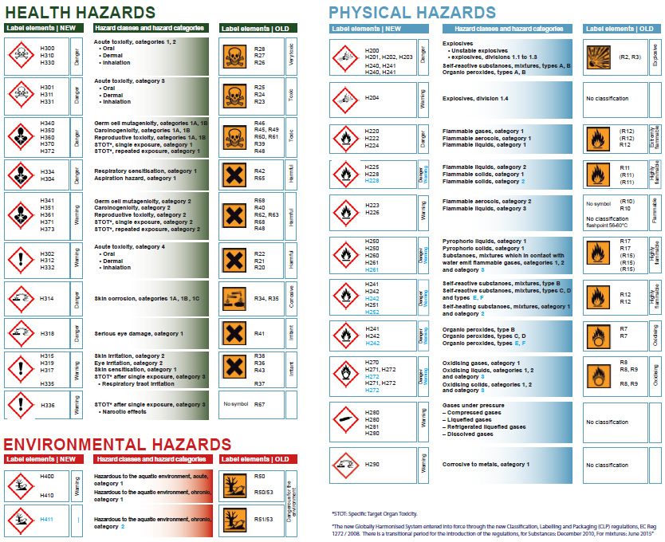

Slide 19
Pictogram
Symbol with graphic elements
    Diamond Shaped
    Red Border
Must convey specific information about the hazards of the chemical
10 Pictograms

Slide 20
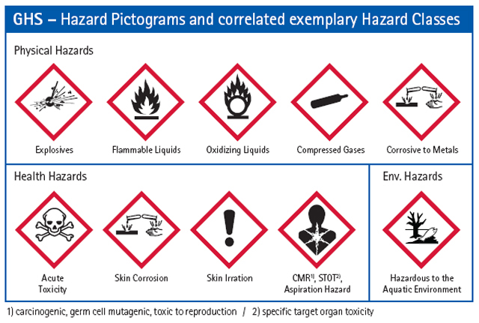

Slide 21
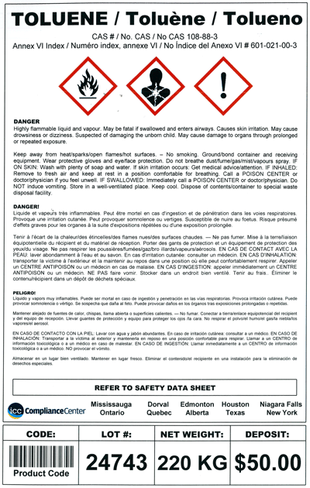
Label Requirements - Container

Slide 22
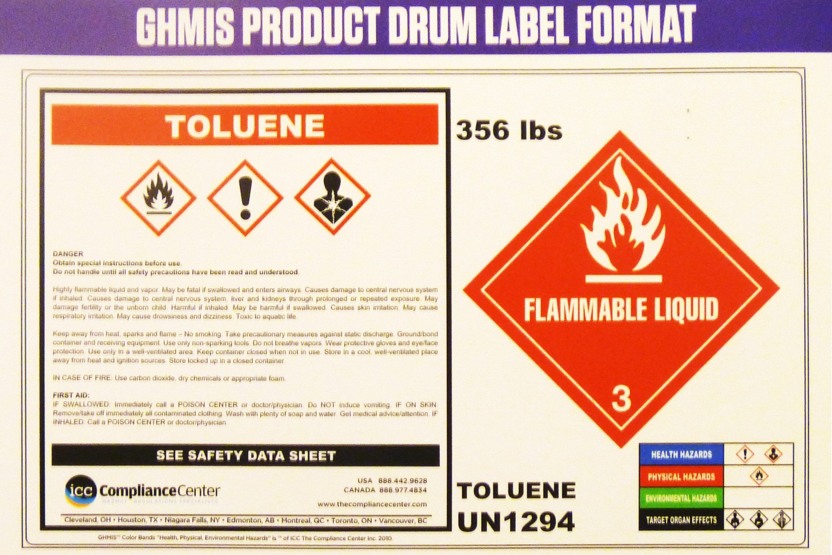
Label Requirements - Drum

Slide 23
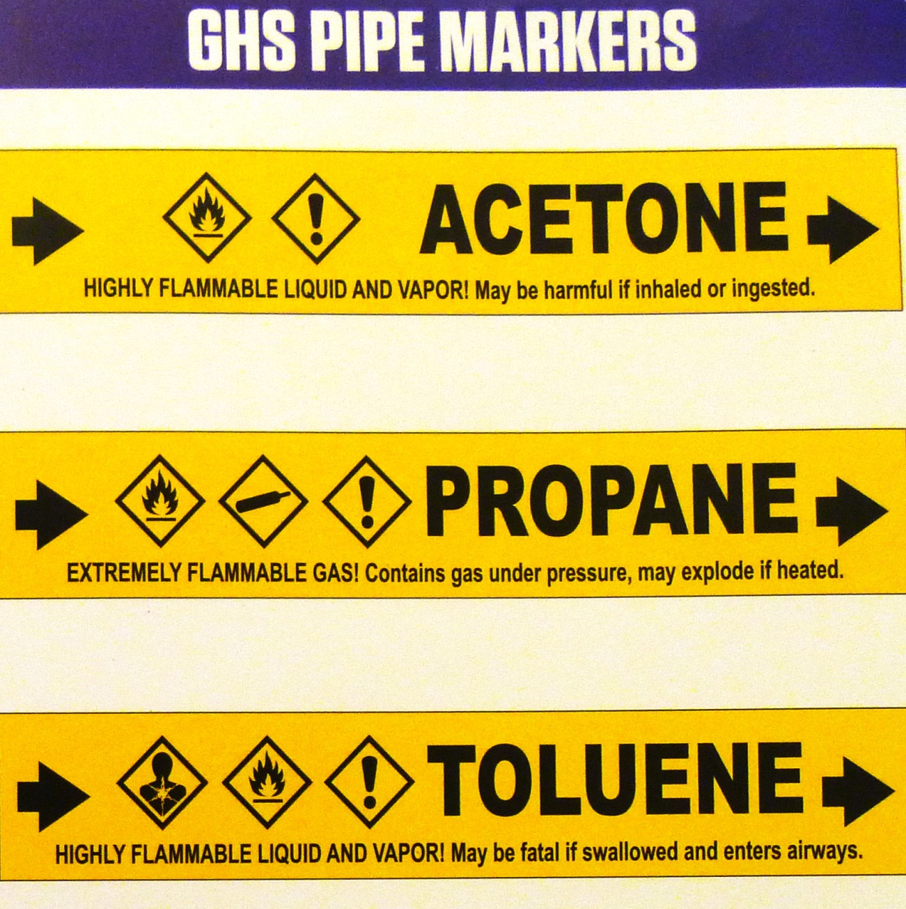
Label Requirements - Pipes

Slide 24
Labels
Must provide employees with specific information regarding the health and physical hazards about the chemical.
Amherst College must use labels that convey the appropriate hazard information about the chemical to the employees
Amherst College shall not remove labels from containers
If Amherst College is made aware of changes to a chemical, we must make the necessary changes to the labels and acquire the appropriate Safety Data Sheets (SDS)

Slide 25
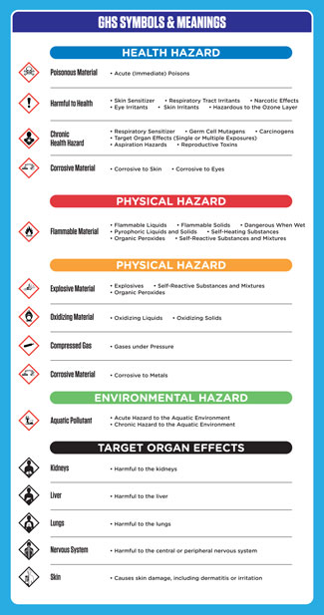
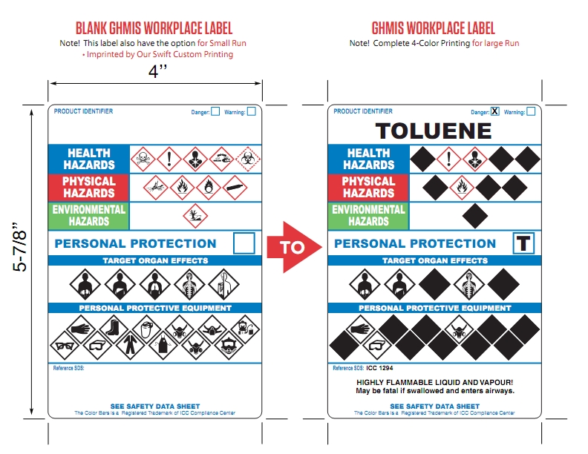

Slide 26
Material Safety Data Sheets
Product Identification
Hazard Identification
Ingredient Information
    Trade Secret
1st Aid Procedures
Firefighting Procedures
Accidental Release
Handling and Storage
Exposure Controls / PPE
Physical and Chemical Properties
Stability and Reactivity (Storage)
Toxicological Information
Ecological Information (Environment)
Disposal Considerations
Transport Information
Regulatory Information
Other Information
  Preparation Date

Slide 27
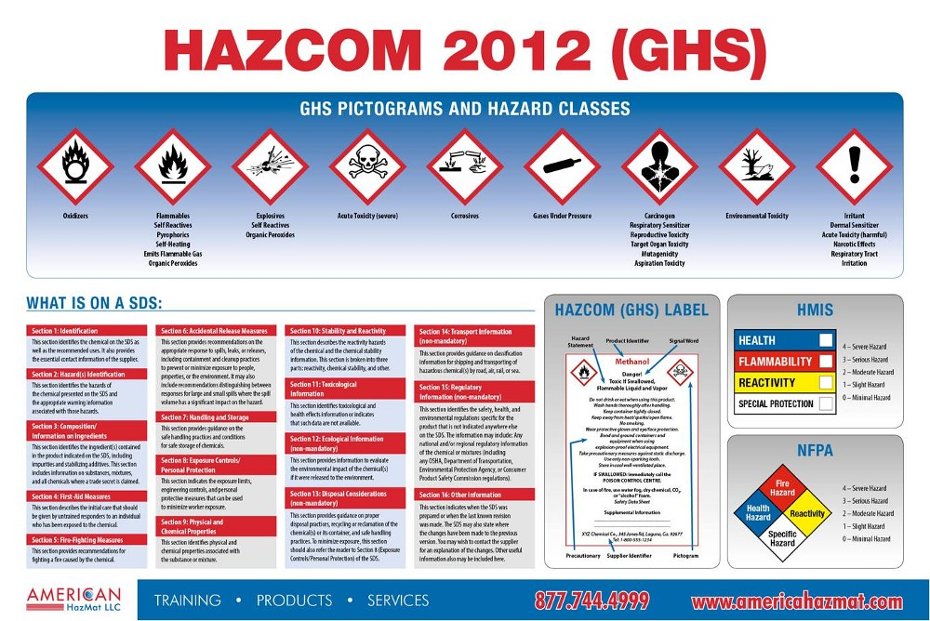

Slide 28
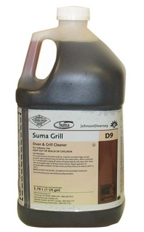

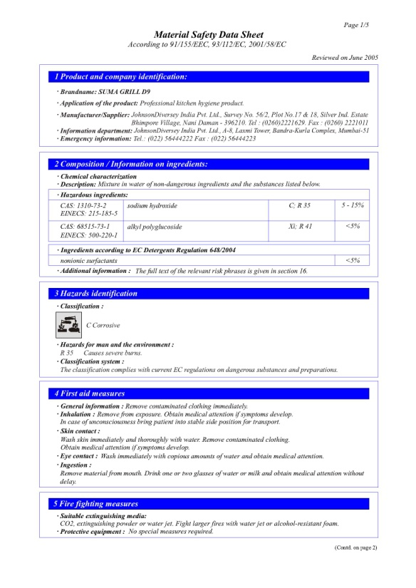
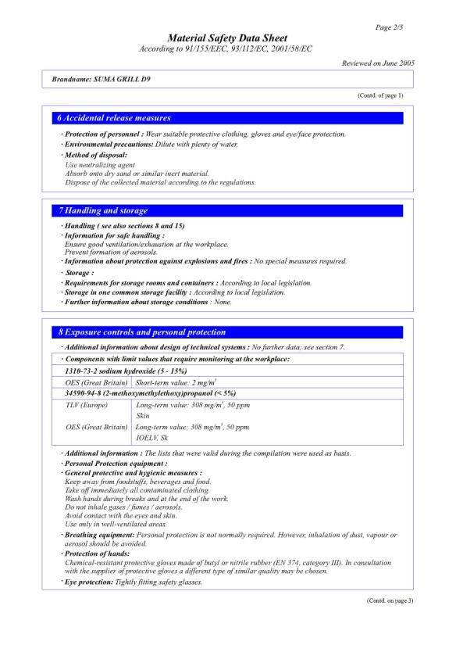
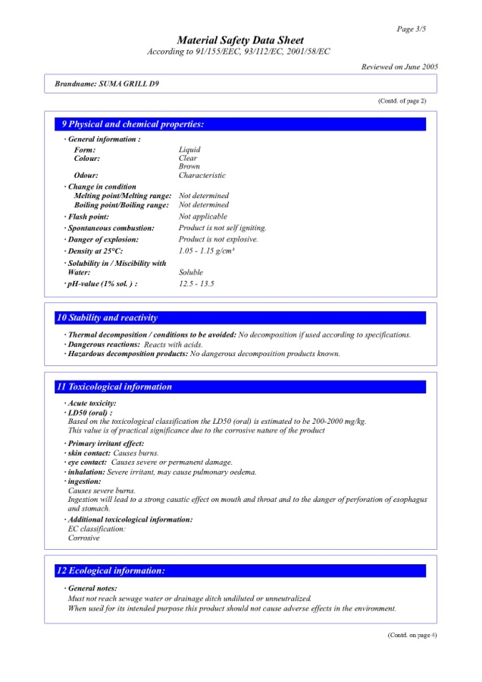
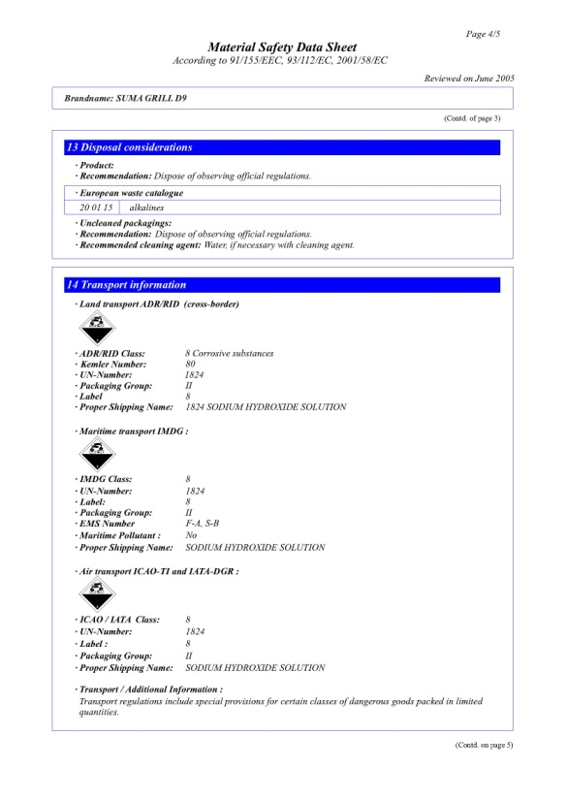
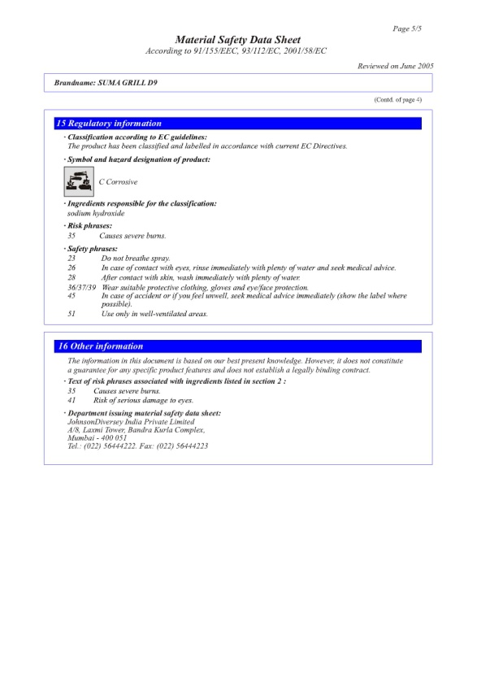
D9
Cleaner
Corrosive

Slide 29
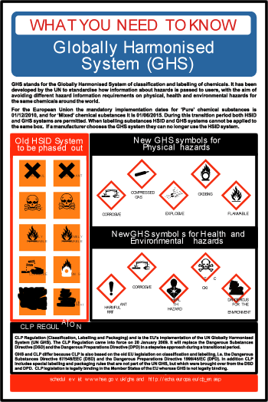
Amherst College must provide information and training on chemicals in the workplace at time of initial assignment and whenever a new chemical is introduced.
Employees must be aware of all of the chemicals in their work area
Employees must know the location of the SDS and how to gain information from them
Employees must be able to detect the presence or release of chemicals and avoid the hazards
Have knowledge of the chemical hazards and the effects the chemicals might have….
  Burning of Skin
  Difficulty Breathing
  Skin Irritation
Proper Emergency Response Procedures
  Illness / Injury
    Treatment
  Whom to call

Slide 30
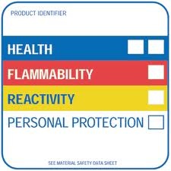
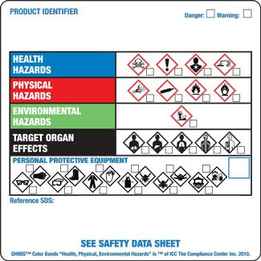
Old HMIS Label
New GHMIS Label

Slide 31
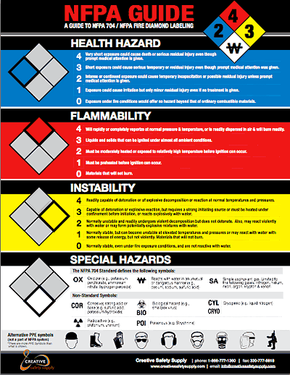
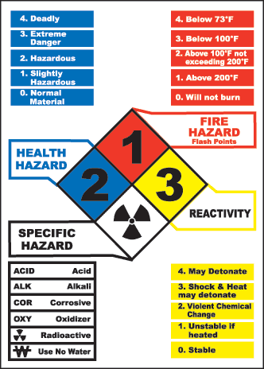
Manufacturer’s could still use both labels, at least for the next couple of years
  The HMIS and the NFPA 704 Diamond Categories are vastly different
    HMIS and NFPA – 4 is Extremely Flammable, 0 – will not burn
    GHMIS – 1 is Extremely Flammable, 4 – will not burn

Slide 32
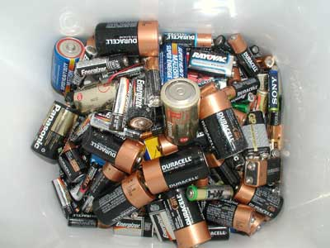


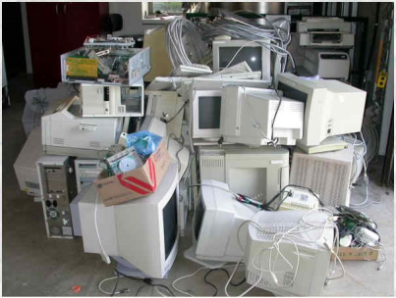
Environmental Protection
Hazardous Material and Waste
  Strictly enforced by MA DEP and EPA
    Significant Fines
  Improper disposal
    Appliances, Chemicals, Oils, Paints, Stains and Tires
Universal Waste
  Batteries
  Computer Monitors
  Light Bulbs
    Incandescent not included
  Residence Hall – Recycling Areas
Notice of Non-Compliance - > $1,000,000.00

Slide 33
Universal Waste Date:___/___/___
Fluorescent Light Bulbs
Name of Generator:____________________________________
Original Location:_____________________________________
Amherst College EPA ID MAD066985367
Physical Plant P.O. Box 5000
Amherst College, Ma 01002-5000 (413) 542-2254
Amherst College - Custodial Dept
Johnson Chapel
Hazardous Waste Date:___/___/___
Hazardous Material:___________________________________
Circle Hazard: Corrosive Flammable Poison Toxic Non-Hazardous
Name of Generator:____________________________________
Location:_____________________________________
Amherst College EPA ID MAD066985367
Physical Plant P.O. Box 5000
Amherst College, Ma 01002-5000 (413) 542-2254
Waste Motor Oil
Physical Plant - Garage
4 East Dr

Slide 34
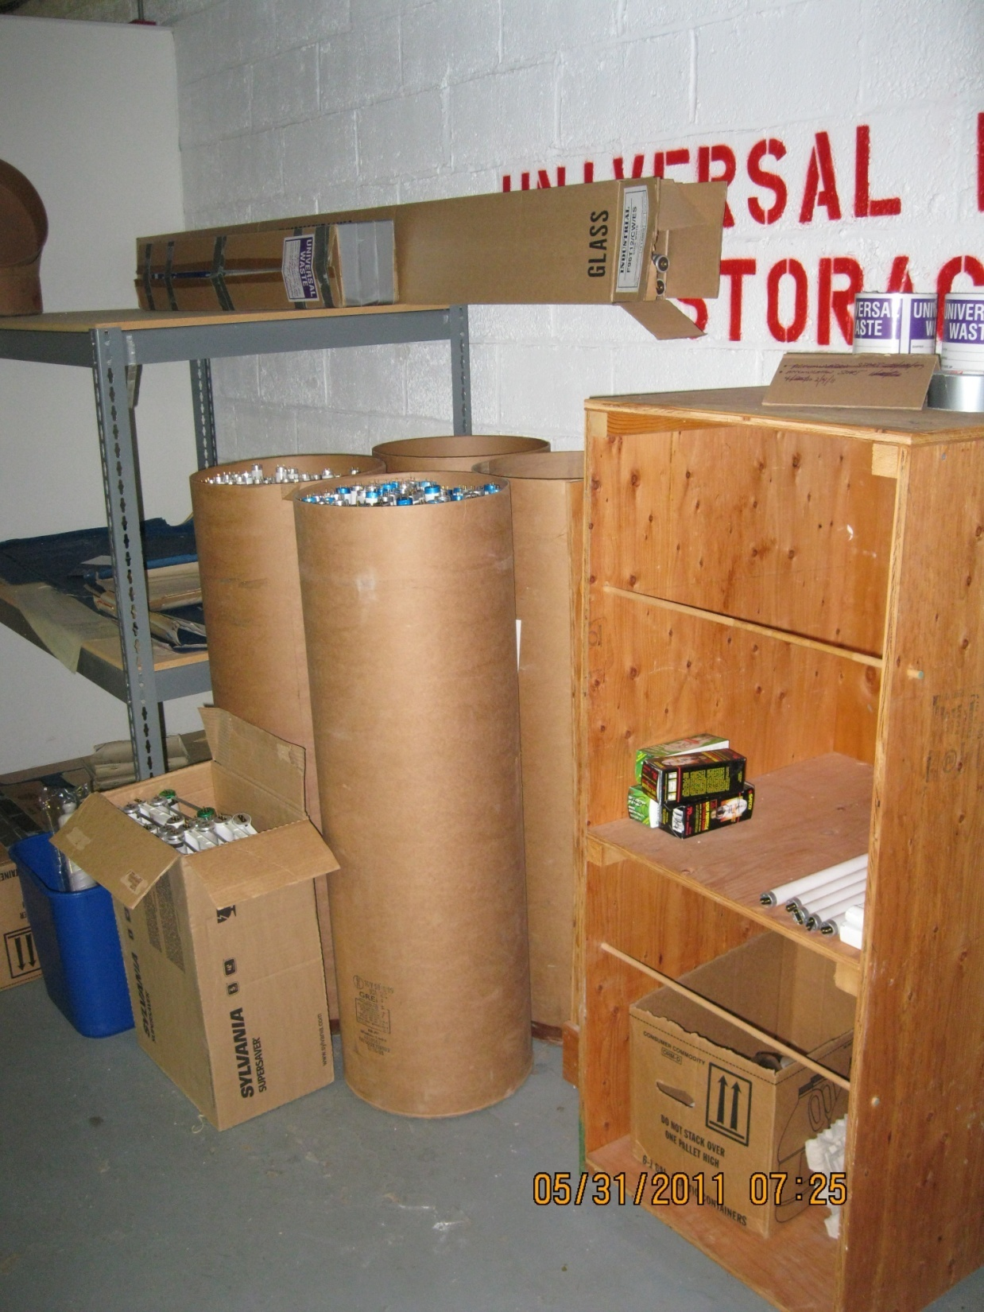
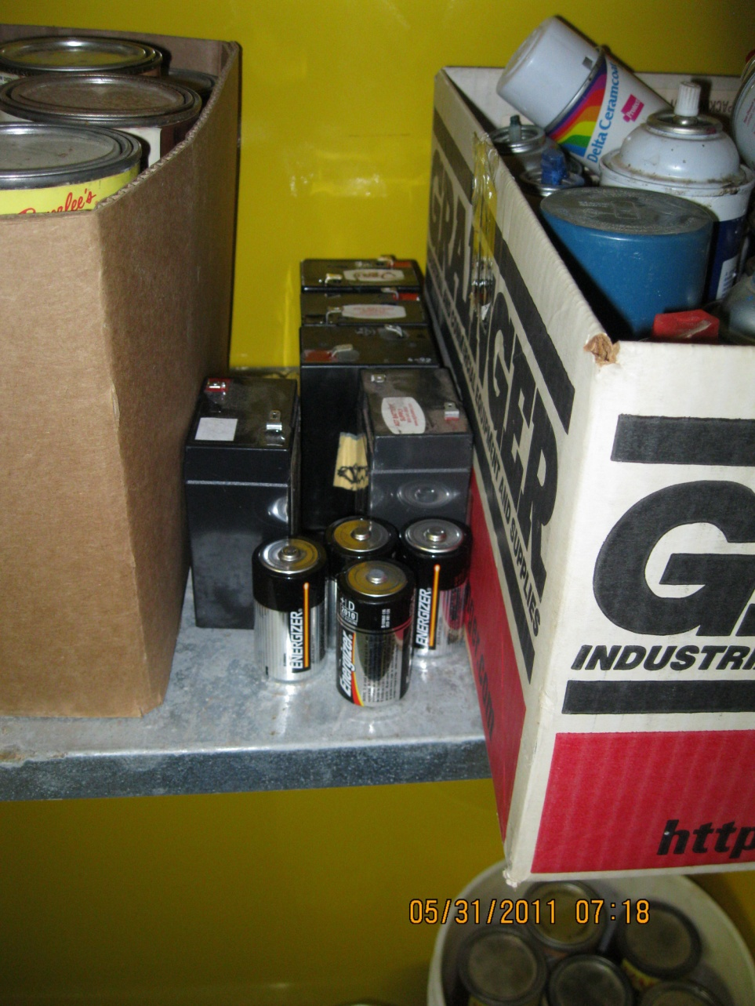
Universal Waste

Slide 35
“Cradle to Grave”

